Slide 1
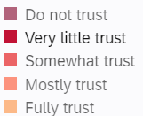
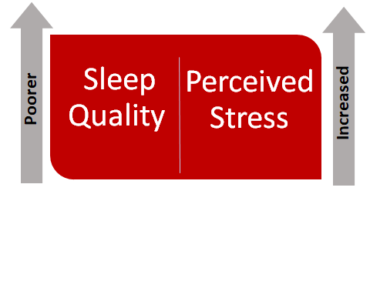
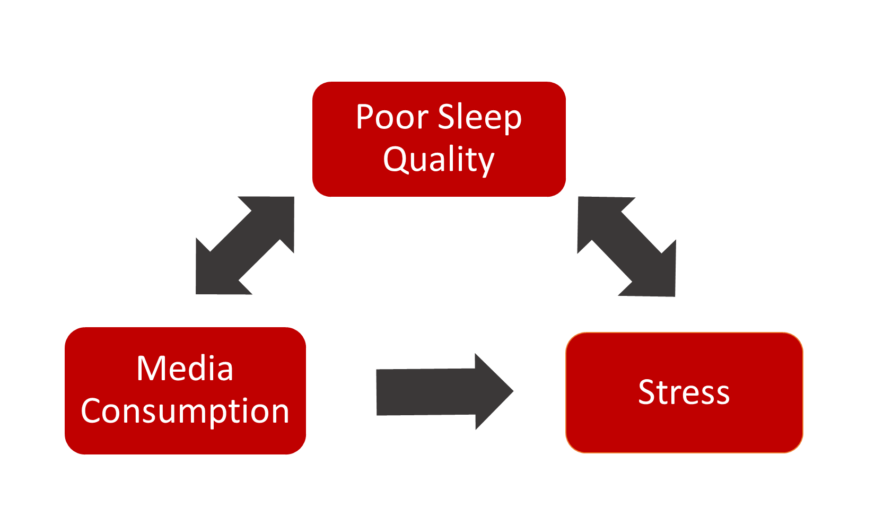
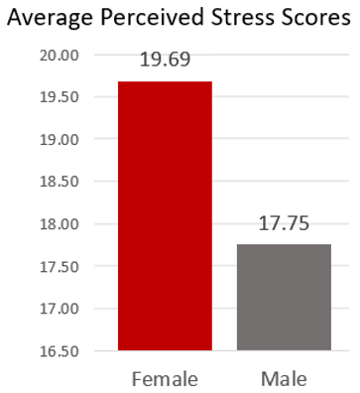
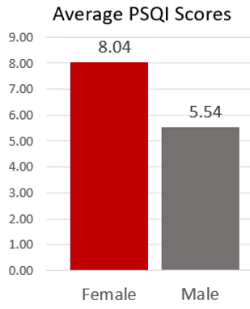
Effect of the events of 2020 on Nicholls State University students and their media consumption, perceived stress, and sleep quality
Kate Chaisson and Jennifer Plaisance, PT, DPT, CSCS
Introduction
Materials and Methods
Results (continued)
Conclusion
The COVID-19 pandemic and subsequent lockdown, along with the abundance of other stressors such as the recent election, social justice issues, and adverse weather events, have given rise to an opportunity to study the interplay between media consumption, perceived stress, and sleep quality. This study aims to determine if these three variables may have been related during the COVID-19 pandemic and the other events of 2020. In doing so, it may be possible to better understand and address the challenges brought about by major disasters such as a pandemic.
Sleep Quality and Stress
Sleep hygiene, the healthy sleep behaviors that lead to higher quality sleep, can biologically affect the way stress is experienced since a lack of sleep can increase the presence of the stress hormone cortisol. In existing literature, it is shown that there is a correlation between higher stress and poorer sleep quality, although a cause and effect relationship has yet to be established.
Stress and Media Consumption
Media plays a crucial role in the public’s awareness of current events, and it has the potential to educate or misinform the public. Literature has shown that both the qualitative and quantitative aspects of media consumption correlate with stress. Trust in government can act as a coping mechanism. When citizens feel their government is competent in handling dilemmas, they are more likely to experience less anxiety.
Sleep Quality and Media Consumption
Similar to the relationship between sleep quality and stress, the literature states that media can both influence sleep quality and be influenced by sleep quality. Increased media consumption can result in increased sleep disturbances; likewise, poorer sleep quality can act as a predictor of increased media consumption.
A survey compiled in Qualtrics was used to gather information including:
demographics
background information
media use
the perceived stress scale
Pittsburgh sleep quality index
The perceived stress scale was developed in 1983 and is used to analyze how events affect emotions and feelings. The Pittsburgh sleep quality index (PSQI) analyzes seven aspects of sleep to determine sleep quality including sleep latency, subjective sleep quality, and sleep duration. These three survey sections were compiled in Qualtrics with the use of a computer and was sent out to a sample of 500 Nicholls State students through their undergraduate email. SPSS software was used to analyze the data.
Trust in Main News Source &
Feeling Educated Rather than Fearful
Participants who reported “Do not trust” and “Very little trust” for how much they trusted their main news source were more likely to report that they felt fearful after watching news-related media. Likewise, those who reported that they felt more educated by watching news-related media were more likely to report that they trusted their main news source. This is consistent with the concepts found in previous studies emphasizing the value of trust as a coping mechanism.
Through this research, correlations between two of the three predicted interplaying variables was found. Although there was no significant correlation between media consumption, quantitative or qualitative, and perceived stress score or sleep quality scores, there were several other correlations that indicate how students were impacted by the events in 2020.
This study further validates current literature that shows a relationship between perceived stress and sleep quality. This also illustrates how pervasive both poor sleep quality and stress can be in health behaviors.
According to our data, women are significantly more affected by both stress and poor sleep quality.
This relationship may be indicative of how men and women differ in how they process stress and internalize their environment around them.
Understanding the relationships of how people interact with media, especially news media, may better equip the public to engage in media in a healthier way. (i.e. If one is more prone to feel fearful watching news media, it may be best to limit exposure.)
Lastly, this study further proves a correlation between adverse personal events such as job loss and poor sleep quality. This can be useful in providing the necessary resources for coping, such as guidelines on how to maintain healthy sleep hygiene.
Results
Sleep Quality & Job Loss
Those who reported that they had lost a job during the lockdown were more likely to have poor sleep quality.
This research on how Nicholls State University students were affected by the events in the year 2020 produced five statistically significant relationships.
Sleep quality and Perceived Stress
As predicted, based on current literature, participants that reported higher amounts of perceived stress also reported poorer sleep quality and vice versa
Bibliography
Huether SE, McCance KL, Felver L. Study Guide for Understanding Pathophysiology. St. Louis: Elsevier; 2017.
Halter MJ. Sleep-Wake Disorders. In: Trussler M, ed. Varcarolis' Foundations of Psychiatric Mental-Health Nursing A Clinical Approach. 8th ed. St. Louis, MO: Elsevier; 2018:356-360.
Krebs C, Weinberg J, Akesson EJ, Dilli E. Lippincott Illustrated Reviews: Neuroscience. Philadelphia, PA: Wolters Kluwer; 2018:400-401
Potter PA, Perry AG, Stockert PA, Hall A. In: Essentials for Nursing Practice. St. Louis, MO: Elsevier; 2019:917-937.
Kryger M, Roth T, Dement W. Principles and Practice of Sleep Medicine. 6th ed. St. Louis, MO: Elsevier; 2017.
Geiger SD, Sabanayagam C, Shankar A. The relationship between insufficient sleep and self-rated health in a nationally representative sample. J Environ Public Health. 2012;2012:518263. doi:10.1155/2012/518263
National Institutes of Health. National Institutes of Health Sleep Disorders Research Plan. nhlbi.nih.gov. https://www.nhlbi.nih.gov/files/docs/resources/sleep/201101011NationalSleepDisordersResearchPlanDHHSPublication11-7820.pdf. Published 2011. Accessed October 22, 2020.
Alotaibi AD, Alosaimi FM, Alajlan AA, Bin Abdulrahman KA. The relationship between sleep quality, stress, and academic performance among medical students. J Family Community Med. 2020;27(1):23-28. doi:10.4103/jfcm.JFCM_132_19
Safhi MA, Alafif RA, Alamoudi NM, et al. The association of stress with sleep quality among medical students at King Abdulaziz University. J Family Med Prim Care. 2020;9(3):1662-1667. Published 2020 Mar 26. doi:10.4103/jfmpc.jfmpc_745_19
Gupta R, Grover S, Basu A, et al. Changes in sleep pattern and sleep quality during COVID-19 lockdown. Indian Journal of Psychiatry. 2020;62(4):370-378. doi:10.4103/psychiatry.IndianJPsychiatry_523_20
Borbély AA, Daan S, Wirz-Justice A, Deboer T. The two-process model of sleep regulation: a reappraisal. J Sleep Res. 2016;25(2):131-143. doi:10.1111/jsr.12371
Zhao E, Wu Q, Crimmins EM, Ailshire JA. Media trust and infection mitigating behaviours during the COVID-19 pandemic in the USA. BMJ Global Health. 2020;5(10). doi:10.1136/bmjgh-2020-003323
Mohammadi MR, Zarafshan H, Bashi SK, Mohammadi F, Khaleghi A. The role of public trust and media in the psychological and behavioral responses to the COVID-19 pandemic. Iranian Journal of Psychiatry. 2020;15(3):189-204. Accessed October 22, 2020. https://search-ebscohost-com.ezproxy.nicholls.edu/login.aspx?direct=true&AuthType=ip,cookie,url,uid&db=a9h&AN=144778646&site=eds-live&scope=site
Sampath H, Soohinda G, Sharma A, Dutta S. Media exposure to earthquake-related content in its aftermath as a risk factor for acute stress disorder. Open Journal of Psychiatry & Allied Sciences. 2018;9(2):152-156. doi:10.5958/2394-2061.2018.00032.0
Proper, Ruth E., Stickgold, Robert, Keeley, Raeann, Christman, Stephan D. Is Television Traumatic? Dreams, Stress, and Media Exposure in the Aftermath of September 11, 2001. Psychological Science. 2007;18(4):334. Accessed October 22, 2020. https://search-ebscohost-com.ezproxy.nicholls.edu/login.aspx?direct=true&AuthType=ip,cookie,url,uid&db=edsjsr&AN=edsjsr.40064615&site=eds-live&scope=site
Muazzam A, Ahmad A. Predictors of Sleep Disturbances among College Students: Interplay of Media Exposure and Health Related Quality of Life. Pakistan Journal of Psychological Research. 2017;32(2):393-406. Accessed October 22, 2020. https://search-ebscohost-com.ezproxy.nicholls.edu/login.aspx?direct=true&AuthType=ip,cookie,url,uid&db=a9h&AN=127233970&site=eds-live&scope=site
van der Schuur WA, Baumgartner SE, Sumter SR. Social media use, social media stress, and sleep: Examining cross-sectional and longitudinal relationships in adolescents. Health Communication. 2019;34(5):552-559. doi:10.1080/10410236.2017.1422101
Tavernier R, Willoughby T. Sleep problems: predictor or outcome of media use among emerging adults at university? Journal of Sleep Research. 2014;(4):389. doi:10.1111/jsr.12132
State of New Hampshire. Perceived Stress Scale. https://das.nh.gov/wellness/docs/percieved%20stress%20scale.pdf. Published 2020. Accessed October 24, 2020.
Aurora University. Sleep Quality Assessment (PSQI) . aurora.edu. https://aurora.edu/documents/wellness/assessment.pdf. Accessed October 24, 2020.
Other Relevant Statistics
76% of participants reported poor sleep quality
The average hours of sleep was 6.5
96% of participants reported Moderate stress
Perceived Stress & Gender
Females were more likely to report higher perceived stress scores. A score between 14 and 26 indicates moderate perceived stress.
Sleep quality & Gender
Females were more likely to report poorer sleep quality. A score equal to and above 5 indicates poor sleep quality.
Limitations
Due to the nature of this survey, there are several limitations within this research. The limited responses to the survey have produced a smaller than desired sample size which can affect representation to the target population. Secondly, at the time of research, a media consumption scale could not be found. In future studies, having such scale would most likely improve the accuracy of such study. Lastly, due to the timing in which the survey was sent, mid-January 2021, this data may not accurately reflect the participants’ full experience of the events of 2020.
Approved by Human Subject Institutional Review Board of Nicholls State University

