Slide 1

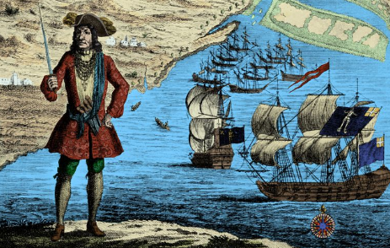
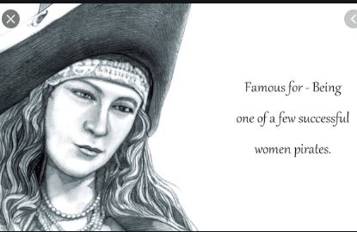
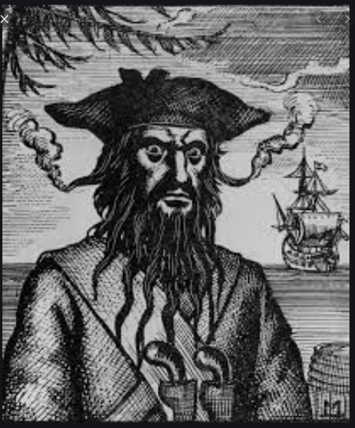
Golden Age of Pirates Effecting the World
Lauren St. Pierre – College of Liberal Arts
Abstract
Research
Conclusion
The Golden Age of Piracy began around the late 1600s and lasted until the early 1700s. It was around this time that some iconic legends were created. Chief among them were Blackbeard, Anne Bonny, Black Bart, Calico Jack, etc. This project examines how Blackbeard, Anne Bonny, and Black Bart became the legends, their pirate career, and how after they died, they influenced the world. We would look at the times of when pirates sailed, and we would look at the future (start in 2000 and up). Readers should be able to see how piracy then was harsh and how people today romanticized it. Readers should also by the end of this project should have a, somewhat, clear view of why some pirates made history and how people today use those legends for anything (books, games, movies).
The Golden Age of Piracy began around the late 1600s and ends during the early 1700s. Many legends came from this and I wanted to learn what has made them so legendary that people today know about them. Three examples of these famous pirates are Blackbeard, Anne Bonny, and Bartholomew Robert (Black Bart). Blackbeard was born in around 1680 and before he became a pirate, was a participant in Queen Anne’s War, then joined Captain Benjamin Hornigold, and later became a pirate in his own way (famously becoming the infamous Blackbeard) and then his death. Anne Bonny was born around 1680 and her life before running off and joining Calico Jack’s crew was a life of hardship due to women having little rights during this era. Anne ran away from home, joining Calico Jack’s crew as male and then eventually being found as a woman, almost hanged, then later died in 1783. What made Anne Bonny famous was that she dared to break the mold for women in society and she led a full life with her dying at an old age. Bartholomew Roberts was born May 17, 1682 and his original name was John Robert. Young John began his career by being a deckhand. He likely served in the Royal Navy during the War of Spanish Succession. He then became a merchant after leaving the navy. It was the ship Princess of London (slave ship) that changed his life. A pirate captured the ship and Robert was sailing with pirates. It was from this experience that leads him to becoming a pirate. But what made Bartholomew Robert different was his way of pirating. Hi wrote articles for his crew and Robert is quoted “In an honest service, there is thin commons, low wages, and hard labour; in this (pirating), plenty and satiety, pleasure and ease, liberty and power …” This is what probably lead to those articles and how he governed his business as a pirate. Piracy during the late 1600s and early 1700s was a business, a bad one, but still a business. It disrupted empires and the punishment for being a pirate is death by hanging. The East India Trading Company is one of other companies to despise pirates and if captured, the pirate is branded. But what really gets me is that people died from being a pirate, but what if that person did not have a choice. Sometimes the right path is a path of piracy. Though in that time, piracy (good or bad) was seen as the same in many eyes.
In the end, I have concluded that all legends of the golden age of piracy has affected the world. The way they had affected the world in the late 1600s and early 1700s is by bringing an age of where people did not want to fit into society and that piracy was a dangerous business that often led to many pirates dying before 60. Blackbeard is one pirate who left a mark on the world because he was well known for the ruthlessness he showed fighting and pillaging, Today, Blackbeard is remembered still a ruthless pirate, but he is shown in moves (Pirates of the Caribbean), books, and games (Assassin’s Creed – Black Flag). Anne Bonny is one of few female pirates that changed the world by breaking the mold of women and becoming respected by other pirates. She is also remembered because of her surviving a death sentence and then living to an old age in the Americas. She is featured in Assassin’s Creed – Black Flag. She is also a figure for books and movies. Bartholomew Robert is another pirate that has left a legend and affected the world. He is remembered for being a more civilized pirate. He wrote Articles, that were guidelines to help manage his crew. He is also one of the richest pirates because of his adventures and stealing treasure. He is a figure that is reflected in books and, it is believed that in the Pirates of the Caribbean First Brethren Court, Bartholomew is Bartholomew Robert. All of these examples are just some of the many legends of pirates and each have a story that is remembered in society. The Golden Age of Piracy brought a world of chaos and exploration. In modern times, pirates are remembered for their legends but also because of people romanticizing it. Movies, books, and games show that pirates left a mark and will continue to leave a mark.
Methodology
Researching the Golden Age of Piracy was hard, and it is because there are not a lot of genuine documents of pirates left. But for my project I focused on three pirates that were famous, but also for their different lives. Blackbeard, Anne Bonny, and Bartholomew Robert (Black Bart) are just three of many famous pirates, but they were chosen because of the legends that they left. Blackbeard left behind his legend in his ruthlessness and his treasure that he stole. Anne Bonny was chosen because she is one of the few female pirates that broke the mold for women in that society. Bartholomew Robert was chosen because he is better known for a different way of thinking like a pirate. He created rules and guidelines for his crew, and he is also known for his treasure. Not only did I choose these three pirates, also note that the times of which they lived in. Piracy was a dangerous and ruthless business, and it effected many empires. But each pirate left behind a legacy that is used in movies, books, and games.
Work Cited
Lee, Robert E. Blackbeard the Pirate : A Reappraisal of His Life and Times. J. F. Blair, 1974.
Bartholomew Robert (Black Bart)
Anne Bonny
Blackbeard
Phillip Thomas Tucker. Anne Bonny the Infamous Female Pirate. [N.p.]: Feral House, 2017.
Sue L. Hamilton. Bartholomew Roberts. Pirates. Edina, Minn: Abdo & Daughters, 2007.

