Slide 1



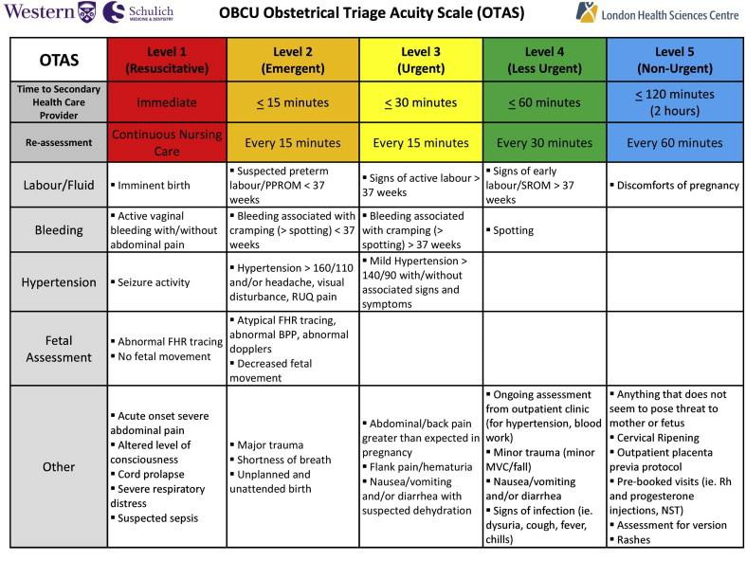
Implementation of an Obstetric Triage Tool for Emergency Department Utilization
Amy Ostheimer
Obstetric triage is considered to be the gatekeeper for initial assessment and evaluation in order to begin treatment for or observation of obstetric complaints.
Hospital X’s current obstetric policy is based solely on gestation, with the two categories being “less than 20 weeks” or “greater than 20 weeks.”
This policy poses an issue as many factors contribute to the decisions that need to be made regarding the care provided to obstetric patients.
The current obstetric policy being utilized at Hospital X continues to overwhelm the family birthing unit (FBU) due to the policy’s lack of pertinent details in regards to the triage process for obstetric patients in the emergency department (ED) and the absence of obstetric triage tool usage.
The FBU has seen an ongoing trend of patients being transferred from the ED that have not been appropriately triaged to determine if the patient has a complaint or health issue that warrants a departmental transfer.
Non-obstetrical types of complaints, such as those related to motor vehicle accidents, trauma, musculoskeletal injuries or viral infections, can be treated and subsequently discharged from the ED or transferred to a department that handles such cases, which alleviates the need to consistently transfer obstetrical patients to the FBU for the sole reason being they are pregnant.
American College of Obstetricians and Gynecologists (2016) recommends EDs and obstetric units collaborate and establish guidelines for the triage of pregnant women.
Implementation of a standardized obstetric triage tool may improve the quality of care, as well as patient satisfaction in the triage process of obstetric patients (Fakari, Simbar, Modares, & Majd, 2019)
Moderate-quality evidence states that the obstetric triage acuity scale (OTAS) has higher reliability and validity than other triage tools (Moudi et al., 2020).
An obstetric-specific triage tool that could be utilized by the emergency department staff would be beneficial when determining urgent versus nonurgent obstetric-related complaints (Kilfoyle et al., 2017).
The use of triage in obstetric patients benefits labor and delivery units by limiting the amount of valuable resources being pulled from high acuity patients, such as those that are actively laboring, especially when units have a high census (Angelini & Howard, 2017).
To implement the use of an obstetric triage tool to be utilized by the ED that would guide healthcare providers in determining appropriate placement of obstetric patients for safe maternal-fetal outcomes while minimizing overutilization of antenatal labor and delivery practices.
Obstetric patients will be triaged correctly in the ED using an obstetric triage tool, based on many different factors.
Urgent, high acuity, obstetric-specific complaints may be treated in a timely manner
Limit the use of valuable resources on the FBU by non-urgent obstetric patients
Obstetric patients with non-obstetrical complaints will be treated properly in the appropriate department
Facilitate better, more efficient treatment of patients who are either antepartum or postpartum that come to the seeking healthcare
BC Women's Hospital + Health Center. (2016, June 28). Obstetrical triage and assessment policy. Retrieved from http://policyandorders.cw.bc.ca/resource-gallery/Documents/BC%20Women%27s%20Hospital%20-
%20Fetal%20Maternal%20Newborn/WW.05.02%20Obstetrical%20Triage%20and%20Assessment.pdf.
Griffin, D., & Hyrkas, K. (2016, June 13). The development and implementation of an obstetrical triage tool to prioritize patients and track process times by risk categories. Retrieved from https://onlinelibrary.wiley.com/doi/full/10.1111/1552-6909.12340.
Kilfoyle, K. A., Vrees, R., Raker, C. A., & Matteson, K. A. (2017). Nonurgent and urgent emergency department use during pregnancy: An observational study. American Journal of Obstetrics and Gynecology, 216(2), 181.e1- 181.e7. https://doi.org/10.1016/j.ajog.2016.10.013
Moudi, A., Iravani, M., Najafian, M., Zareiyan, A., Forouzan, A., & Mirghafourvand, M. (2020). Obstetric triage systems: A systematic review of measurement properties (Clinimetric). BMC Pregnancy & Childbirth, 20(1), 1–11. Retrieved from https://doi-org.ezproxy.nicholls.edu/10.1186/s12884-020-02974-0
Smithson, D. S., Twohey, R., Rice, T., Watts, N., Fernandes, C. M., & Gratton, R. J. (2013). Implementing an obstetric triage acuity scale: Interrater reliability and patient flow analysis. American Journal of Obstetrics and Gynecology, 209(4), 287–293. https://doi.org/10.1016/j.ajog.2013.03.031
The American College of Obstetricians and Gynecologists. (2016, July). Hospital-based triage of obstetric patients
- ACOG. Retrieved from https://www.acog.org/-/media/project/acog/acogorg/clinical/files/committee- opinion/articles/2016/07/hospital-based-triage-of-obstetric-patients.pdf.
Yoder-Wise, P. S. (2019). Leading and managing in nursing (7th ed., pp. 322-323). Elsevier.
Problem
Review of Literature
Proposal
Expected Outcomes
Needs Assessment
References
(Smithson et. al, 2013)

