Slide 1

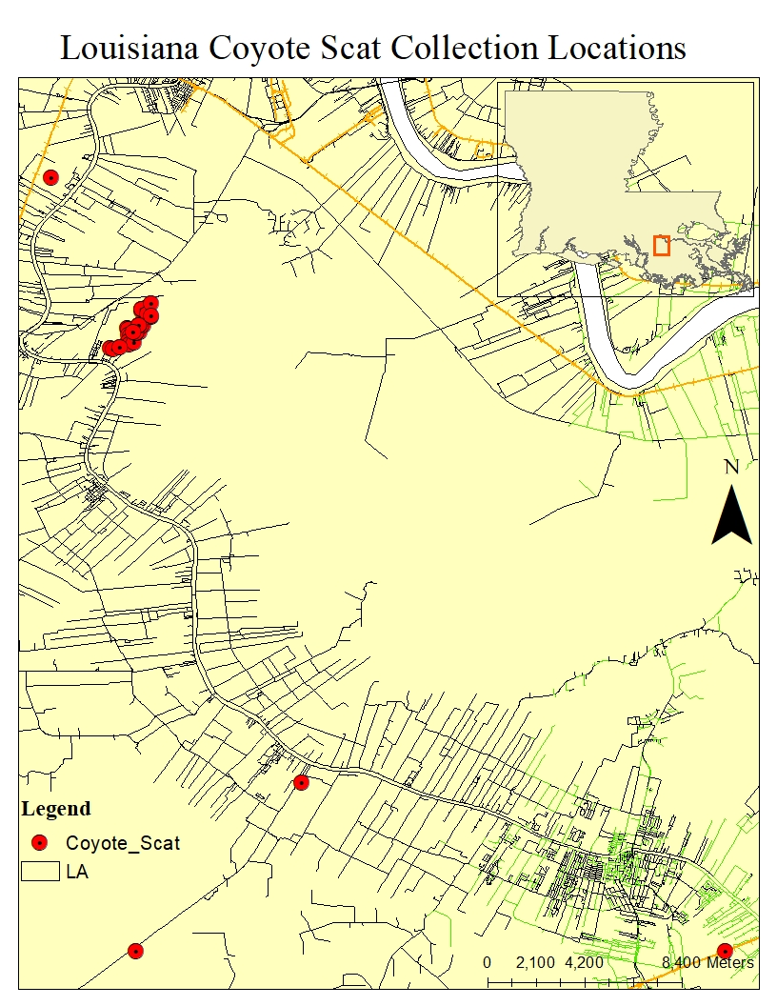
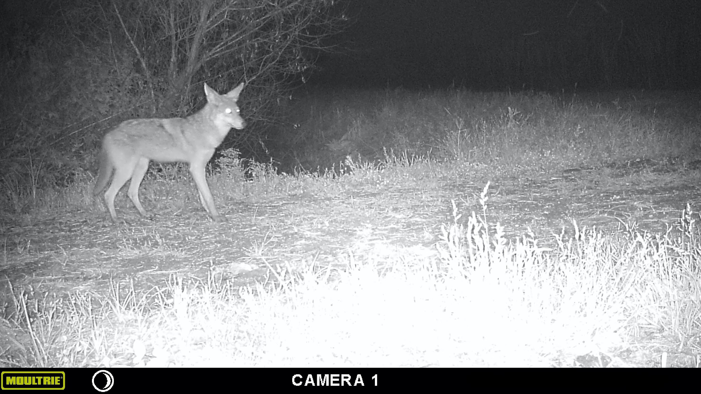
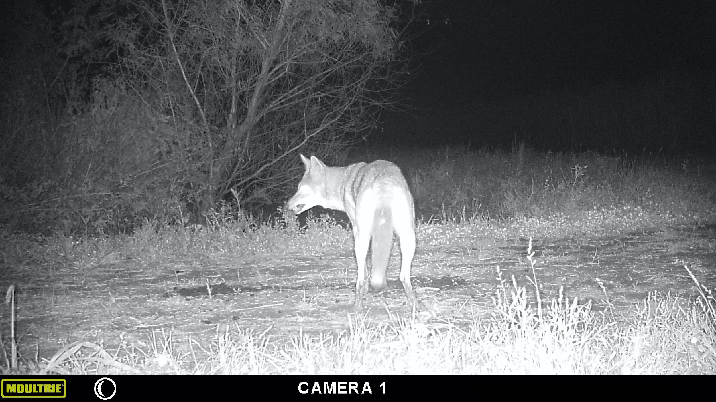
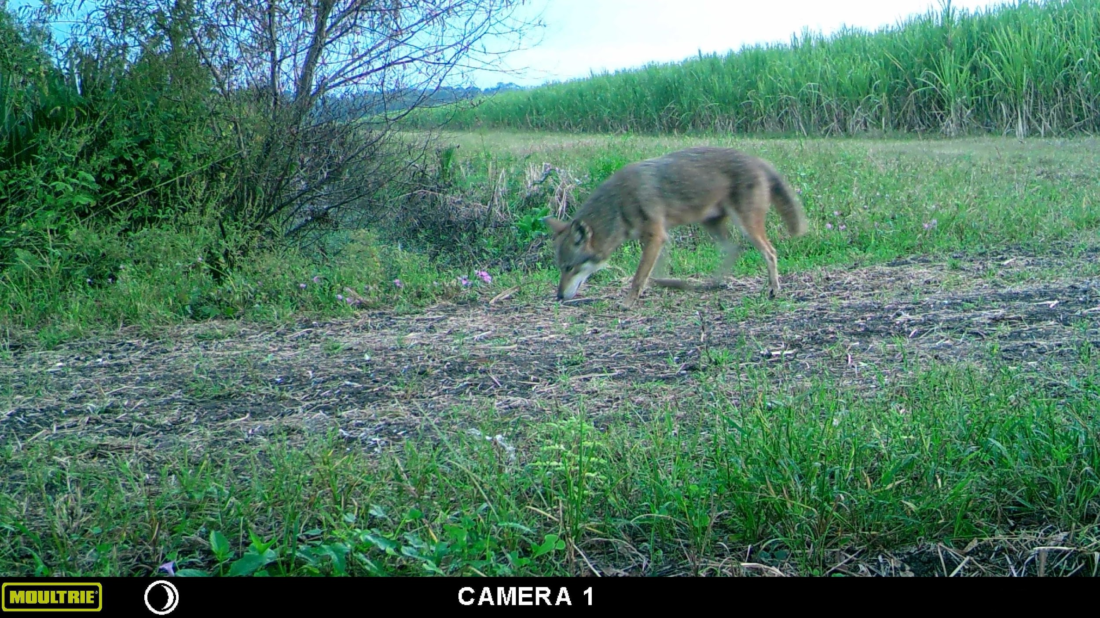
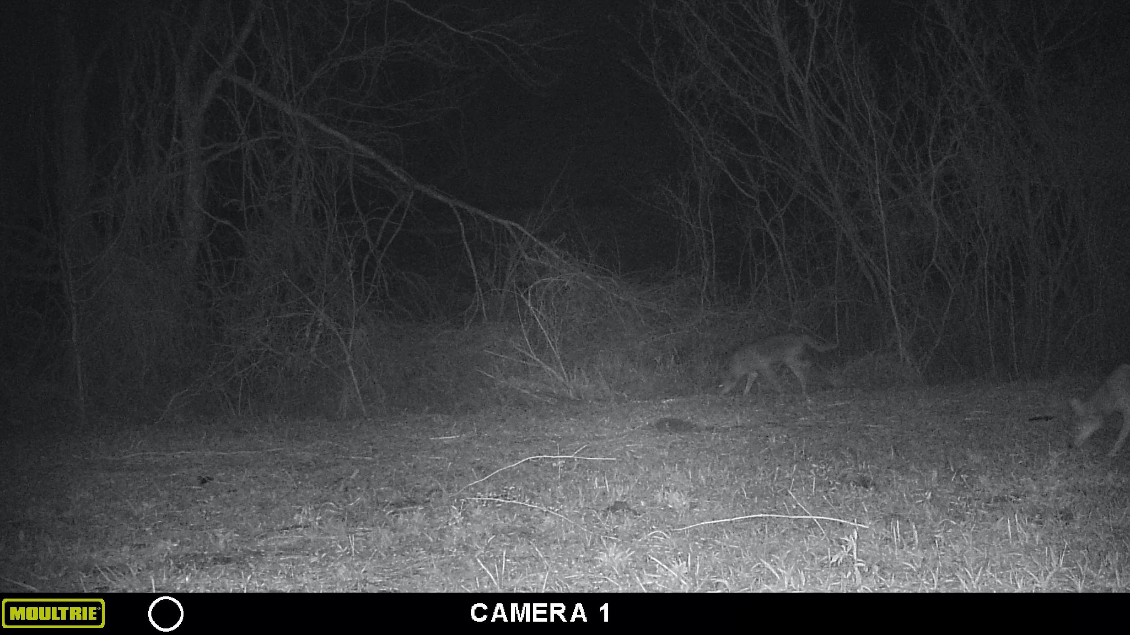
Microsatellite Genotyping of Canis latrans in Southeastern Louisiana
Annie Alexander, Wyatt Voelker, and Justine M. Whitaker
Nicholls State University, Biological Sciences
Background
Methods
Eastern Coyote expansion into the Southeastern U.S. is recent, so information regarding their morphology, genetics, and population structure is limited.
Elusive and highly social, coyotes deposit scat to communicate and mark territory borders (Cepak 2004).
Non-invasive genetic sampling (NGS) is used to collect fecal DNA and ID individuals based on microsatellite genotypes, allowing estimation of population dynamics, genetic diversity, and gene flow (Morin et al. 2016).
Apex predator extirpation has led to rises in mesocarnivore populations (Jones et al. 2016).
Coyotes regulate keystone herbivore and mesopredator populations through neonate predation, altering prey distribution and ecosystems (Jones et al. 2016).
Presumed coyote feces were collected by walking known coyote territories.
DNA extractions were preformed on 24 coyote and 1 dog sample using Qiagen QIAmp DNA Stool Mini Kit® to confirm the species.
7 microsatellite loci are being genotyped (Henger et al. 2019).
Microsatellite PCR products are run on an ABI3730 for fragment analysis at University of Arizona Genetics Core Lab.
Results
37 scat samples have been collected from Lafourche and Assumption Parishes.
DNA has been extracted from 25 samples, including 24 presumed coyotes and 1 known dog fecal sample.
3 coyote fecal samples have been successfully genotyped at 5 microsatellites.
Table 1. Results demonstrating homozygosity or heterozygosity of 3 coyotes at the 5 microsatellite markers by locus.
Sample ID | FH2001 | FH2611 | FH2054 | FH2088 | FH2137 - 1
C12 | 143/151 | 199/203 | 164/164 | 118/122 | 189/189
C22 | 147/151 | 191/195 | 172/176 | 98/118 | 169/169
C15 | 131/151 | 195/199 | 164/168 | 102/114 | 169/77
Figure 2. Trail camera photos of Eastern Coyotes set in Assumption Parish sugar cane fields (left 3) and at the Nicholls State University Farm in Lafourche Parish (far right). Trail cameras were used to determine coyote movements for scat collections.
Discussion
A larger sample distribution is needed to determine gene flow more accurately between populations.
Future studies can indicate relatedness patterns of family units inhabiting sample areas.
Conduct future studies to indicate sex ratios.
This research can be applied to study local mesopredator ecology.
Figure 1. Map of Canis latrans (Eastern Coyote) scat collection locations in Southeastern Louisiana. Red dots represent GPS locations of collected scats from September to December 2021.
References
Objectives
Collect canid scat from Lafourche and Assumption Parishes to begin a bank of samples for use in future studies.
Estimate population connectivity using 7 microsatellites optimized for Canis latrans from various family units.
Cepak JD, 2004. Diet Composition of Coyotes in the Cuyahoga Valley National Park, Ohio. Ohio Journal of Science. 104:60-64.
Henger C.S., Herrera G.A., Nagy C.M., Weckel M.E., Gormezano L.J., Wultsch C., and Munshi-South J. 2019. Genetic diversity and relatedness of a recently established population of eastern coyotes (Canis latrans) in New York City. Urban Ecosystems. 23:319-330.
Jones BM, Cove MV, Lashley MA, Jackson VL, 2016. Do Coyotes Canis Latrans Influence Occupancy of Prey in Suburban Forest Fragments? Current Zoology. 62: 1-6.
Morin DJ, Kelly MJ, Waits LP, 2016. Monitoring Coyote Population Dynamics with Fecal DNA and Spatial Capture-Recapture. The Journal of Wildlife Management. 5: 824–836.
Acknowledgements
I acknowledge and thank Dr. Justine Whitaker and graduate student Wyatt Voelker for their help in collection of scat samples and mentorship in running laboratory procedures, and the University of Arizona Core Genetics Lab for running our PCR products for fragment analysis.
aalexander20@nicholls.edu
Notes:
I’m Annie Alexander and I, along with graduate student Wyatt Voelker, and Dr. Justine Whitaker have been conducting research on microsatellite genotyping of Canis latrans Eastern Coyotes in Southeastern Louisiana.
Eastern Coyotes are found throughout North America but only fairly recently expanded into this region so there’s limited information regarding their morphology, genetics, and population structure.
They are highly social and use scat deposition to communicate and mark territory borders, making them a good candidate for Non-invasive genetic sampling, which is collecting fecal DNA to ID individuals based on microsatellite genotypes. This allows for estimating population dynamics, genetic diversity, and gene flow of populations.
It’s important to study this because as humans remove apex predators from environments, mesopredators such as the coyote fill that vacancy in the food chain which alters the ecology of ecosystems.
Table 1 is just a map showing the locations we collected scat for this study.
Our 2 objectives were to collect scat to from Lafourche and Assumption Parishes to begin a bank of samples for use in future studies and to estimate population connectivity using 7 microsatellites optimized for Canis latrans from various family units.
We collected coyote scat samples from Assumption and Lafourche Parishes and then preformed DNA extractions on 24 coyote and 1 dog sample Qiagen QIAmp DNA Stool Mini Kit® to confirm the species.
We then genotyped 7 microsatellite loci and sent the Microsatellite PCR products to the University of Arizona Genetics Core Lab to be run on an ABI3730 for fragment analysis.
Of the 37 scat samples we collected, we extracted DNA from 25 samples—24 being presumed coyote and 1 confirmed dog.
Table 1 shows 3 coyote fecal samples that’ve been successfully genotyped at 5 microsatellite loci. So C12 is showing that it’s heterozygous for the FH2001 allele but homozygous for FH2054 allele. If you were to look at all 7 microsatellite loci across a population, you can tell if there’s gene flow based on the frequency of each allele. The microsatellites also can ID individuals if you use enough loci to get unique patterns for each coyote.
This research is still ongoing so we have yet to acquire that data.
Figure 2 shows some trail camera photos that we captured to determine coyote movements. The 3 to the left are from a sugarcane field in Assumption Parish and rightmost image is what we presume to be the alpha pair at the Nicholls Farm location.
We’d need a larger sample distribution to accurately determine gene flow between state-wide populations. However, future studies can indicate relatedness patterns of family units as well as sex ratios of coyotes within a particular area.
We also hope to be able to use this study’s data to conduct future research on the ecology of other residential mesopredators.

