Slide 1

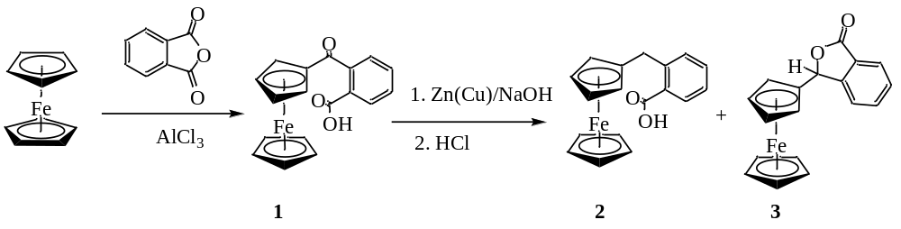
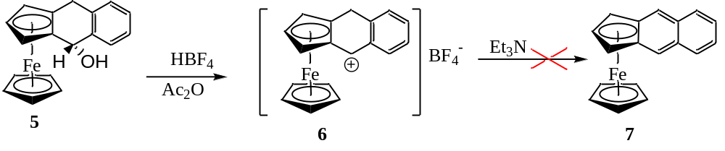
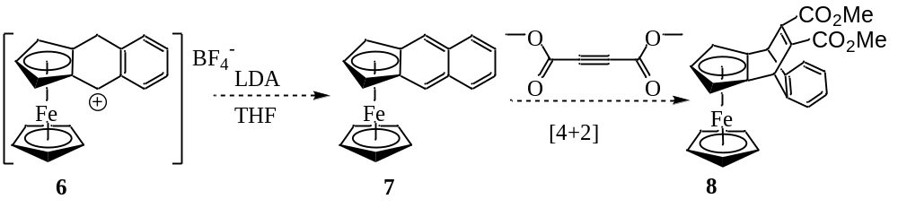
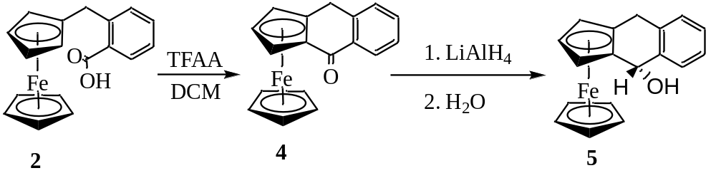
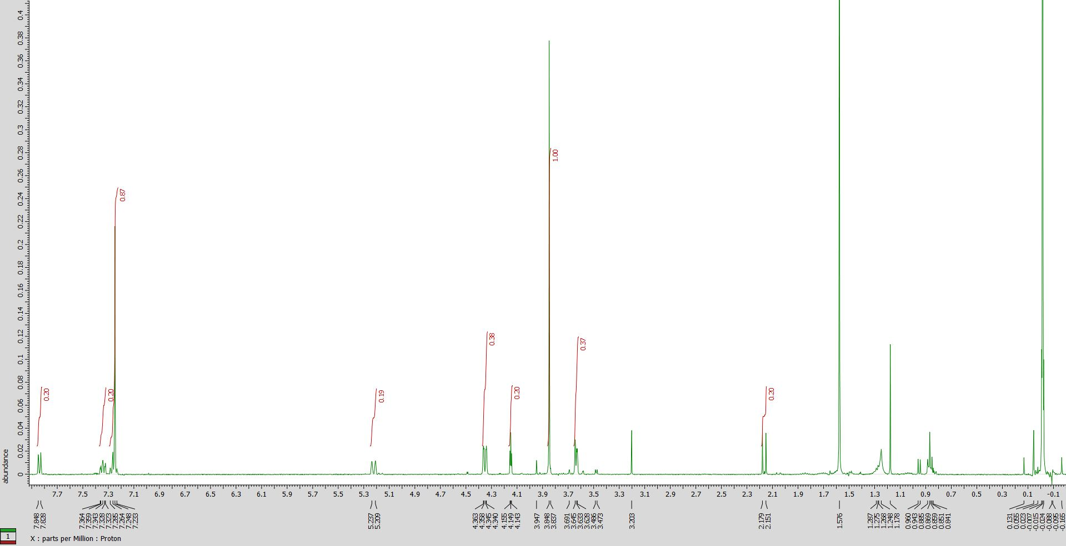
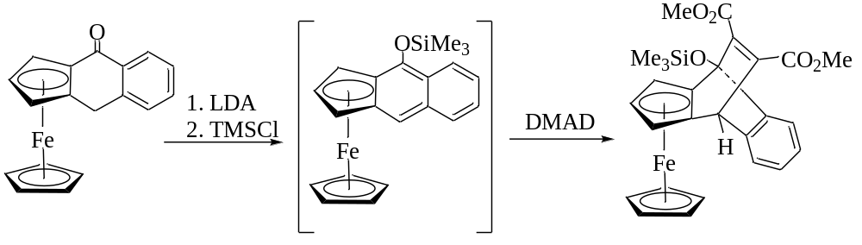
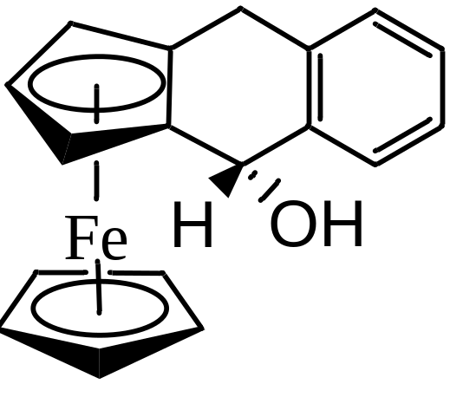
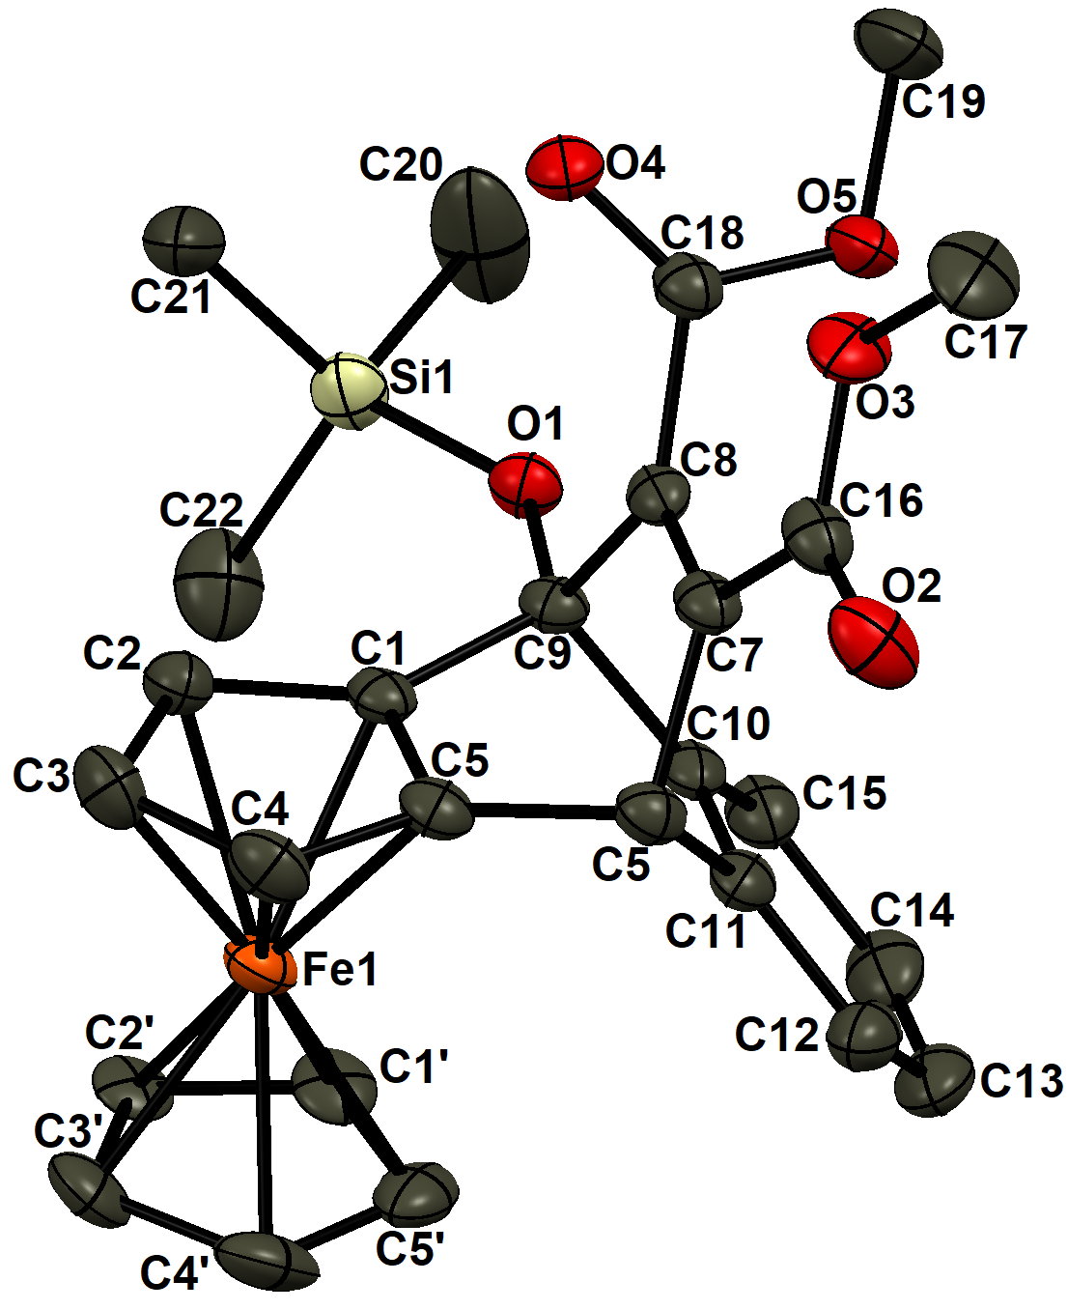
An approach to generate a π-extended ferrocene and its capture by Diels-Alder cycloaddition
Brandon LeBlanc and Uttam Pokharel
Department of Chemistry & Physical Sciences, Nicholls State University, Thibodaux, LA 70301
Introduction
Results
In this project, we explore a methodology to extend the π conjugation of ferrocene by deprotonation of a carbocation. Ferrocene, a benchmark organometallic compound, has been regarded as an analogue of benzene due to their similarity in stability and aromatic reactivity. Homologation of benzene has resulted in the formation of higher polycyclic aromatic hydrocarbons (polyacenes). These compounds are being explored for their potential applications in organic electronics. However, the extension of the π-conjugation in ferrocene and other metallocenes is still in its infancy. Although there are few reports of complexation of transition metal center with benz[f]indenide, the iron complex of the ligand has not been reported yet. The extension of the π-conjugation of ferrocene can alter the properties of organic polyacenes due to the reversible electrochemistry of the iron center present in the molecule. Currently, we present our attempts to extend the π-conjugation via deprotonation of the carbocation stabilized by both ferrocene and an arene moiety using strong non-nucleophilic bases.
Friedel-Crafts acylation of ferrocene with phthalic anhydride and Clemmensen reduction
Attempted solvolysis and aromatization
Friedel-Crafts acylation of ferrocene with phthalic anhydride gave desired keto carboxylic acid, 1 in 52% yield
Reduction of keto group in complex 1 using Zn(Cu) and NaOH followed by acidification gave a mixture of desired carboxylic acid, 2 (44%) and lactone, 3 (30%)
The compound 2 was separated from 3 by extraction in NaOH.
We used tetrafluoroboric acid to avoid the nucleophilic attack of anion to the carbocation.
The solvolysis of complex 5 was indicated by the color change from light yellow to dark green to give salt, 6.
Our attempts to deprotonate the salt using triethylamine or pyridine failed.
Future direction
Ring-closing and reduction of the ketone
Background
We will attempt to isolate the salt 6 in the solid form and deprotonate stronger non-nucleophilic base like lithium diisopropyl amide, LDA
If the product 7 is stable, we will isolate and characterize it. However, if it is unstable, it will be trapped as an adduct, 8 by reacting with dienophile like Dimethyl acetylenedicarboxylate (DMAD).
Earlier, we observed that the ferrocene bound “anthrone” can be deprotonated using strong base like lithium diisopropylamide (LDA). We isolated the adduct between the silylenol ether of the enolate and dienophile like Dimethyl acetylenedicarboxylate (DMAD). These results indicated that the π-conjugation is possible, but the compound is not very stable. This is probably due to the presence of electron-releasing silyl ether group bound to diene.
The carboxylic acid, 2 reacts with trifluoroacetic anhydride (TFAA) giving a bright red ketone, 4 (84%).
The ¹H NMR of complex 4 shows three different signals for substituted Cp due to broken symmetry in the molecule
Based on ¹H NMR analysis, reduction of the complex 4 with LAH gave only one stereoisomer, possibly endo carbinol, 5, due to preferred exo attack of LAH
The carbinol, 5 is highly susceptible to air oxidation to ketone, 4
Conclusions
We have synthesized and characterized the ferrocene-capped carbinol, 5 starting from ferrocene itself.
The carbinol underwent solvolysis giving carbenium salt but its deprotonation with triethylamine or pyridine was not successful
We plan to isolate the carbenium salt and then treated with LDA to extend the π-conjugation of ferrocene, 7.
If the complex 7 is highly reactive, we will trap it in situ using dienophile like DMAD.
¹H NMR of complex 5
References
Pokharel, U. R., Organometallic Heterocycles and Acene-Quinone Complexes of Ruthenium, Iron and Manganese. In PhD dissertation, University of Kentucky: 2012.
Pokharel, U. R.; Bergeron, J. T.; Fronczek, F. R., Synthesis and crystal structures of 2-(ferrocenylcarbonyl)benzoic acid and 3-ferrocenylphthalide. Acta Crystallogr. Sect. E 2020, 76, 1163-1167.
Acknowledgments
Financial support
  Department of Chemistry & Physical Sciences

