Slide 1
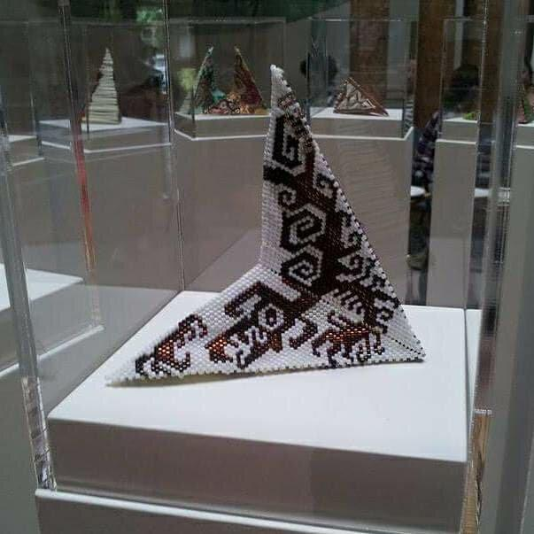
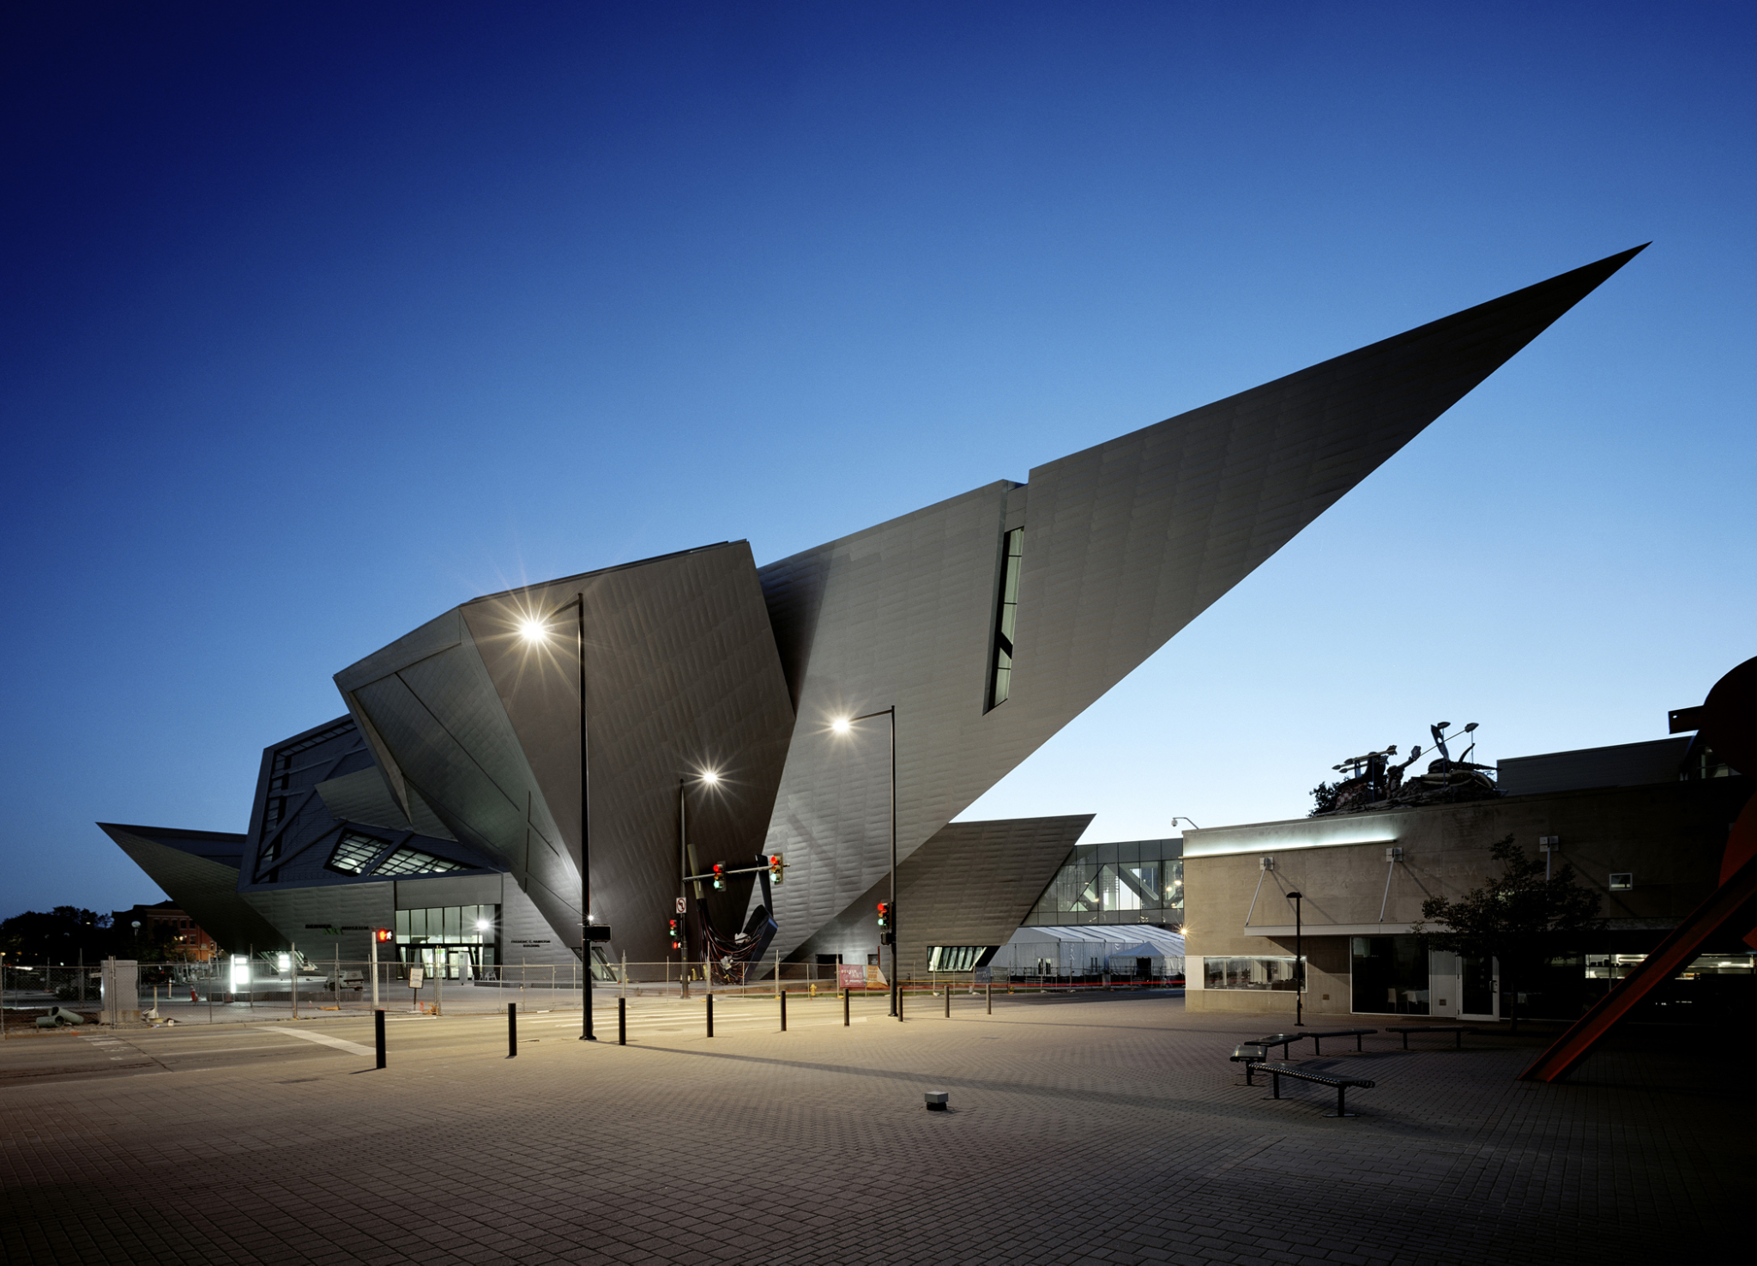
Introduction
Native American Art and Museums
By Brianna Porche
Art Department, Nicholls State University
Conclusions
Museums are institutions where visual arts are meant to be preserved and appreciated. However, for centuries, museums have subconsciously glorified colonization. North American Indigenous people view museums as a reminder that the culture and society they created have been taken from them. Museums can address this problem by featuring work by Indigenous artists that refer to contemporary issues faced by their tribes.
Although museums today are more respectful of North American Indigenous cultures and artists, there are still many issues in both the art world and society that need to be addressed.
Contemporary art created by Indigenous artists, especially Native Americans and First Nation people, helps create awareness of the cultural issues the tribes face in the United States and Canada.
Spirit Transformations by Nico Williams from 2017 is a sculpture that uses motifs from the artist’s culture. The exhibition of this work and other work like it allows museums to celebrate indigenous culture rather than appropriate funerary and sacred objects.
]
Spirit Transformations, 2017
by Nico Williams
Methods/Content
This study argues that museums have tried to preserve objects removed from their original context. This includes burial goods and ritual objects.
The conclusions are informed by exhibitions organized by the Museum of Modern Art assessed in Catherine Berlo’s article. In comparison to MoMA, the Denver Art Museum has more anthropological exhibitions.
It is important to note that First Nation Indigenous people are protesting and asking to reclaim stolen culture.
Citations
Denver Art Museum, 1949
Beatty, Liz. “Connecting Cultures: a Journey through Indigenous Art in Canada”. National Geographic Society. National Geographic Partners. Last edited June 14, 2019. https://www.nationalgeographic.com/travel/article/partner-content-indigenous-art-canada
Berlo, Catherine Janet. “The Art of Indigenous Americans and American Art”.Journals Open Edition, University of Rochester.Feb 2015, https://journals.openedition.org/perspective/6004#quotatio
"Cultural Appropriation of Indigenous Peoples in Canada". In The Canadian Encyclopedia. Historica Canada. Article published September 07, 2017; Last Edited July 20, 2020. https://www.thecanadianencyclopedia.ca/en/article/cultural-appropriation-of-indigenous-peoples-in-canadan
Acknowledgements
Dr. Deborah Cibelli, instructor of Independent Study.

