Slide 1

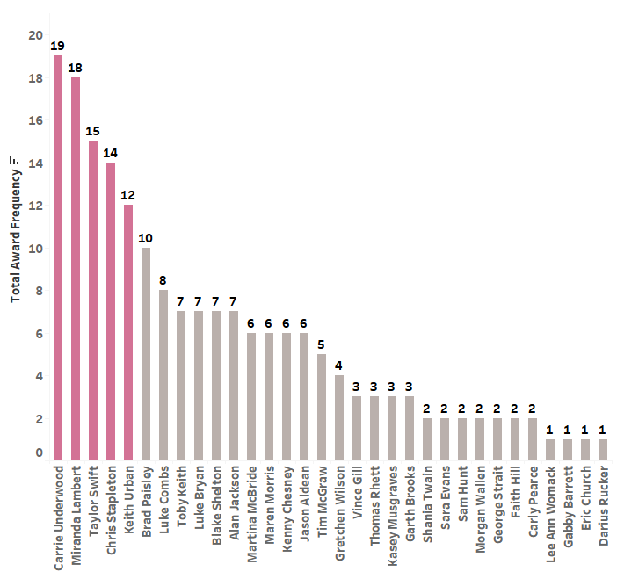
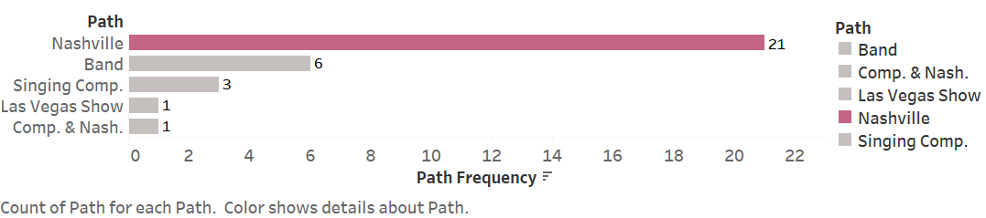
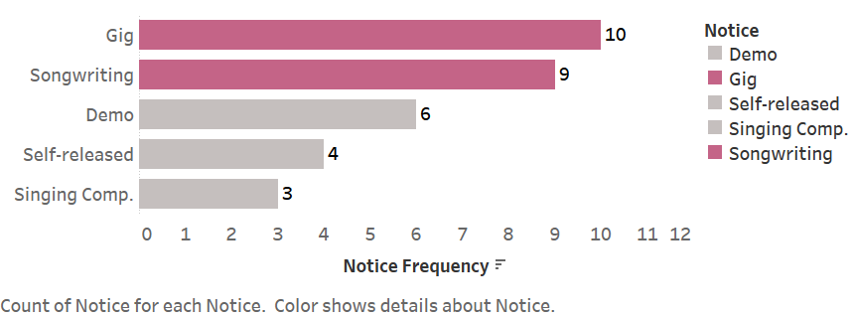
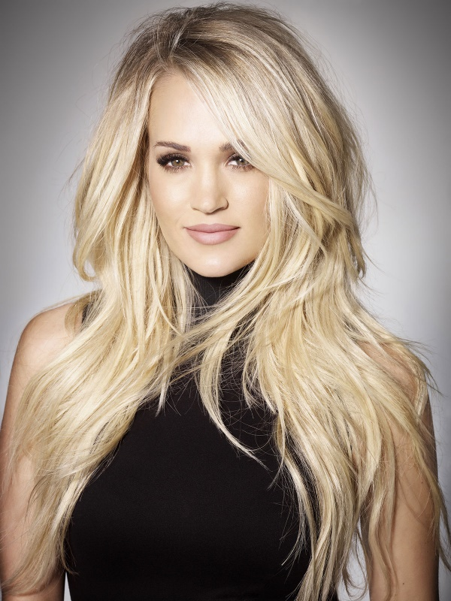
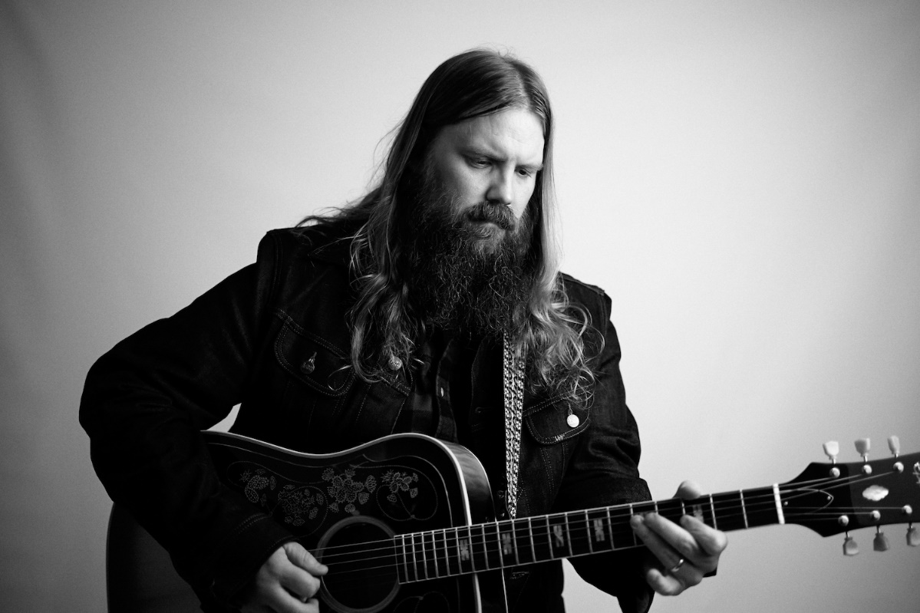
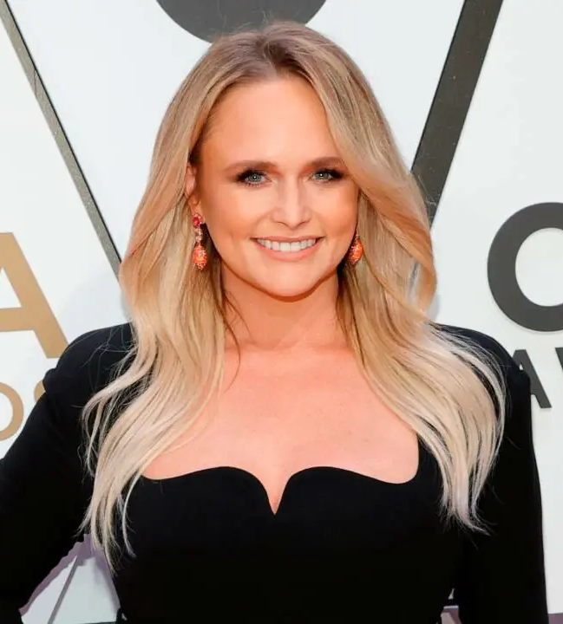
A Marketing Plan: The Creation, Explanation, and Perceived Benefit of Marketing a Musician’s Journey
Introduction
Brianna Simon
College of Business Administration, Nicholls State University
Methods
Musicians aspiring to obtain a larger audience base or fame often hit difficulties in being noticed by more people or even industry leaders. A marketing plan for a musician can help them gain exposure because it can help reveal the singer’s strengths and weaknesses. The final product of this study will be a country music marketing plan for an aspiring local musician. Additionally, research was gathered on multiple twenty-first century country stars and how they achieved their high status, exposure, and record deal. The data will help determine which path and strategies are the most effective in becoming a famous country singer. Since the study is still ongoing, this presentation will mainly cover the researched collected on the famous twenty-first century country artists and their strategies. With these findings, other country musicians will have evidence-based strategies and paths they can follow to increase their chance of exposure.
This method used in this study consisted of gathering data on the top country artists from 2001-present. The 32 artists used in the data were chosen based on getting at least one award in the following year-end award categories: Billboard Top Country Artist, Billboard Female Top Country Artist, Billboard Male Top Country Artist, Country Music Association (CMA) Entertainer of the Year, CMA Female Vocalist of the Year, CMA Male Vocalist of the Year, Academy of Country Music (ACM) Female Vocalist of the Year, ACM Male Vocalist of the Year, Grammy’s Best Country Solo Performance, Grammy’s Best Female Country Vocal Performance, and Grammy’s Best Male Country Vocal Performance. Multiple awards were chosen to have representation from industry leaders and the average listener. All of these artist were complied into an Excel spreadsheet to determine their age, gender, cumulative awards won based on the awards listed above, which path they took to gain exposure, how their first record label noticed the artist, what their first record label was and at what age was the artist when they received the deal, the artist’s current record label and its parent company, and if the artist was accepted or rejected by the following singing competitions: American Idol, The Voice, and Nashville Star. Descriptive coding was used to show paths and how the record label noticed them. This research was conducted to answer the research questions and provide the evidence for musicians developing their marketing plan. Artists who were over 60 years of age and only received one award in the 21st century were taken out of the data. This is because those artists will not represent the 21st century strategies and paths. Additionally, some artists were kept although they received a record label before 2001 because the sample data would have been too small. The data was retrieved from an abundance of sources including bibliographies, Academy and award websites, artists’ websites, articles, newspapers, magazines, and others.³
Results
Research Questions
What is the most taken path to achieve fame and recognition in country music?
What is the most popular way to get noticed in country music by a record label?
What is the average age for receiving a record deal in country music?
Who holds the highest popularity in regard to country music awards based on vocal skill and performance?
What strategies did the 3 of the most popular awarded country artists use to gain fame in the genre?
Most Taken Path
Highest Popularity
The data results show that the most taken path to achieve fame and recognition in country music is Nashville, with 21 artists taking it to gain exposure. The next largest path taken is forming a band and touring at 6 artist. Singing competitions, a Las Vegas Show, and doing a singing competition and Nashville are all the least taken paths. This reveals that moving to Nashville has been the best option for those interested in performing country music at a high level. Musicians can use this information to choose their path in their marketing plan.
The artists that hold the highest popularity in regard to country music awards based on vocal skill and performance are Carrie Underwood in first, Miranda Lambert in second, Taylor Swift in third, Chris Stapleton in fourth, and Keith Urban in fifth. Refer to methods to see how the total awards were calculated. A glimpse of three of these artists’ journeys and strategies will be shown below.
Most Popular Way to Get Noticed
Average Age for Receiving a Record Deal
The data results also presented that gigs are the most popular way to get noticed in country music by a record label. Ten artist got discovered by a record label because they were playing a gig in a bar or restaurant, mainly in Nashville. Songwriting comes in next with nine artists. Multiple artists received publishing deals before they got their record labels, while others were just known for their songwriting capabilities with other famous artists. Being noticed through a demo, self-released music, or a singing competition is not as frequent, but the top two artist, Carrie Underwood and Miranda Lambert, got discovered through singing competitions. Musicians should use this information to decide how they want to expose themselves to record label producers.
The average age for receiving a record deal is 25. Knowing this can help musicians determine at what age they should expect to receive a record deal. Although record deals can happen in some artists teen ages, musicians should realize that it might take years and a lot of hard work to get a record deal.
Conclusion
In conclusion, there are multiple ways a musician can gain exposure in country music. The main themes found were a love for singing, the dedication to pursue the trade, to stay true to oneself, to take any opportunity, and to go after the dream. The top artists never gave up. It is important to recognize that the artists knew what their talents were, whether it was singing or songwriting, they used their strength to get into the country music industry. A musician can now use this information to create their own marketing plan on how to gain exposure. They could potentially try out for a singing competition, move to Nashville and play gigs, start small through local plays or talent shows, and take the path that feels right for them.
Literature
For this study, literature research was conducted on what is included in a marketing plan and its benefits to set up the musician for what they can include in their own marketing plan and why they should make one. Multiple sources were used to research the specific components of a marketing plan, including textbooks, newspapers, journals, magazines, and others. The main source used was the marketing plan outline from Marketing Strategy Vol. Eighth Edition written by Ferrell, Hartiline, and Hochstien. A traditional business marketing plan includes executive summary, situation analysis, SWOT analysis, marketing goals and objectives, marketing strategy, marketing implementation, and evaluation and control.¹ Creating a marketing plan is beneficial for a musician because it is the main way an artist can become famous. It helps an artist organize and present their talent to gain exposure.²
6
9
11
Carrie Underwood:
She grew up on a farm in a small town in Oklahoma called Checotah.⁴
Her early life consisted of playing with farm animals, singing at church, school plays, and talent shows. ⁴
She went to Northeastern Sate University in Oklahoma to pursue a career in journalism. ⁴
In her final semesters, Underwood decided to try out for the fourth American Idol season. She made it onto the show and ended up winning the whole thing, which got her the record deal with Arista Records. Because of her singing talent and down to earth personality, the industry and people loved her. ⁴
The strategy Underwood took here is to be honest about who she was and to take the opportunity to do what she loved through American Idol.⁵
Chris Stapleton:
He grew up in Kentucky and decided to move to Nashville when he learned that he wanted to write songs.⁷
After 4 days of being in Nashville, he landed a publishing deal with Sea Gayle Music. He worked with multiple bands, had multiple jobs, and played music around Nashville. ^{7,8}
Chris Stapleton landed his record deal with Mercury Nashville because of his songwriting talent, which became evident because he worked with many artists. Although, he was a songwriter for years before he was noticed for his voice. ⁷
Stapleton’s strategy was hard work and dedication to what he loved. He never gave up and made ends meet until he was ready to take on his solo career. ⁷
Miranda Lambert:
She grew up in a small town called Lindale, Texas.
Her father was a singer and songwriter, which sparked Lambert’s interest in music. He also taught her how to play guitar.¹⁰
She performed in many talent and variety shows in Texas. This led to her being in a commercial and teen comedy. She then started her own band in high school because she knew she wanted a career in country music. She even released an independent self-titled CD. Her big break came when tried out for the Nashville Star singing competition. Although she did not win, she still got a contract with Sony Music. ¹⁰
Miranda Lambert’s strategy was to keep playing country music in any way she could. She also put her music first and taking the opportunity to expose herself through Nashville Star. ¹⁰
Cited
1. Ferrell, O. C., Hartiline, M. D., & Hochstein, B. W. (2022). Marketing Strategy: Vol. Eighth Edition.
2. Agrawal, A.J. (2016). How digital marketing is changing the music industry. Inc. www.inc.com/aj-agrawal/how-digital-marketing-is-changing-the-music-industry.html
3. References available upon request
4. Ray, M. (2022). Carrie Underwood. Britannica. https://www.britannica.com/biography/Carrie-Underwood
5. [Idols Global]. (2020, Oct. 16). Carrie Underwood before she became famous [Video]. YouTube. https://www.youtube.com/watch?v=kgFCb376Cdk&ab_channel=IdolsGlobal
6. Carrie Underwood Cry Pretty [Photo]. Universal Music Group. https://www.carrieunderwoodofficial.com/
7. McHugh, C. (2020). Chris Stapleton biography. A&E Television Networks. https://www.biography.com/musician/chris-stapleton
8. AllMusic. (2022). Chris Stapleton biography. AllMusic, Netaktion LLC. https://www.allmusic.com/artist/chris-stapleton-mn0001766237/biography
9. Chris Stapleton. [Photo]. Universal Music Group. https://www.chrisstapleton.com/photos/
10. Biography Editors. (2020). Miranda Lambert biography. A&E Television Networks. https://www.biography.com/musician/miranda-lambert
11. Miranda Lambert CMA Awards. [Photo]. Getty Images. https://www.hellomagazine.com/celebrities/20220309135019/miranda-lambert-new-addition-surprise-news-close-to-her-heart/

