Slide 1
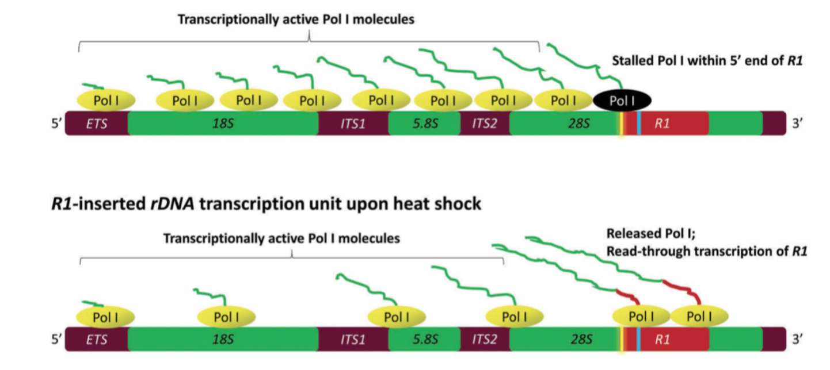
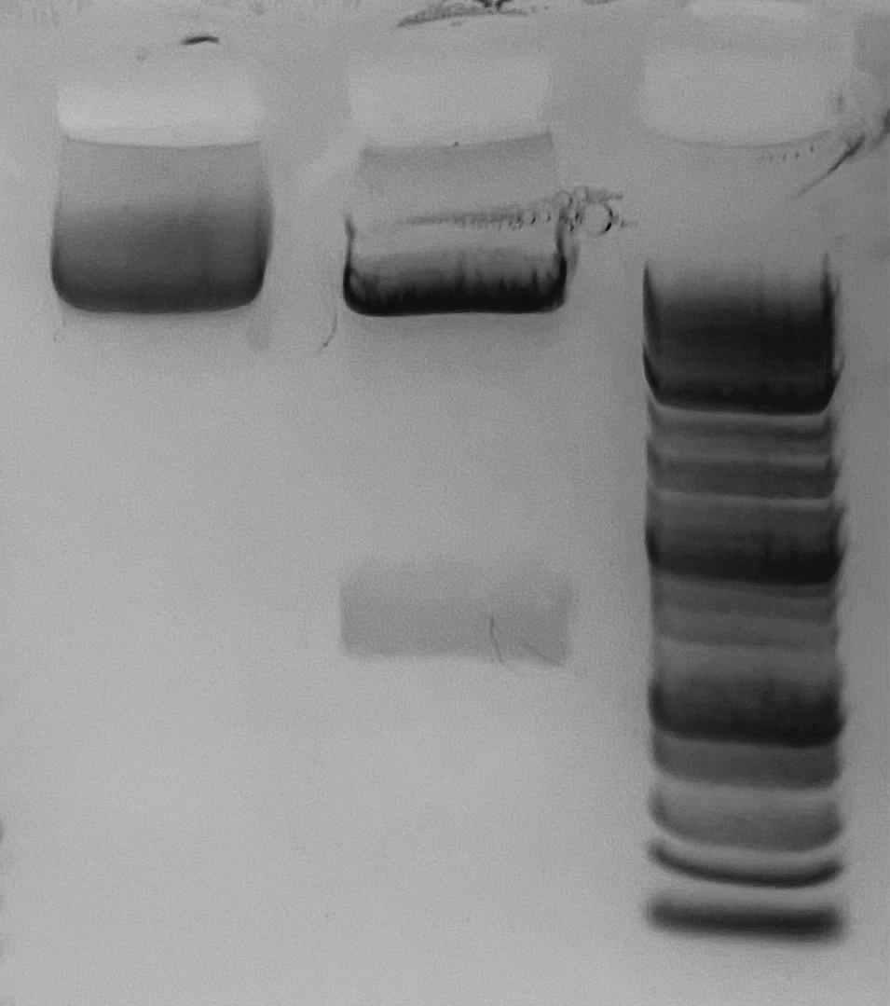
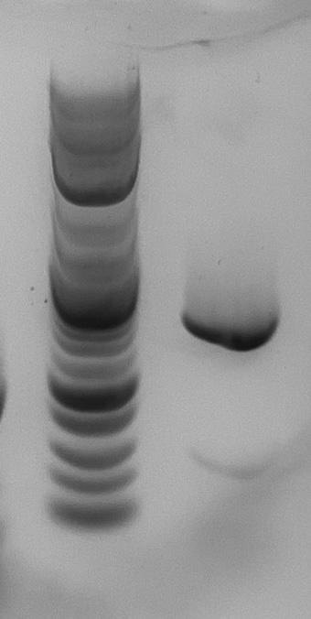
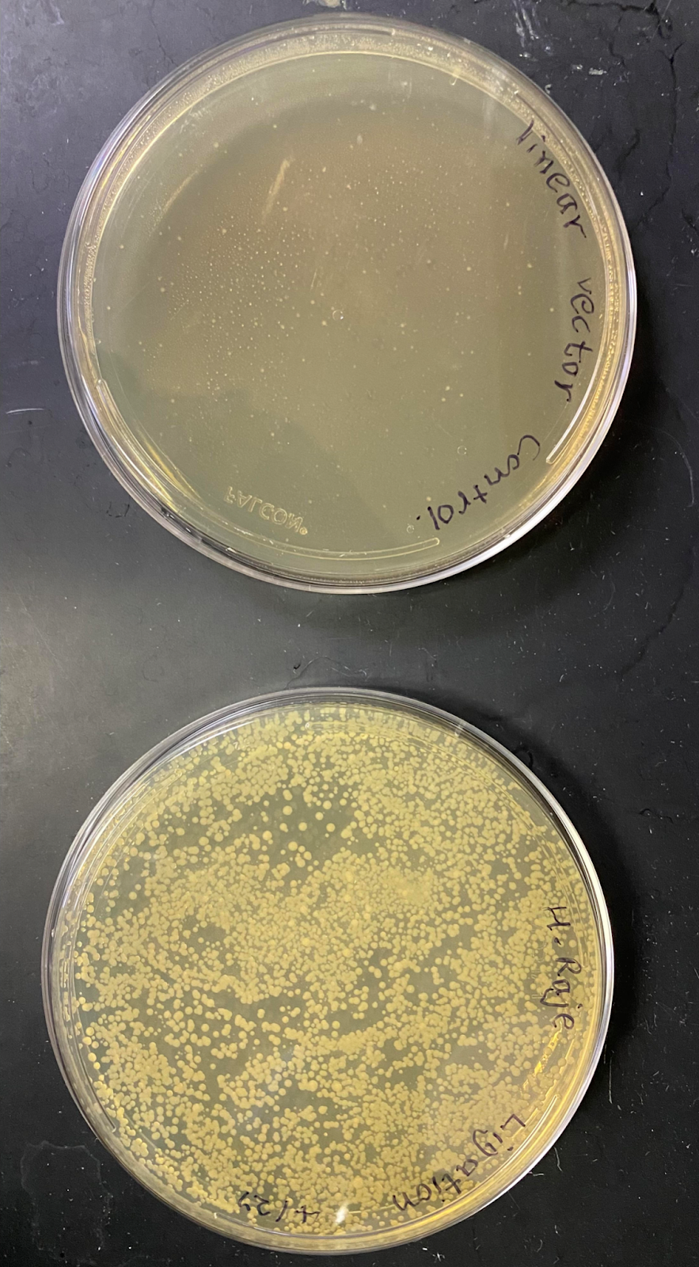
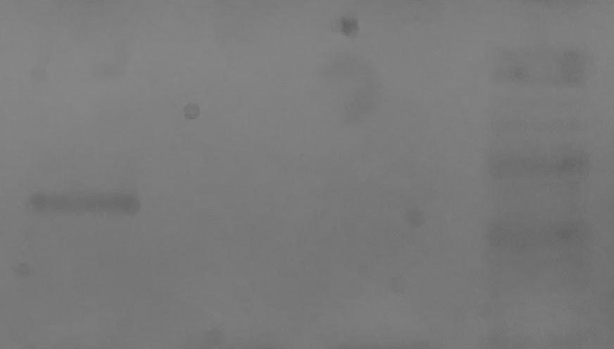
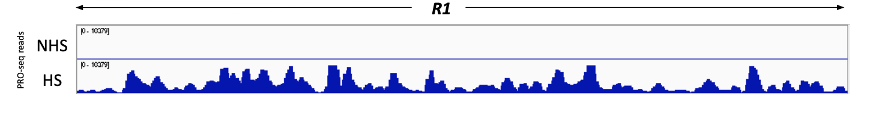
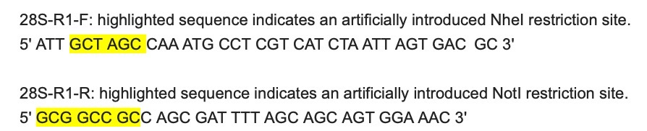
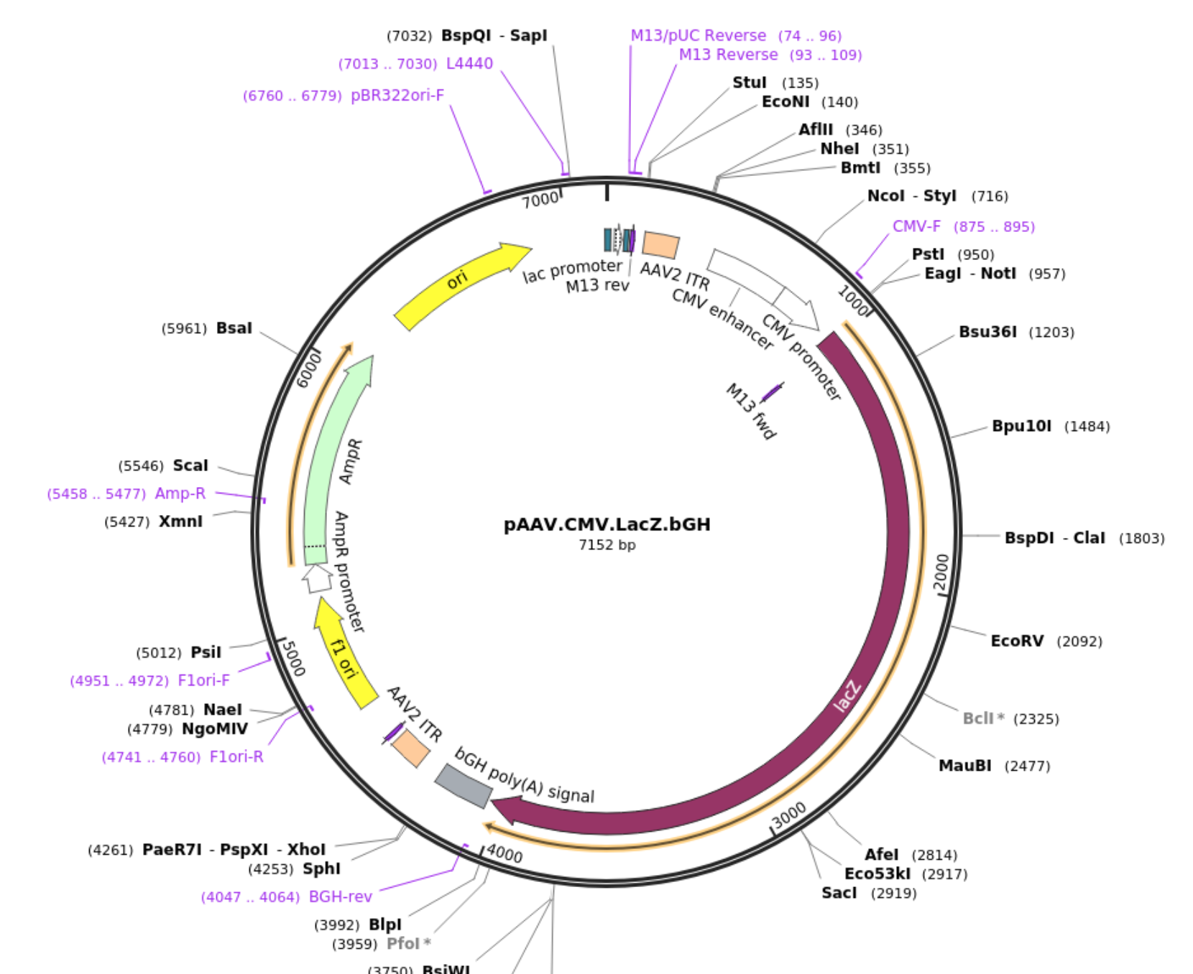
Elucidating the Transcription Start Site of the Heat Induced R1 Retrotransposon Transcript in Drosophila melanogaster
Chloe McDaniel, Claire Blanchard, and Himanshu Raje
Department of Biological Sciences, Nicholls State University
______________Introduction_____________
___________Results/Discussion____________
Uncut plasmid
Plasmid cut with NotI and NheI
1Kb plus DNA ladder
1Kb plus DNA ladder
5’ end of R1
Control: bacterial transformation with
cut plasmid.
Bacterial transformation with ligation
reaction.
Fig. 1: Successful restriction digest of pAAV.CMV.LacZ..bGH plasmid
Fig. 2: Successful PCR product using Notl and Nhel enzymes
Fig. 3: Amplicillin based selection of the transformant bacteria
Expression of R1 retrotransposon is induced upon heat shock in W1118 stock of Drosophila melanogaster.
R1 is transcribed by RNA polymerase I upon heat shock.
Heat-induced R1 transcripts are believed to be the co-transcripts with the rest of the ribosomal RNA.
It is not yet known if R1 has it’s own promoter which could potentially recruit RNA polymerase I upon heat shock.
Heat shock
RT control
No heat shock
1Kb plus DNA ladder
_______________Methods________________
Primers
Fig. 5: High throughput sequencing depicting R1 expression.
Fig. 4: R1 expression under no-heat shock and heat shock conditions
___________Observations/Future____________
Observations:
R1 expression is significantly induced upon heat shock in the wild type Oregon-R stock of Drosophila melanogaster.
We successfully amplified the 5’ end of R1.
We have generated the cDNA libraries for no-heat shock and heat shock conditions.
We have not observed any R1 transcripts under no-heat shock conditions by high throughput sequencing (Iso-seq).
Future:
Attempt to ligate the 5’ end of R1 in the pAAV.CMV.LacZ.bGH plasmid.
Transfect the recombinant plasmid into Drosophila S2 cells to test for LacZ expression.
Perform high throughput sequencing on the cDNA library generated from heat-shocked Drosophila larvae.
PCR
Amplifying 5’ end of R1
1. 94 degrees for denaturing
2. 55 degrees for annealing
3. 72 degrees for extension
30 cycles.
Restriction DIgestiton of Plasmid
plasmid 7 ul
NotI 1ul
NheI 1 ul
cutsmart buffer 1 ul
Total volume = 10 ul.
______________References_______________
Raje, H.S., Lieux, M. E., & DiMario, P. J. (2018). R1 retrotransposons in the nucleolar organizers of Drosophila melanogaster are trtansribed by RNA polymerase 1 upon heatshock. Transcription, 9(5), 273-285.
pAAV.CMV.LacZ.bGH was a gift from James M. Wilson (Addgene plasmid # 105531 ; http://n2t.net/addgene:105531; RRID: Addgene_105531)
Cloning/Bacterial Transformation
j
Insertion of the recombinant plasmid into competent E. coli cells.

