Slide 1
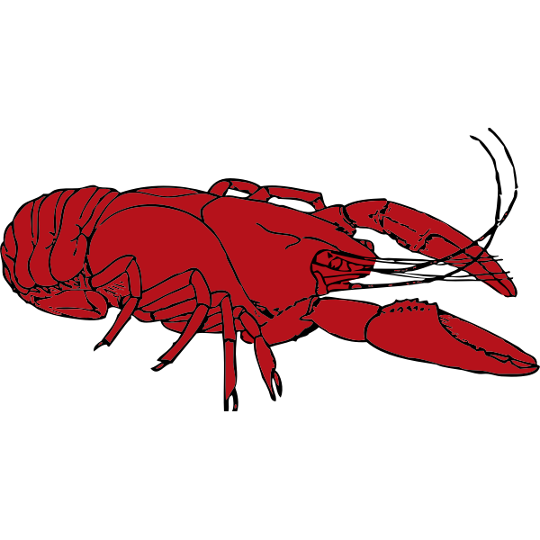

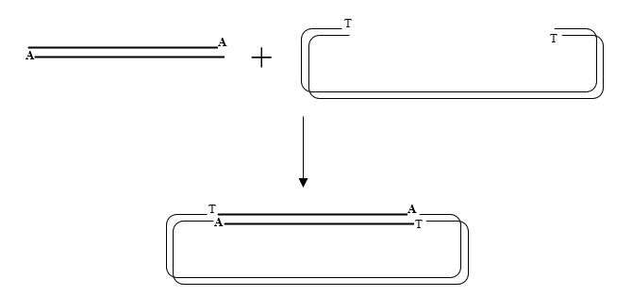
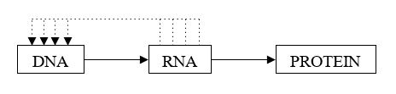
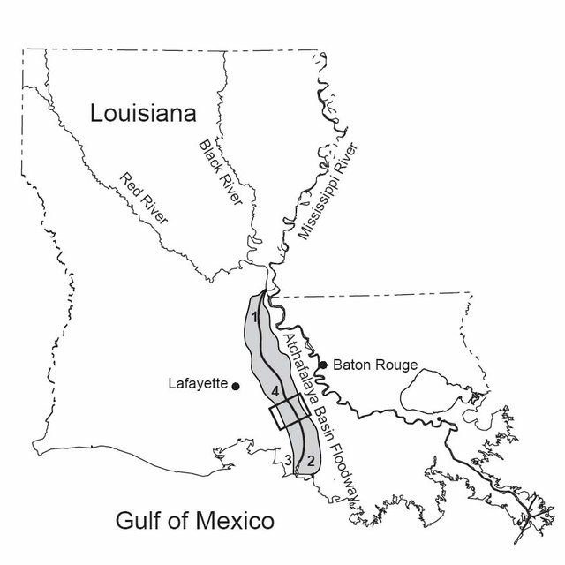
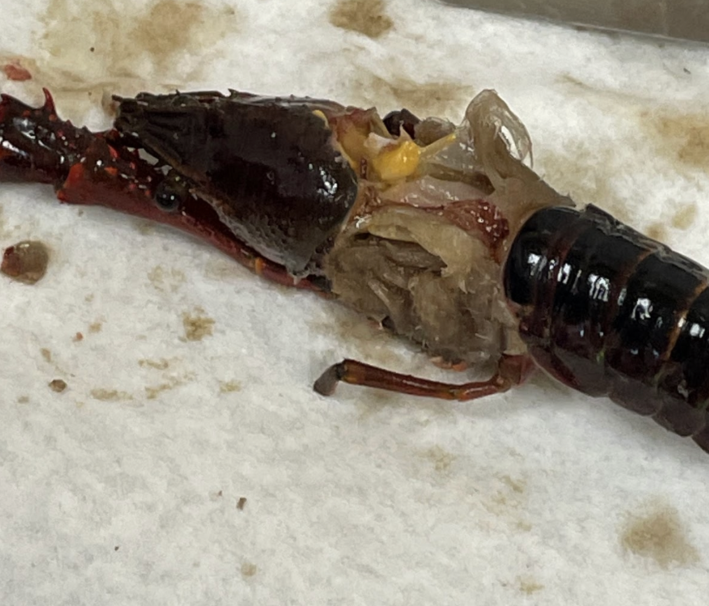
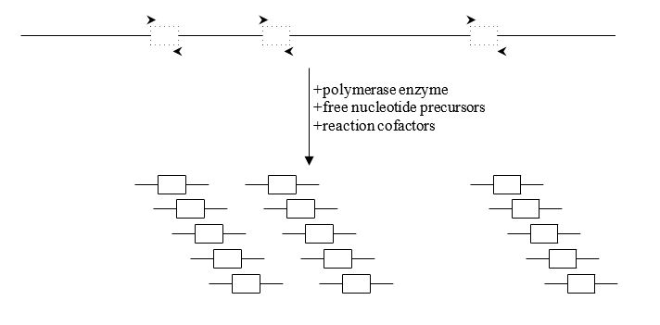
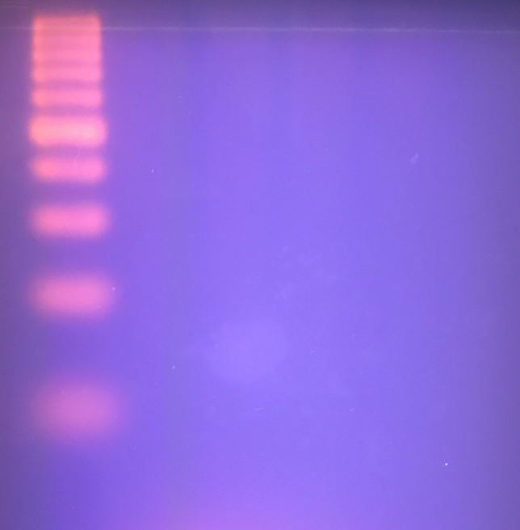
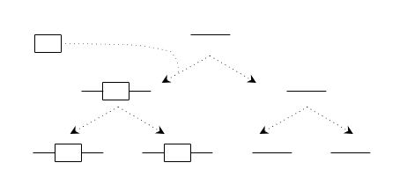
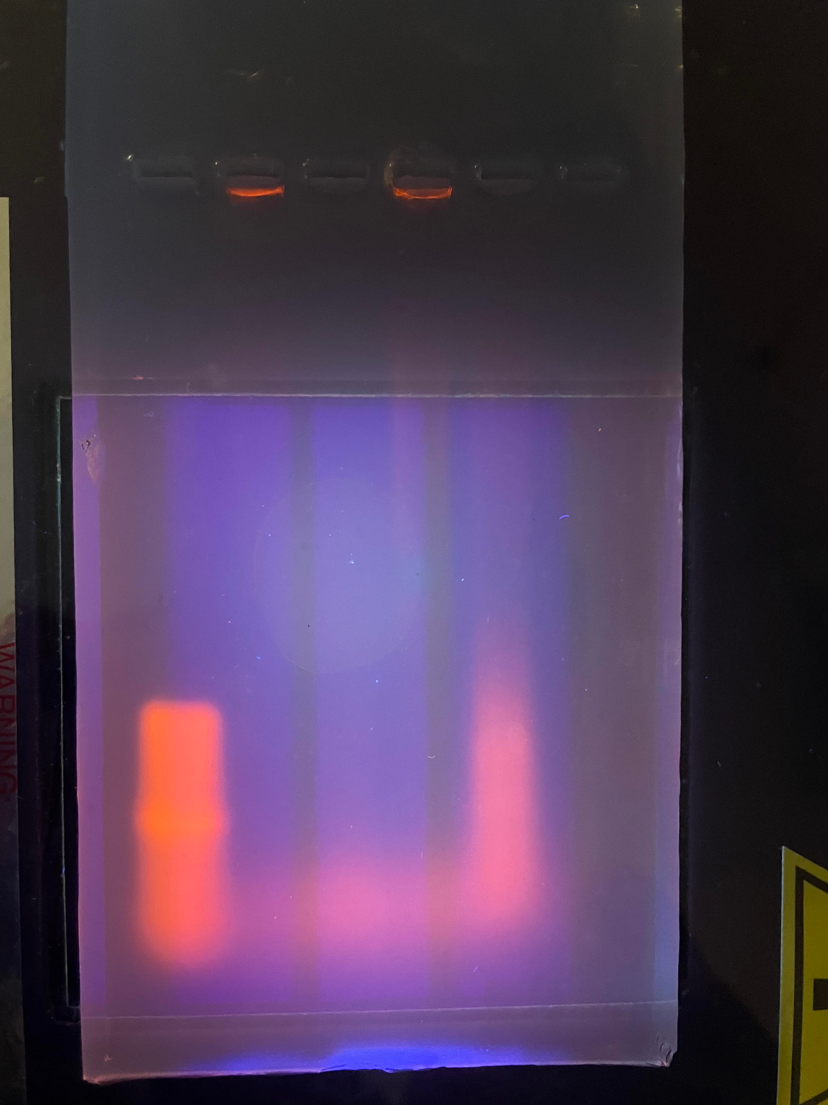
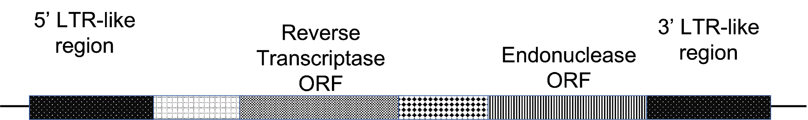
Isolation of Unique Retroelements in
Genomic DNA of Procambarus clarkii
Courteney Dufrene, Sam Songe and Sarah Bergeron
Department of Chemistry & Physical Sciences, Nicholls State University, Thibodaux, LA 70301
Introduction
Purpose
A second (primers FPEN-1B and RPEN1B) and third (primers RT4 and RT5) round of nested PCRs are conducted with the previous PCR product using nested primers.
The red swamp crawfish (Procambarus clarkii) generates $300 million annually in Louisiana from the harvest of approximately 110 million pounds of crawfish (1). Since Louisiana must often compete with the Chinese crawfish market comprised of the same species, we seek to differentiate the two populations at the genetic level based on retroelement sequences located in the non-coding regions.
The flow of genetic information is typically from DNA to RNA. However, retroelements accumulate in an organism’s DNA by being copied in the reverse direction (RNA to DNA) over the course of many generations.
Retroelements can serve as population genetic markers as (1) they are permanent additions to heritable DNA, (2) known mutation rates can be used to estimate retroelement ages, and (3) they cause no harmful impact on the organism.
The reverse transcriptase gene, encoding the RNA-dependent DNA polymerase, will serve as the target for a PCR amplification strategy aimed at identifying novel population specific retroelements of the red swamp crawfish, Procambarus clarkii.
Primer Name | Sequence
FPEN-1B (FP) | 5’ – TAY NGN YTN CCN AAD ATH CAT– 3’
RPEN-1B (RP) | 5’ – NGW NKS NRT NKV CTT NMN ATA-3’
RT4 (FP) | 5’ – GGN NNI BCI ATG GGI WSI CC -3’
RT5 (RP) | 5’ – ANN ANR TCR TCI ABR TAI C – 3’
Methods
Specimens were collected from Louisiana’s Atchafalaya Basin, highlighted in grey below. Crawfish were dissected for:
    (1) hepatopancreas–a yellow, fatty organ
    (2) tail muscle
PCR products are then run on an agarose gel. PCR products corresponding to the approximate length of the retroelements, known to be ~100-300bp, are then extracted from the gel, purified, and cloned into a plasmid for sequencing.
(1)
(2)
Following insertion into a chromosome (horizontal line, below) of a parent, a retroelement (rectangle) is transmitted to all descendants in each generation, making the parent’s line of descent genetically different than other members of the species. With as many as a million retroelement insertions in a modern species, many populations within a species can be differentiated by analyzing specific retroelement insertion positions along the chromosomes.
Sequence analysis allows for homology comparison to known retroelement polymerases, likely providing genetic markers for future population studies.
Results and Conclusions
For each sample, genomic DNA (gDNA) was extracted, purified, and quantified via UV-Vis Absorption Spectroscopy before being subjected to PCR.
We are looking to optimize the PCR process:
Longer protein digestion pre-DNA purification
Check quality of extracted DNA with restriction enzymes
Alter gDNA concentration
Change Mg concentration
500 bp
500 bp
Initially, genomic DNA is PCR amplified using primers targeted to the conserved sequences of the PLE reverse transcriptase gene. Due to possible variability in the consensus sequence of the reverse transcriptase gene primers were designed with positional variability in the nucleotide sequence, e.g., degenerative primers.
2+
Ladder
10 ul HP
2 ul HP
10 ul Tail
2 ul Tail
Ladder
10 ul HP
2 ul HP
10 ul Tail
2 ul Tail
These transposable elements accumulate mutations at a neutral mutation rate, as they rarely directly affect an organism's phenotype. The general structure of the retroelements, termed Penelope-Like Elements, include from 5’ to 3’: a 5’ long terminal repeat like region, a reverse transcriptase gene, an endonuclease gene, and a 3’ long terminal repeat. The reverse transcriptase and endonuclease genes are conserved and are required for autonomous retroelement insertion.
References
Hupp, C., & Noe, G. (2006). Sediment and nutrient accumulation within lowland bottomland ecosystems: An example from the Atchafalaya River Basin, Louisiana. Hydrology and Management of Forested Wetlands - Proceeding of the International Conference.
Ronnie Self. (2005). The Genome of the Red Swamp Crawfish, Procambarus Clarkii. I. Evidence of Retropositional Modification. Nicholls State University.
Primer Name | Sequence
FPEN-1 (FP) | 5’ – TAY NGN YTN CCN ATH CAY A – 3’
RPEN-1 (RP) | 5’ – NGW NKS NRT NKV CTT NMN RTA -3’
Acknowledgments
Nucleotide designations are as follows: R=A/G, H=A/C/T, Y= C/T, M=A/C, V=A/C/G, K=G/T, S=C/G, N=A/C/G/T, W=A/T, I=inosine. FP= forward primer, RP=reverse primer.
Financial support
  Department of Chemistry & Physical Sciences

