Slide 1


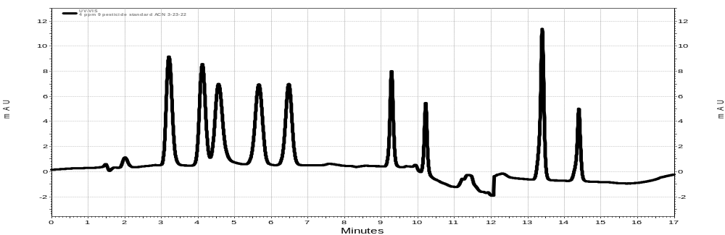
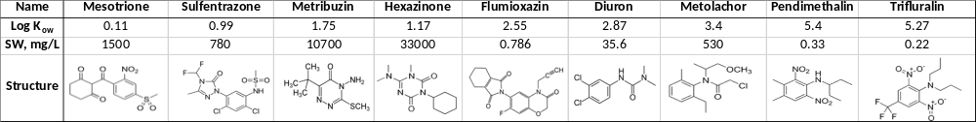
The influence of soil composition on the persistence of nine common herbicides used in Southeast Louisiana soils.
Bergeron, D.,† Wayment, D.G.† and White, P.M. Jr.,‡
†Nicholls State University, Department of Physical Sciences, Post Office Box 2022, Thibodaux, LA 70310
United States Department of Agriculture (USDA), Agricultural Research Service (ARS), Sugarcane Research Unit, Houma, Louisiana 70360
Introduction:
Herbicides are widely used to control unwanted plant growth in crop fields and it is important to know the rate at which they degrade in soil for agricultural usage. Herbicide persistence in soil depends not only on microbial growth, but also the properties such as soil composition (relative amounts of sand, silt, clay), as well as organic-matter content. Clay, for instance, is more likely to bind organic molecules and water due to its makeup of very small particles compared to silt loam, which is made up of larger particles. This project investigates the persistence of common herbicides used in Southeast Louisiana sugarcane fields and the role that soil composition plays with regards to two different soil types, Schreiver Clay and Cancienne Silt Loam. These herbicides vary greatly in Log Kow values and water solubility.
Objectives
To develop an HPLC method that can simultaneously analyze nine herbicides with a wide range of Kow values.
Validate the method using percent recovery
Use method to analyze the dissipation of the herbicides over time.
Results:
(1) (2) (3) (4) (5) (6) (7) (8) (9)
Figure 1: 4 ppm standard of the nine herbicides in ACN. (1) mesotrione, (2) sulfentrazone, (3) metribuzin, (4) hexazinone, (5) flumioxazin, (6) diuron, (7) metolachlor, (8) pendimethalin, (9) trifluralin.
Experimental:
HPLC:
Cancienne Silt Loam and Schriever Clay were treated with the nine herbicides and monitored for over 125 days under laboratory conditions.
Soil samples were taken out at eight different time points and analyzed in triplicate.
10 mL of ACN was added to each sample as well as 6 mL of H₂O. Then the samples were mixed on an orbital shaker for 5 minutes and centrifuged for 10 minutes.
The ACN extracts were analyzed by HPLC.
Gradient 33:67 ACN : H₂O (0.02% TFA) to 75:25 ACN : H₂O (0.02% TFA)
Flow rate of 0.5 mL/min for 5 minutes and 1.0 mL/min to complete the run
Phenomenex Kinetex C8 Column, 75 x 4.60 mm, 2.6 µm
UV-Vis detection at 235 nm then after 9.7 minutes 224 nm then at 12.0 minutes back to 235 nm.
Regression analysis using Excel
Figure 2: The nine herbicides dissipation in Clay and Silt Loam over 14 days. Sand (green), silt loam (red) and clay (blue), t= 0, 7 and 14 d.
Discussion:
Sulfentrazone, Flumioxazin, Diuron, Pendimethalin and Trifluralin dissipate in both soils over 14 days.
Mesotrione, Hexazinone, and Metolachor do not seem to dissipate in either soil after 14 days.
Metribuzin seems to bind much more to clay than to silt loam.
Diuron, Pendimethalin, and Trifluralin dissipate faster in silt loam than clay .
Method validation:
Spike recoveries ranged from 89% - 95.7% for Silt Loam and 91% - 97.2% for Clay except for Metribuzin which had 71.1%.
Table 1: Log K_{ow},, water solubility (SW) and chemical structures of the nine herbicides..

