Slide 1

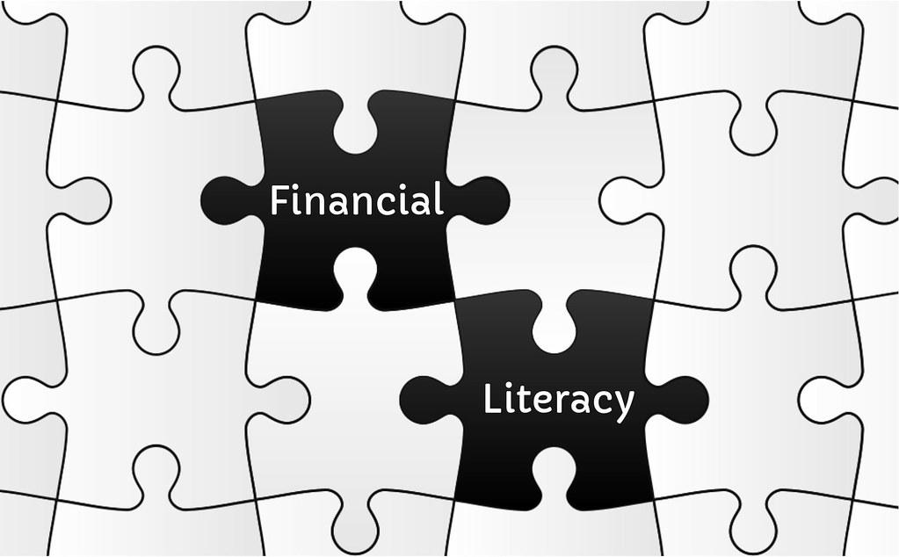
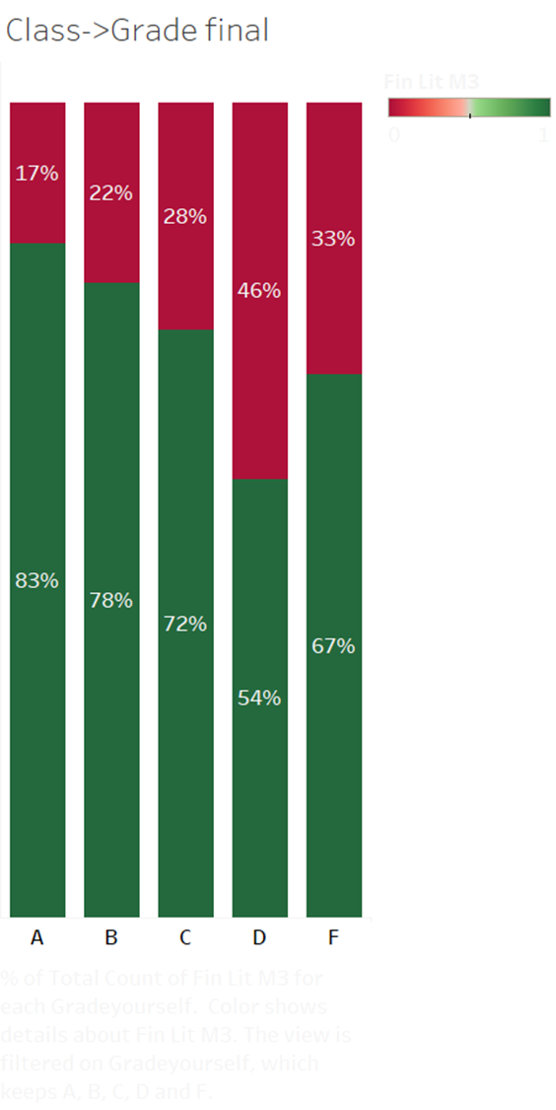
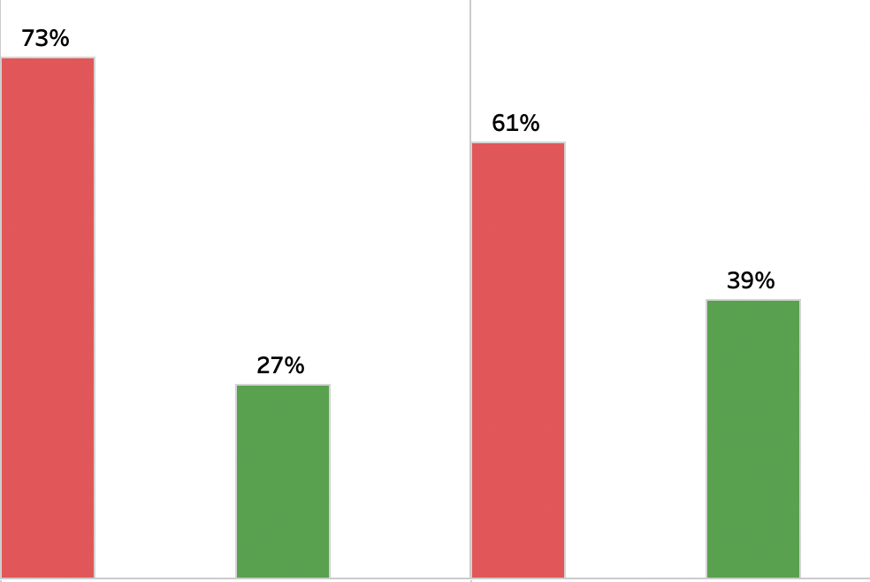

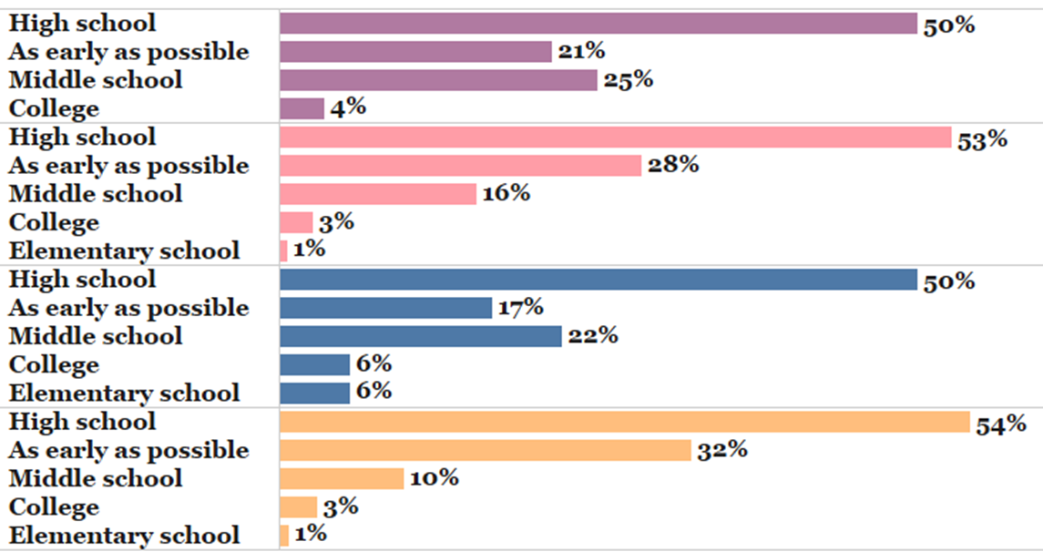
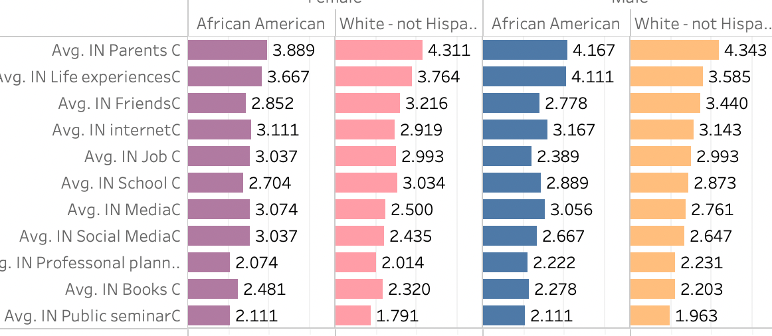
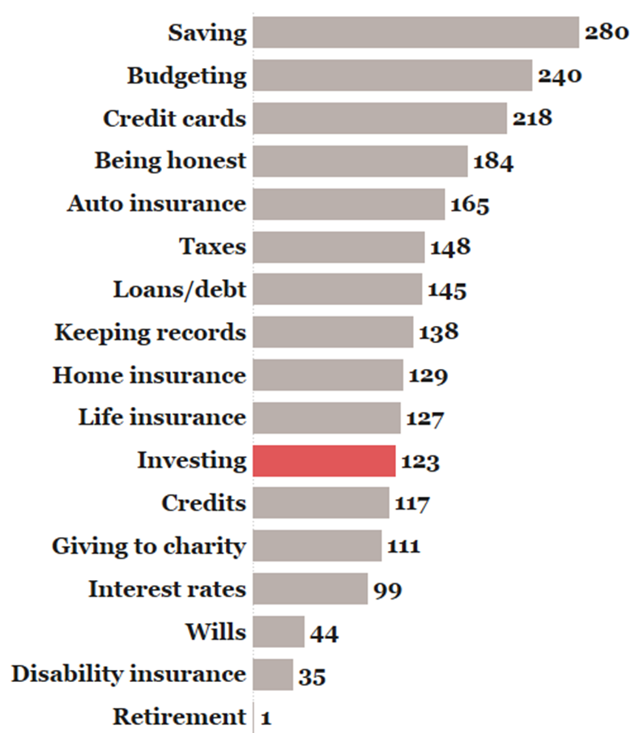
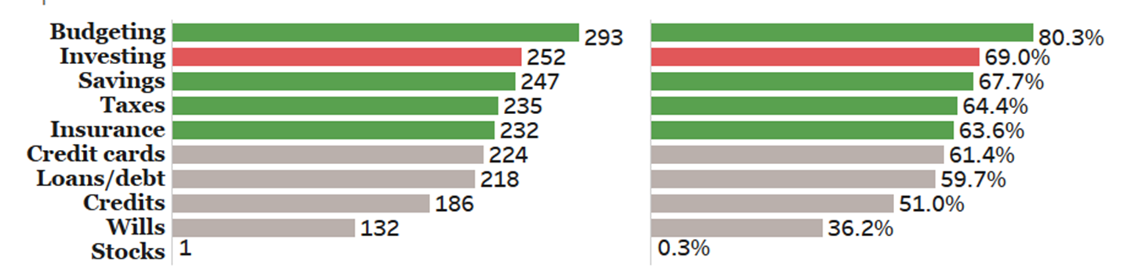
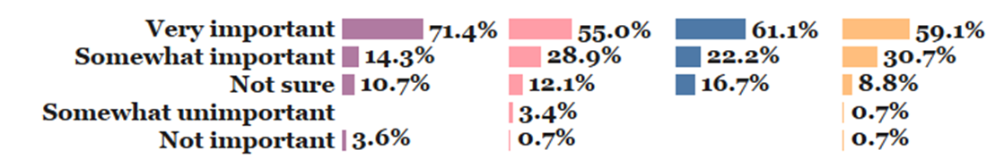
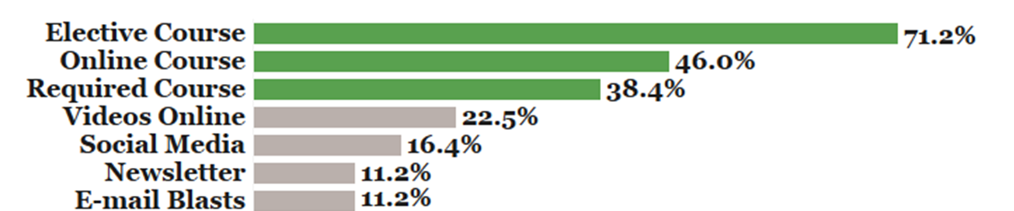
Checkout
9.67
You’re playing the wrong game!
Financial dreams delivered through the power of financial literacy
Danielle Duplay, Dr. En Mao College of Business Administration
Introduction
How financial literate are our students?
Importance of Financial Literacy
Interest in Financial Literacy
Service Learning
Being financially literate involves being in tune with all aspects of one’s financial life. This includes but is not limited to budgeting, investing, credit, saving for long and short term goals, major purchases such as an auto or home, insurance decisions, and estate planning. Many people work their whole lives without ever knowing how to handle their money. Two in three Americans are in debt (Statista, 2021) and half of the US families have no retirement savings (Sainato, 2021). How is that possible when the US is the most overworked developed nation in the world (Miller, 2022)? Are people playing the wrong game? With inflation at its highest level in four decades (Tepper, 2022), it is more important than ever for young adults and consumers to embrace financial literacy.
This project was initiated as service-learning project for CIS 370 Data Analytics class from the College of Business Administration. Key research questions include: How financial literate are our students? Who influence our students in the areas of financial literacy? When is it best to start teaching financial literacy in schools? What knowledge should be delivered? How should we deliver such knowledge?
Knowledge Test: Assume you are in your early twenties and you would like to build up your nest egg for a secure retirement in 30 years. Which of the following approaches would best meet your needs?
4.72
4.13
The service-learning project allowed me to get a hands-on experience with a real-world application.
Applied data cleaning and business analytics to solve high impact educational problems.
It also allowed me to develop connections with members of the community. I sharpened my communication skills through interactions with my faculty mentor, Dr. En Mao and other staff from multiple schools.
It helped me think more creatively about how things are related to each other.
Continuous discovery process of learning.
Personal and professional growth.
Developed skills that helped nurture development and maximize my potential.
Found knowledge that can help teach those around me the importance of financial literacy.
The red portion represent the portion of students who have not taken a course in finance, money management, or economics.
Not taken a class
Taken a class
While the students realize financial literacy is very important (average rating 4.72 out of 5), they show much less interest in learning about it (4.13 out of 5)
Where do you expect to learn about financial literacy?
The green represent the portion of students who have taken a class.
Most people expect to learn about financial literacy from life experiences. Many wished that they would have learned more from their parents, but did not. Their life experiences guided them, and most still do not know enough about it.
The good news is that students expect to learn about financial literacy from school!
“A” graders have the largest proportion (83%) of students who have taken a course followed by B, C, F, and D graders.
Incorrect
Correct
Incorrect
Correct
Overall, 234 (64.11% out of 365) students answered incorrectly.
There is a positive effect of taking a class in the area of finance. There is a larger proportion of students who answered the knowledge question correctly have taken a finance course 39% vs 27%.
When is it best to start teaching financial literacy in schools?
Methods
Who influence our students in regard to financial literacy?
Black Female
We designed a survey to collect data. A total of 365 students responded. In the survey, we assess students’ financial literacy level, interest, the perceived importance of financial literacy, family influences, areas of interests, their desired methods of learning, and when financial literacy should be taught in schools, if at all. In addition, we conducted eight personal interviews including subjects from various age groups and racial backgrounds.
While white male students reported the highest level of influence from their parents, black female reported the lowest.
The effect of life experience is the highest among black male students and lowest for white males students.
Friends have higher influences for white students (above 3.2) while much lower for black students (below 2.9).
Overall, the school influence is low (ranged between 2.7 to 3). Books are even lower (ranged between 2.2 and 2.5).
All groups indicate high school to be the most common starting point. About half of the students.
white male and female students indicated “As early as possible” as the second highest response.
Black male and female students’ 2nd highest response was middle school.
Parents
Black Female
White Female
Black
Male
White
Male
White
Female
Life Experience
Friends
Internet
Job
Data Analysis
School
Black
Male
Media
Social Media
The data was first cleaned to transform values of variables to numeric values in Excel. To create the visualizations, we used Tableau which is a professional visualization software. Regression analysis was performed using Excel.
Professional Planner
Books
Public Seminar
White
Male
Results
What did you learned from home?
What topics would be of interest to you?
Quotes from Interviews
We found that those students who have taken a financial class, graded themselves higher than those who have not. 27% of students who have not taken a finance related class answer our knowledge question correctly versus 39% of the students who have taken a class answered the financial knowledge question correctly. This shows that there is a positive effect from taking a class. While the students rate the importance of financial literacy at 4.72 out of 5, their interest is less at 4.13. We can determine that this is a disconnect between the perceived importance and interest in learning. Over 50% say that high schools is where financial literacy education should begin. We saw that parents were the most influential in these participant’s lives. We found that black students at Nicholls are less knowledgeable, and less willing to learn about financial literacy than white students. This greatly stems from their family’s influences. This lack of knowledge is a generational issue. If parents do not have the knowledge, they cannot teach their children, or expect them to be interested in these topics. The good news is that students expect to learn about financial literacy in school. Specifically, they are interested in learning about budgeting, investing, savings, taxes, and insurance. Most prefer taking it as an elective course.
“I wish my parents would have better taught me about money”
Male Coach, 45
“I think we should be taught financial literacy. It is a part of our lives and not many people know enough about it”
Female student, 22
“A financial literacy class should be required every year for 9th - 12th grade.”
Male coach, 37
“I wish I would've learned about budgeting and taxes in high school.”
Female coach, 24
240 (66% out of 365)
students learned about
budgeting from home.
Only 123 (34% out of 365) students learned about investing from home.
Parents exert significant influences on their children. This helps to explain the absence of teaching about their children about investing at home can lead to the lack of knowledge about investing in the long run.
80.3% out of 365 students said that they were most interested in budgeting. You can see by following the curved green arrow to the left of the graph, 66% students learn about budget from home. Students still feel they need to learn more about budgeting. Perhaps there is a deficiency in knowledge.
The second most interested topic (69%) is investing. This makes sense as you can see by following the curved red arrow, only 34% of students learned about investing from home. This is good news as students are interested in investing, which is an important strategy for achieving financial success.
Savings, taxes, and insurance made the remaining top 5 topics that students are interested in. We further interview students about some specific on the top 5 topics:
“Budgeting is important so you know exactly where your money is going and the challenge is to stay within budget.””
Female 51
“ Investing is important to make sure you have adequate money to retire.”
  Male 68
Savings gives you piece of mind in helping protect you in case of an emergency.”
Male 52
“I would like to be educated more on what insurance is necessary so that I am not paying too much money on things that are not needed.”
Male 25
Regression Model
Goal Setting about Spending
The more exposure to financial knowledge at home, the more often people make goals about how to spend money.
The more exposure to financial knowledge at home, the more secure they feel about their financial situation.
Exposure to Financial Knowledge at Home
More Secure Feeling about Financial Situation
How important is being in control of your finances?
How should we deliver financial literacy?
References
Conclusions
Black Female
White Female
Black Male
White Male
Miller, G. E. (2022, January 29). The U.S. is the most overworked nation in the world. 20somethingfinance.com. Retrieved February 24, 2022, from https://20somethingfinance.com/american-hours-worked-productivity-vacation/
(n.d.). Topic: Personal debt in the U.S. Statista. Retrieved February 24, 2022, from https://www.statista.com/topics/1203/personal-debt/#dossierKeyfigures
Sainato, M. (2021, December 13). 'at 75, I still have to work': Millions of Americans can't afford to retire. The Guardian. Retrieved February 24, 2022, from https://www.theguardian.com/money/2021/dec/13/americans-retire-work-social-security
Tepper, T. (2022, February 10). Why is inflation so high? Forbes. Retrieved February 24, 2022, from https://www.forbes.com/advisor/investing/why-is-inflation-rising-right-now/
Financial literacy is an important life skill. Our students need to sharpen their financial literacy. Nicholls has a great responsibility to education and prepare our students for future financial and life success. We need to offer elective, online and required courses focusing on budgeting, investing, savings, taxes, and insurance. We do not want our students play the wrong game. Let’s get Nicholls financial literacy to the next level!
Having control of your finances is a major step in being comfortable handling them. According to our study, the majority of the students (ranged from 55% to 71.43%) feel that it’s very important to be in control of your finances. Black female students in particular feel this is important.
71.2% out of 365 students selected that they would like to be taught financial literacy through an elective course. 46% would take it online. Only 38.4% say that they would like it to be required. This shows the lack of interest that our students have in financial literacy. We need to do a better job to inspire young people to learn about financial literacy.

