Slide 1

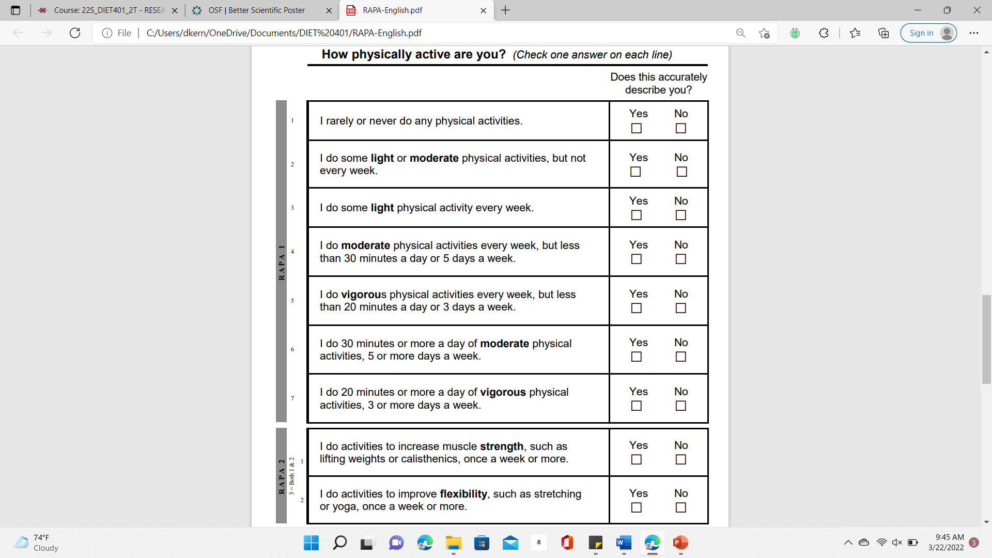
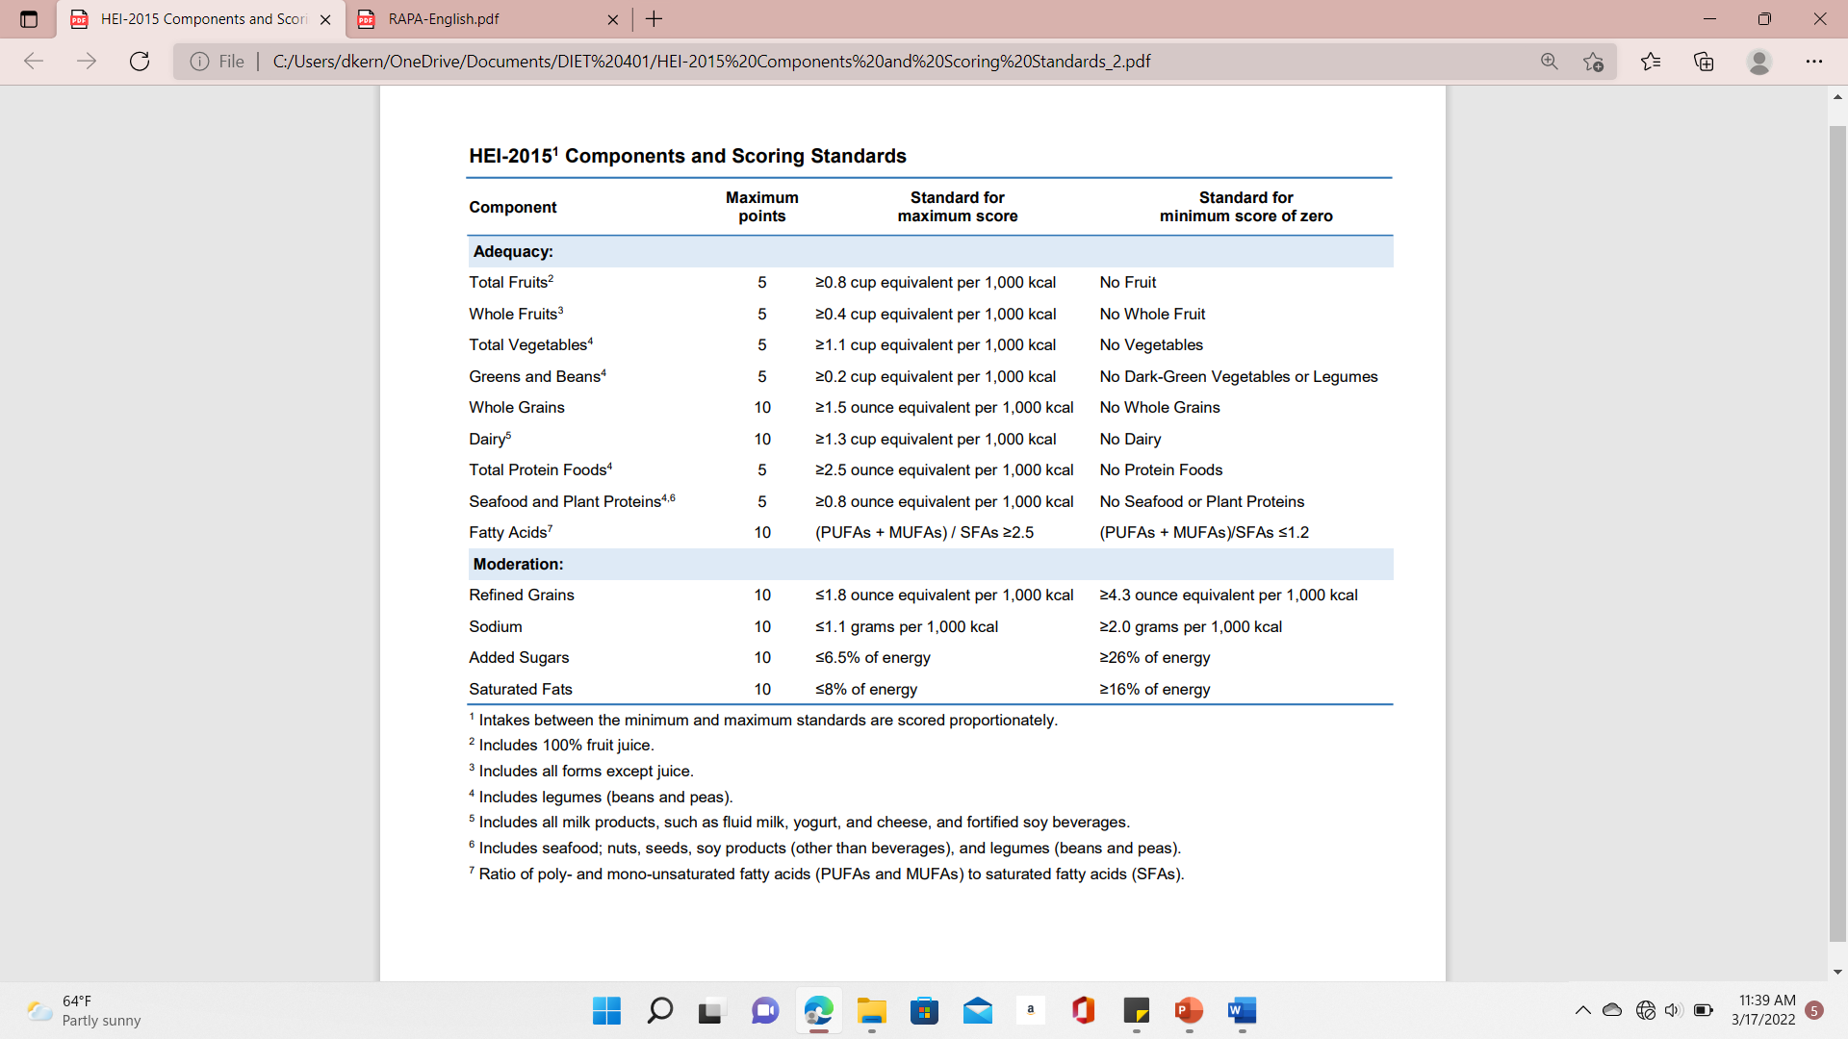
Diet Quality and Physical Activity Levels in Health and
Non-Health Majors
Desiree Kern
Nicholls State University-College of Sciences and Technology
Abstract
Materials
Results
Conclusion
Difference in study-focus of health and non-health majors may reveal a difference in the way these two sectors of college students view their health. A study assessing these differences can reveal a target population for improving health promotion, especially with the growing rates of overweight and obesity in this population.
The purpose of this study is to determine if health majors are more likely to have higher diet quality and physical activity levels than non-health majors.
The total sample size included two groups of 44 health majors and 54 non-health majors. The Healthy Eating Index (HEI) was used to assess the students’ diet quality and the Rapid Assessment of Physical Activity (RAPA) was used to assess physical activity levels.
On average, health majors HEI scores (M=40.9; SE=1.9) were higher than non-health majors (M=34.3; SE=1.6). This difference was significant (P<.013): t (96) = 2.543. There were no statistically significant differences in RAPA scores in correlation with major. However, there was a correlation with higher HEI scores having higher RAPA scores.
These results suggest that health majors are more likely to have higher diet quality than non-health majors.
RAPA Survey Statements
Health major HEI scores (M=40.9; SE=1.9) were higher than non-health major HEI scores (M=34.3; SE=1.6). This difference was significant (P<.013): t (96)=2.543.
No significant differences in RAPA scores in correlation with major.
Correlation with higher HEI scores having higher RAPA 1 scores (r=0.208, p=.04).
RAPA 1 and RAPA 2 has a slightly positive correlation (r=0.334, p=0.001).
The hypothesis of this research, that health related majors will have higher diet quality and physical activity levels compared to non-health majors, was supported by the results of the surveys’ scores.
Physical activity levels were not correlated with major. However, it was found that students with higher diet quality were more likely to have higher activity levels. Additionally, it is suggested from the results that those who participate in aerobic activities (RAPA 1) are more likely to do other forms of physical activity (RAPA 2).
This kind of research can benefit the field of dietetics in that it provides a basis for colleges and universities in understanding what influences the way their students promote self-health, such as their major, and implementations to improve health promotion of their students.
HEI Scoring Standards
References
Driskell JA, Kim Y.-N, Goebel KJ. Few differences found in the typical eating and physical activity habits of lower-level and upper-level university students. Journal of the American Dietetic Association. 2005;105(5):798-801.
Huang TT.-K, Kempf AM, Strother ML, Li C, Lee RE, Harris KJ, Kaur H. Overweight and components of the metabolic syndrome in college students. Diabetes Care. 2004;27(12):3000-30001.
Hailu GN, Gebru HB, Belay DS. Assessment of healthy diet and physical activity among students of Mekelle university, northern Ethiopia: a cross-sectional study. Nutrition and Dietary Supplements. 2019;2021(13):103-112.
Healthy eating index (HEI). Healthy Eating Index (HEI) | Food and Nutrition Service. https://www.fns.usda.gov/healthy-eating-index-hei. Published July 21, 2020. Accessed November 4, 2021.
Topolski TD, LoGerfo J, Patrick DL, Williams B, Walwick J, Patrick MB. The rapid assessment of physical activity (RAPA) among older adults. Preventing chronic disease. https://www.ncbi.nlm.nih.gov/pmc/articles/PMC1779282/. Published October 2006. Accessed November 4, 2021.
Introduction
Studies show that eating and physical activity habits of college students change over their college experience.¹ According to the National College Health Risk Behavior Survey, as many as 35% of college students are overweight or obese.² A study done between 2019 and 2020 found that college students had about 68% “poor” and 31% “good”, and 59% “poor” and 40% “good” diet and physical activity habits, respectively.³
Since health-related majors have more knowledge on promoting health, they may have better habits than those students not in non-health related majors.
A study that assesses these differences can provide a basis for universities in understanding what influences the way their students promote self-health and what they can implement to improve health promotion of their students.
Methodology
Each paper survey included a consent form, a 24-hour recall, and the RAPA survey.
Surveys were distributed in three small health classes and one large business class along with a complementary snack for all students who chose to participate.
Each survey was given a number and placed in an Excel document with two sheets: Health Majors and Non-Health Majors. The data was then coded according to major (1- health major, 2-non-health major), HEI score, RAPA 1 score (0- sedentary, 1- under-active, 2- underactive regular-light, 3- under-active regular, 4- active), and RAPA 2 score (1-statement one only, 2- statement two only, 3- both statements, and 0- neither statements).
Pearson’s correlation and t-tests were used to analyze the data for each group.
A t-test was run on the difference between majors for HEI scores due to the correlation.
Acknowledgements
Support from my professor, Dr. Brigett Scott, PhD, RD, LDN; and consent from the following professors for allowing me to distribute the paper surveys during class time: Eugene Gouaux; Barbara Blake, MAC, MS, CCC-SLP; and Elizabeth Sloan, MS, RD, LDN.

