Slide 1
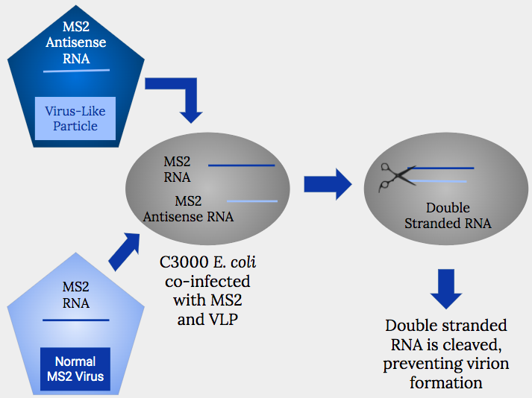
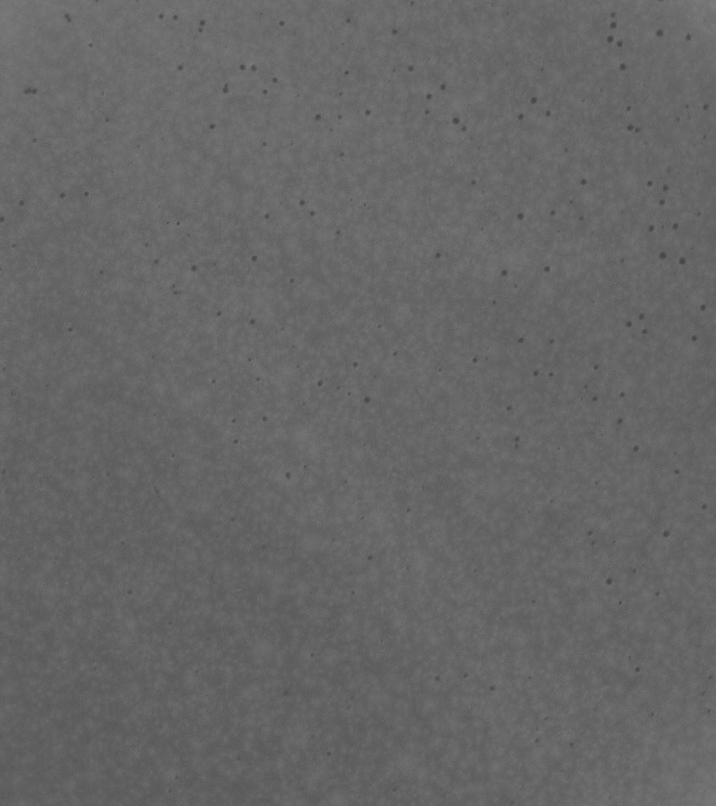
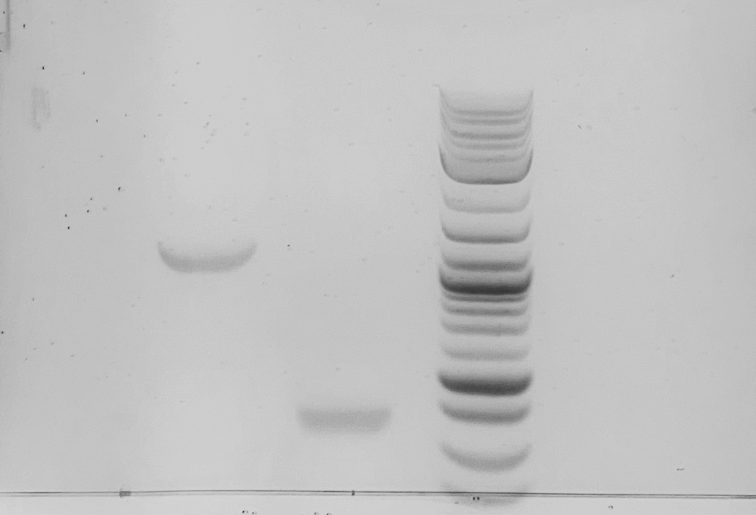
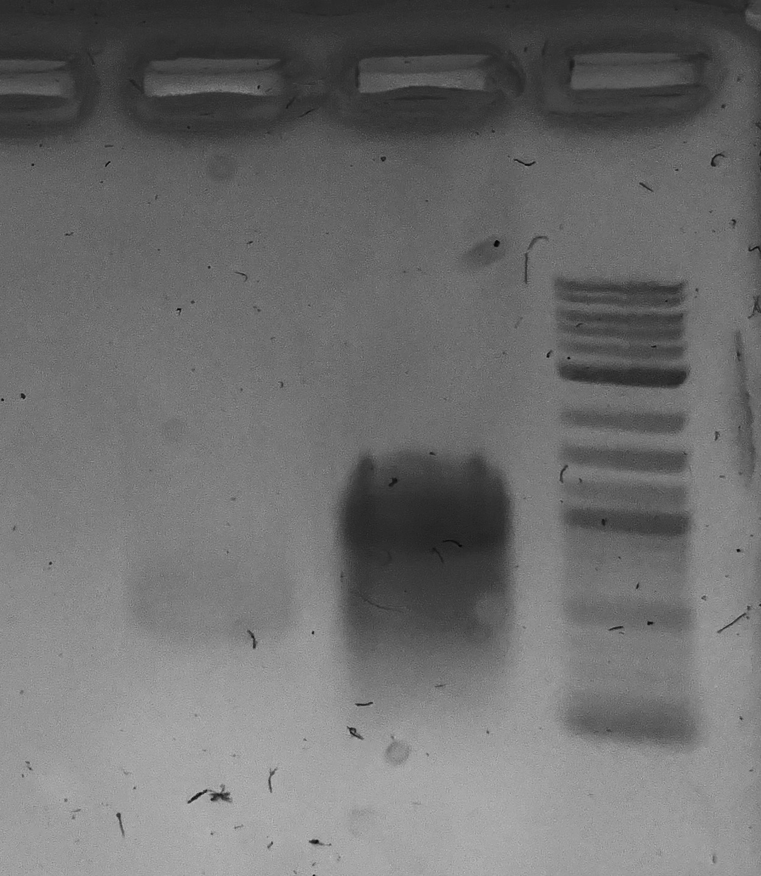
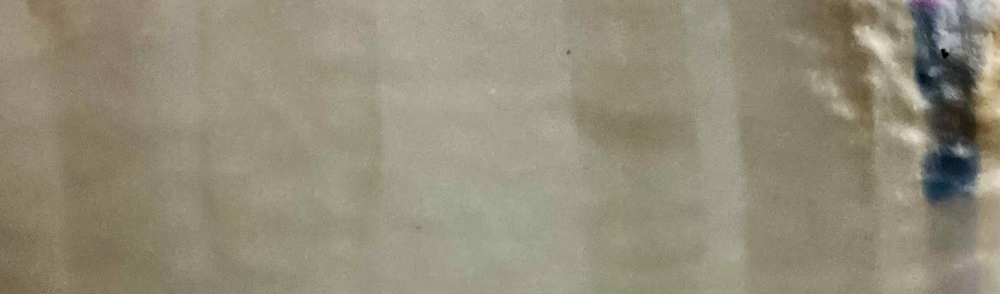
Transient Expression of MS2 Coat Protein and Maturase Genes in E. coli
Emily Danehower and Himanshu Raje
Department of Biological Sciences, Nicholls State University
Hypothesis
Results:
1kb DNA Ladder
1kb DNA Ladder
Maturase
Coat Protein
Coat Protein
Maturase
Random E. coli Extract
MS2 Supernatant
C3000 E. coli Transformation with MS2 CP and Mat genes
MS2 Phage infected C3000 E. coli
C. 3000 E. coli Protein Extract
Protein Ladder
1000 bp
50 kDa
500 bp
37 kDa
Figure 4: Western Blot Using Anti-MS2 Coat Protein Antibody
Figure 1: Plaque Assay- Verify Infectivity of MS2 Phage
Figure 2: Agarose Gel- Purified Coat Protein and Maturase DNA
Figure 3: RNA Gel- In Vitro Transcription RNA Products
Coat Protein Primers
  Forward:TAATACGACTCACTATAGgtgcgagcttttagtacccttgata
  Reverse:tctatctagagagccgttgcctgat
Maturase Primers
  Forward:TAATACGACTCACTATAGatggcttctaactttactcagttcgt
  Reverse:ttagtagatgccggagtttgctgcg
Methods
Plaque Assay
Determination of MS2 Phage Integrity
Progress
Determined that MS2 Phage can infect E. coli cells
Amplified MS2 Coat Protein and Maturase Genes
Transcribed Coat Protein and Maturase RNAs separately
Detected MS2 Coat Protein on a Western Blot
Agarose Gel Electrophoresis
Confirmation of PCR Amplification of Coat Protein and Maturase Genes
Gel Extraction
Gel Purification of Coat Protein and Maturase Genes
Moving Forward
Repeat Western Blot
Perform Electron Microscopy to Show Capsid Formation
Package Antisense RNA inside Capsids
Plaque Assay to Observe the Effect of the VLP on Plaque Formation
In Vitro Transcription
Obtain RNA Samples From Purified MS2 Maturase and Coat Protein DNA
RNA Gel Electrophoresis
Confirmation of RNA Gene Products
Resources
Orenstein, W. A., & Ahmed, R. (2017). Simply put: Vaccination saves lives. Proceedings of the National Academy of Sciences of the United States of America, 114(16), 4031–4033. https://doi.org/10.1073/pnas.1704507114
Ruggiero G, Utili R. Utilità e limiti della vaccinazione anti-influenzale [Usefulness and limitations of vaccination against influenza]. Recenti Prog Med. 1992 Jun;83(6):337-40. Italian. PMID: 1496181.
LiverTox: Clinical and Research Information on Drug-Induced Liver Injury [Internet]. Bethesda (MD): National Institute of Diabetes and Digestive and Kidney Diseases; 2012-. Valacyclovir. [Updated 2020 Oct 20]. Available from: https://www.ncbi.nlm.nih.gov/books/NBK548655/
Bacterial Transduction
Determination of Bacterial Translation of MS2 Phage Genes
Acknowledgements
Western Blot
Confirmation of Gene Expression
Dr. Angela Corbin
Dr.Rajkumar Nathaniel
Dr. Ramaraj Boopathy

