Slide 1


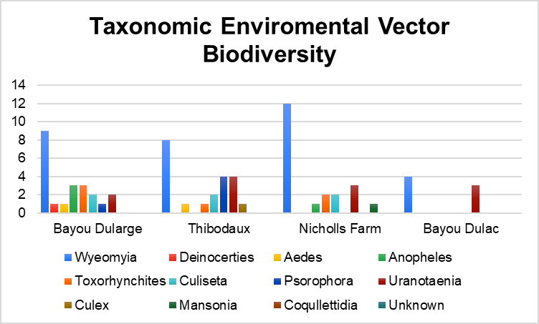
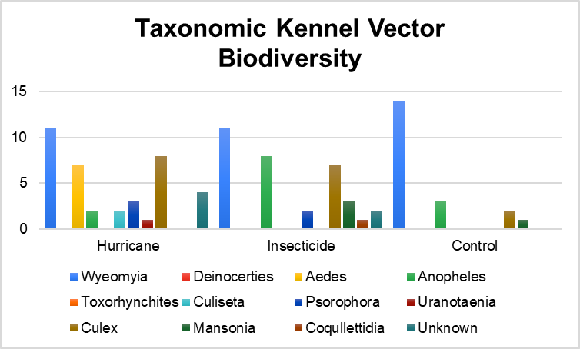

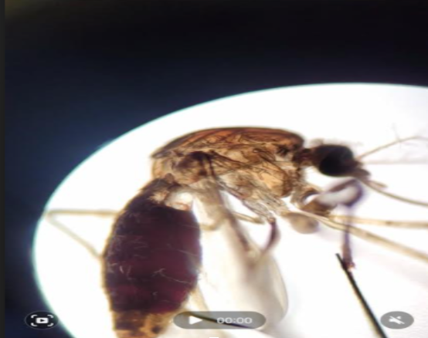

Characterization of Mosquito Diversity in Southeast Louisiana
Faith Boutte, Connor Lee and Justine Whitaker
Nicholls State University
fboutte@nicholls.edu
Introduction
- Few samples were collected from Bayou Dulac
- Bayou Dularge has the most biodiversity
Mosquitos are vectors for disease-causing parasites.
Heartworm disease is a canine illness caused by capillary wall abrasions due to Dirofilaria spp. growth and movement.
Previous studies have shown that weather, climate, and competition affect vector fecundity (Moise et al 2018).
Other studies analyzed the emergence of varied Dirofilaria species and determined vector diversity and competence. (Mckay et al 2013, Alsarraf et al. 2021)
Many studies test for mircofilaria with mosquito head and thorax, but there is a lack of studies sampling the whole mosquito(Watts et al. 2001).
There is a limited pool of comprehensive studies concerning Dirofilaria spp. and vector trends
Figure 1. Distribution of genera from four locations sampled in September 2019.
Figure 2. Distribution of genera sampled from a local dog kennel after Hurricane Ida and insecticide use.
- The kennel population was most biodiverse after the hurricane, and least outside of spawning season (control)
Estimate mosquito population diversity in southeast Louisiana ecosystems.
Culex spp. with blood meal
Wyeomyia spp. had the highest overall abundance
Taxonomic Identification
US & Alaska Mosquito Genera Key
Nikon Eclipse 2200 microscope
Discussion
Increased temperatures and pooled water sources after a hurricane may increase vector diversity.
Increased use of insecticide spray appears to decrease vector diversity.
Currently amplifying an 800 bp region of the cytochrome oxidase I (COI) gene to identify samples to the species level. PCR product will be Sanger sequenced.
DNA Extraction
QIAGEN QIAamp Fast DNA Stool Mini Kit ®
Thermo Fisher Scientific NanoDrop 1000 Spectrometer
References
Watts, K. J., Reddy, G. R., Holmes, R. A., Lok, J. B., Knight, D. H., Smith, G., & Courtney, C. H. (2001). Seasonal prevalence of third-stage larvae ofdirofilaria immitisin mosquitoes from Florida and Louisiana. Journal of Parasitology, 87(2), 322–329. https://doi.org/10.1645/0022-3395(2001)087[0322:spotsl]2.0.co;2
Moise, I. K., Riegel, C., & Muturi, E. J. (2018). Environmental and social-demographic predictors of the southern house Mosquito Culex quinquefasciatus in New Orleans, Louisiana. Parasites & Vectors, 11(1). https://doi.org/10.1186/s13071-018-2833-5
Mckay, T., Bianco, T., Rhodes, L., & Barnett, S. (2013). Prevalence of Dirofilaria immitis (Nematoda: Filarioidea) in mosquitoes from northeast Arkansas, the United States. Journal of Medical Entomology, 50(4), 871–878. https://doi.org/10.1603/me12197
Alsarraf, M., Levytska, V., Mierzejewska, E. J., Poliukhovych, V., Rodo, A., Alsarraf, M., Kavalevich, D., Dwużnik-Szarek, D., Behnke, J. M., & Bajer, A. (2021). Emerging risk of dirofilaria spp. infection in northeastern Europe: High prevalence of dirofilaria repens in sled dog kennels from the Baltic countries. Scientific Reports, 11(1). https://doi.org/10.1038/s41598-020-80208-1

