Slide 1
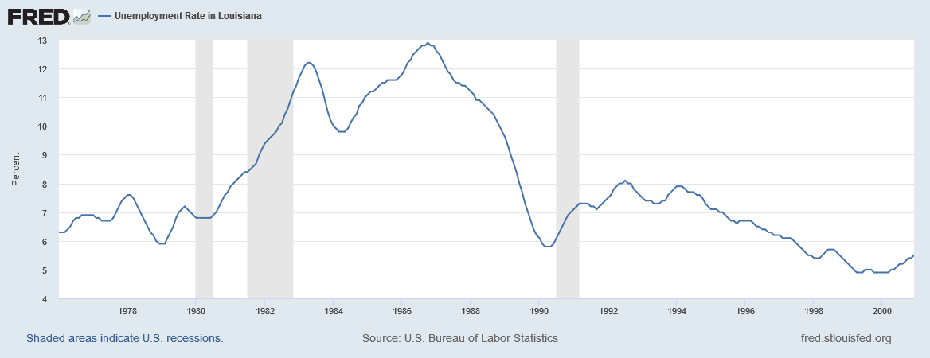

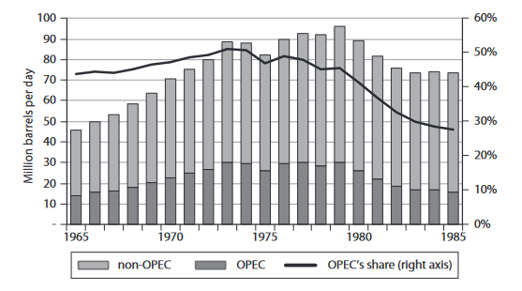
How the Global Oil Glut of the 1980s Affected Louisiana
Gabrielle Evans, Undergraduate of Multinational Business Administration
INTRODUCTION
BAYOU REGION IMPACTS: WHAT HAPPENED TO THE PEOPLE?
CONCLUSION
Louisiana has always been a place of crude oil production, the coast dotted with oil rigs and families supported by those rigs. Because of this, it’s no surprise that when the world suffers an oil bust, or a glut, the effect is felt heavily in the region. In the 1980s, a mixture of new oil companies selling oil for less, decreased demand, and continued high production brought the Louisiana oil business to its knees. This poster explores the roots of the international oil glut and the specific impacts to the state and, specifically, the Bayou Region. Internationally, the world recoiled as the oil boom turned to a resounding bust, as other nations flooded the market. Slashed oil prices damaged communities, which saw mass out-migration, and families who lost income.
In the 1970s, working in the oil field was something a lot of young men would do as soon as they graduated high school (Austin & McGuire, 2002). These young men knew that there was always a need for more rig workers and boat attendants, so that was a good and easy solution. This all turned when the 1980s rolled around, as the oil fields were taking hits, companies downsized and went bankrupt, leaving many out of work and without a higher education to fall back on to get a new job (Austin & McGuire, 2002). Most had no idea that such a huge bust was coming. The change was sudden and crippling. In his oral history, oilfield worker Ronald Callais said:
  “It just blindsided us. Nobody expected that. […] And what we did is we all sat back. We kept crew. We made financial expenditures that looking back on we should have never done. But we thought it was temporary (Austin & McGuire, 2002).”
When the oil jobs collapsed, it rocked the whole economy:
  “Katie was at work at her new temp job at the local hospital. Katie came over later that day, bragging about how her job might become permanent. A week later she had lost the job (Austin & McGuire, 2002).”
With such sudden changes to the economy, there was no way for the locals to respond in time. This led to mass migrations from Louisiana. In Figure 1, Maruggi and Wartenberg (1996) break down migration from 1870-1990, and show a huge spike of departures in the 1980s.
Even after oil production slowed and prices stabilized, many no longer trusted the oil field. Many parents thought that the instability of the oil field, as well as the lost family time, was not worth it in the long run (Austin & McGuire, 2002).
The trauma of this glut reaches as far as my own family today. Of the men in my family that decided to go into the oil field – one of my grandfathers, my uncle, and my father – most of them had little love for the companies. They had a learned distrust. I did not experience the glut of the 1980s, I did experience a glut in 2010, which affected my family personally. My father was called away from our family multiple times to help with wench work even though he had long since climbed to an office job at Oil States. We experienced more financial trouble in the time after the glut as well.
The oil of glut of the 1980s is a part of history that has left a scar on Louisiana. For years to come, parents will still worry that their children may decide to go into the oil field, and that they will experience a downturn like the 1980s. This type of job insecurity, even with all the positives that the job can bring – like high wages and time off – is not often worth giving up time with family and experiencing stress. Oil is a boom-bust industry, and as it now operates, people around the world have to worry not only about where they get their oil from but also whether prices will change at the drop of a hat.
In sum, Louisiana has seen many booms and busts over the years, but one of the worst was the glut of the 1980s. While the wounds of past years have healed, many families in Louisiana will be slow to trust oil companies that want their work. As time and technology progresses, so will the hope that one day signing a contract with an oil company will not mean signing yourself up for insecurity.
Oil may be a Louisiana business, but it’s an international industry. What happens in the world, is felt on every bayou.
HOW THE GLUT HAPPENED
In the 1970s, the oil industry was booming all around the world. At the time, the world’s oil supply was largely controlled by a conglomerate called OPEC, which consisted of oil-rich countries in the middle east. Oil prices were high at the time, with increases on the way by OPEC even as demand for gas decreased due to the high prices (McNally, 2017). The result was that people simply couldn’t afford to do things that used gas or oil, and demand dropped as consumers turned to other sources of energy. But OPEC kept production consistent. This caused an overabundance of oil within OPEC warehouses, the beginning of a glut (McNally, 2017). Concurrently, other oil providers – new oil companies in the United Kingdom and Norway, for example – also were beginning to produce enough oil to compete with OPEC (McNally, 2017). And Louisiana oil fields continued producing at the same rate. The result was that the Louisiana oil fields only added to the growing stores of oil, all accumulating into a glut (Austin & McGuire, 2002). When all that oil hit the market, along with OPEC’s high production– see Figure 1 to note how oil production increased across the board in the 1980s – the bubble popped, and with it so did Louisiana’s decade or so of prosperity. There were mass layoffs (See Figure 2). Many local companies implemented schemes to have their workers rotate to keep costs down, and the unemployment rate was the highest it had ever been in the state, at 13.2% (Austin & McGuire, 2002). As people struggled to find work in Louisiana, the state saw mass out-migration (See Figure 3), Louisiana losing more people in the 1980s than in any decade since the Civil War. After all, not all families could survive when there were not enough jobs to go around.
Figure 2: Louisiana’s Unemployment Rate from 1976-2000
Source: U.S. Bureau of Labor Statistics
Source: Shutterstock
REFERENCES
Figure 1: OPEC’s Share of Global Oil Production
Source: McNally, 2017
Austin, D. and T. McGuire, principal investigators. (2002). Social and economic impacts of Outer Continental Shelf Activities on Individuals and Families. Volume 2: Case studies of Morgan City and New Iberia, Louisiana. Prepared by the University of Arizona, Bureau of Applied Research in Anthropology, Tucson. U.S. Department of the Interior, Minerals Management Service, Gulf of Mexico Region, New Orleans, LA. OCS Study MMS 2002-023. 197 pp.
McNally, R. (2017). Crude Volatility : The History and the Future of Boom-Bust Oil Prices. Columbia University Press.
Maruggi, V. and C. R. Wartenberg. (1996). Louisiana net migration, 1980-1990 : the oil bust reflected. Division of Business and Economic Research, College of Business Administration, University of New Orleans.
McGuire, T. (2008). History of the offshore oil and gas industry in southern Louisiana. Volume II: Bayou Lafourche – Oral histories of the oil and gas industry. U.S. Dept. of the Interior, Minerals Management Service, Gulf of Mexico OCS Region, New Orleans, LA. OCS Study MMS 2008-043. 177 p

