Slide 1
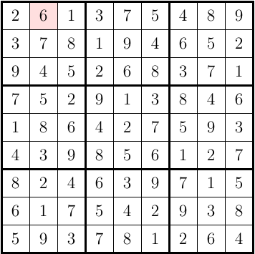
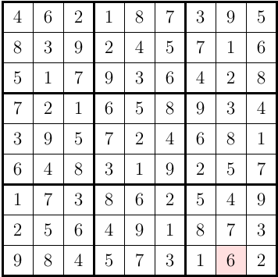
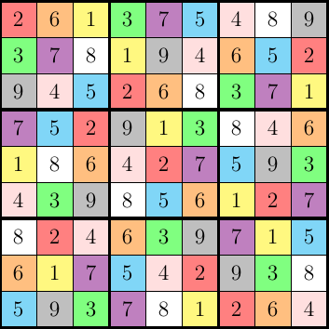
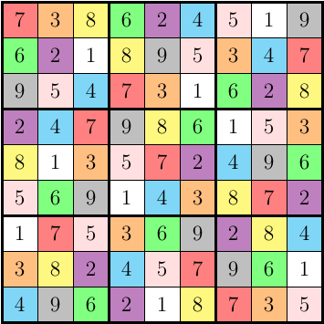
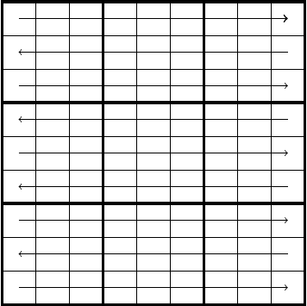
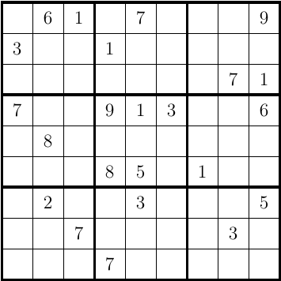
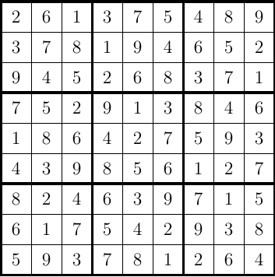
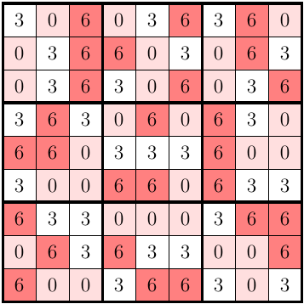

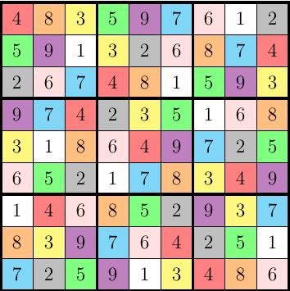

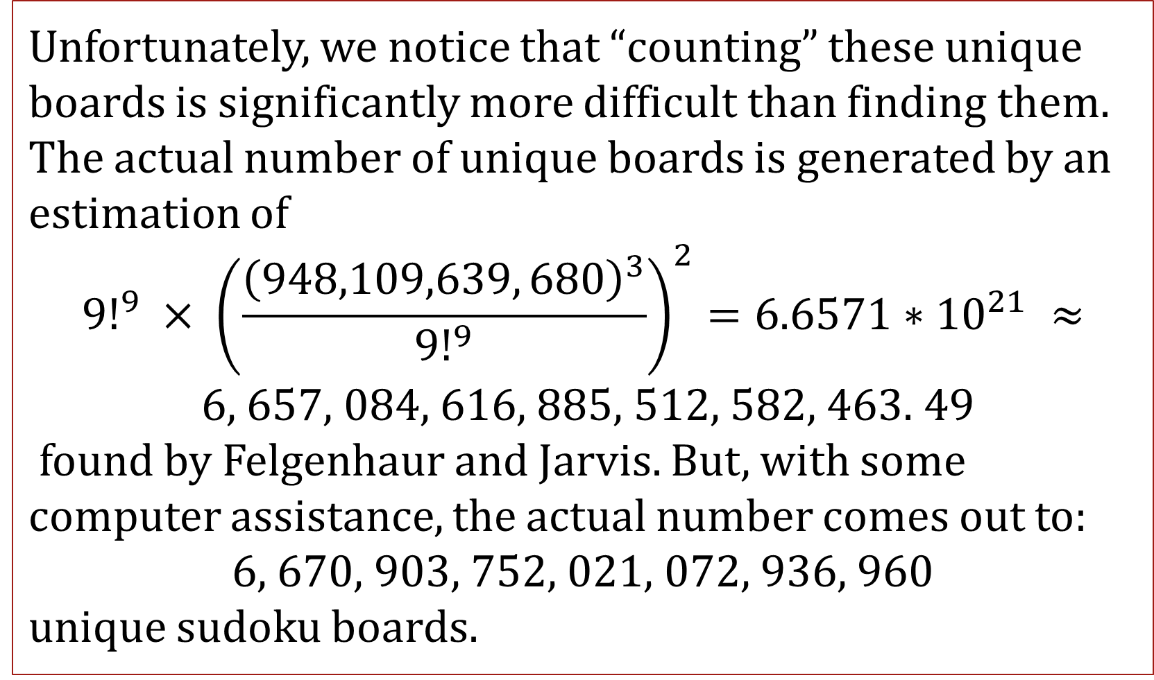
An Earnest Consideration of Sudoku and Other Frivolous Pursuits
Gillian Poe, B.S. Mathematics Candidate
Mathematics Department, College of Sciences and Technology, Nicholls State University
Introduction
Board flipped 180 degrees.
Similarly, this idea may also be applied using multiplication.
Game 3: Hamiltonian Cycles
The goal of this research is to explore mathematical thinking and ideas through the lens of Sudoku. Mathematical thinking is characterized by taking a question, collecting known facts, and reformatting it to reach a conclusion. In this research, we will play three “games” that model the mathematical method of discovery.
Transformation created by distributing in an 8 (mod 9)
Goal of our last game: to reduce creating new boards to a Hamiltonian Cycle problem. To do this, Haythorpe programmed a computer to systematically calculate a value to fill each empty cell while traversing from left to right in a snake-like pattern.
Note: The original board could have been “rolled” on its other sides or flipped along the opposing diagonal.
Pathway of Haythorpe’s program for filling in empty Sudoku boards.
Game 1: Traditional Sudoku
In traditional Sudoku, the player’s goal is to use the numbers 1-9 in every row, column, and box with no repeating values.
We use this method to create 5 new boards from the original cell configuration.
Method 2: Modular Arithmetic
However, the player is limited to those values which create a bijection so that each value has a unique place mod 9. In other words, the player must not select values which are not relatively prime to 9 to distribute into the board. The following figure uses 3 to demonstrate the dangers of doing so.
Example of starting board configuration & solution.
A traditional Hamiltonian cycle is characterized by some sort of shape which starts at a vertex, or point, and travels along each vertex exactly once.
Although a mere swapping of all of one numeric value with another numeric value will produce a unique board. In fact, from one unique board, 9! new boards may be created by swapping one or more values. Unfortunately, this becomes increasingly difficult to keep track of , thus we search for more systematic ways to do these “swaps.” For the following techniques, we assume that our modulus is 9.
Example of a Hamiltonian Cycle
A
B
E
Game 2: New Boards from Old
Addition of two to each original value in cells to produce a new board.
C
(one potential path in red)
Goal: to count the number of unique boards from existing solutions.
To accomplish this, we will employ a number of techniques from intuitive attempts to more advanced methods.
D
Takeaway:
Method 3: Estimation/Computers
Mathematics is about exploring ideas creatively rather than predefined steps. Each method we explored is a valid way to approach our conclusion, but there is not exactly one “best” way because all lead to new mathematical insights.
Unfortunately, we notice that “counting” these unique boards is significantly more difficult than finding them. The actual number of unique boards is generated by an estimation of
$${9!}^{9} × {\left(\frac{{\left(948,109,639, 680\right)}^{3}}{{9!}^{9}}\right)}^{2}=6.6571∗{10}^{21} ≈$$
$6$, 657, 084, 616, 885, 512, 582, 463. 49
found by Felgenhaur and Jarvis. But, with some computer assistance, the actual number comes out to:
6, 670, 903, 752, 021, 072, 936, 960
unique sudoku boards.
Method 1: Flips
Notice that by defining a unique board to be that which holds a different numeric value in at least one cell, then we can achieve unique boards by changing the orientation of the board.
This additive method creates 8 of these 9! potential boards from one existing board.
Contact
References:
Haythorpe, Michael. “Reducing The generalized Sudoku Problem to the Hamiltonian Cycle
Problem” AKEC International Journal of Graphs and Combinatorics. 2016.
Jason Rosenhouse, and Laura Taalman. Taking Sudoku Seriously : The Math Behind the
World’s Most Popular Pencil Puzzle. Oxford University Press, 2011. EBSCOhost, search.ebscohost.com/login.aspx?direct=true&AuthType=ip,cookie,url,uid&db=nlebk&AN=414056&site=eds-live&scope=site.
Lockhart, Paul. “Mathematician's Lament.” Mathematical Association of America, Mathematical Association of America, https://www.maa.org/sites/default/files/pdf/devlin/LockhartsLament.pdf.
Zyga, L., Newton, P., & DeSalvo, S. (2010, February 13). Discovery could lead to more difficult Sudoku puzzles. Phys.org. Retrieved March 3, 2022, from https://phys.org/news/2010-02-discovery-difficult-sudoku-puzzles.html
Gillian Poe
gpoe@nicholls.edu
Advanced Mathematics Major

