Slide 1

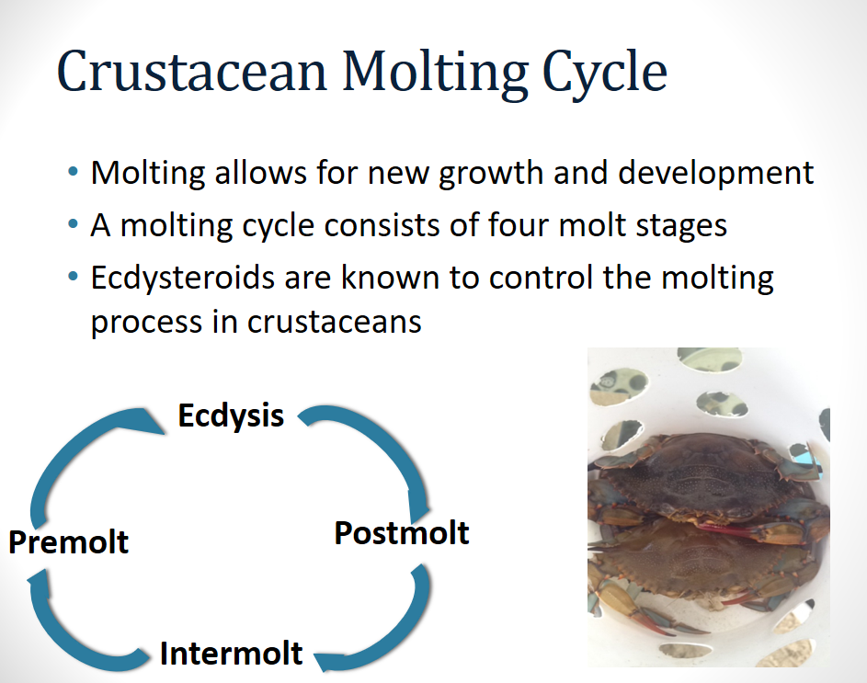
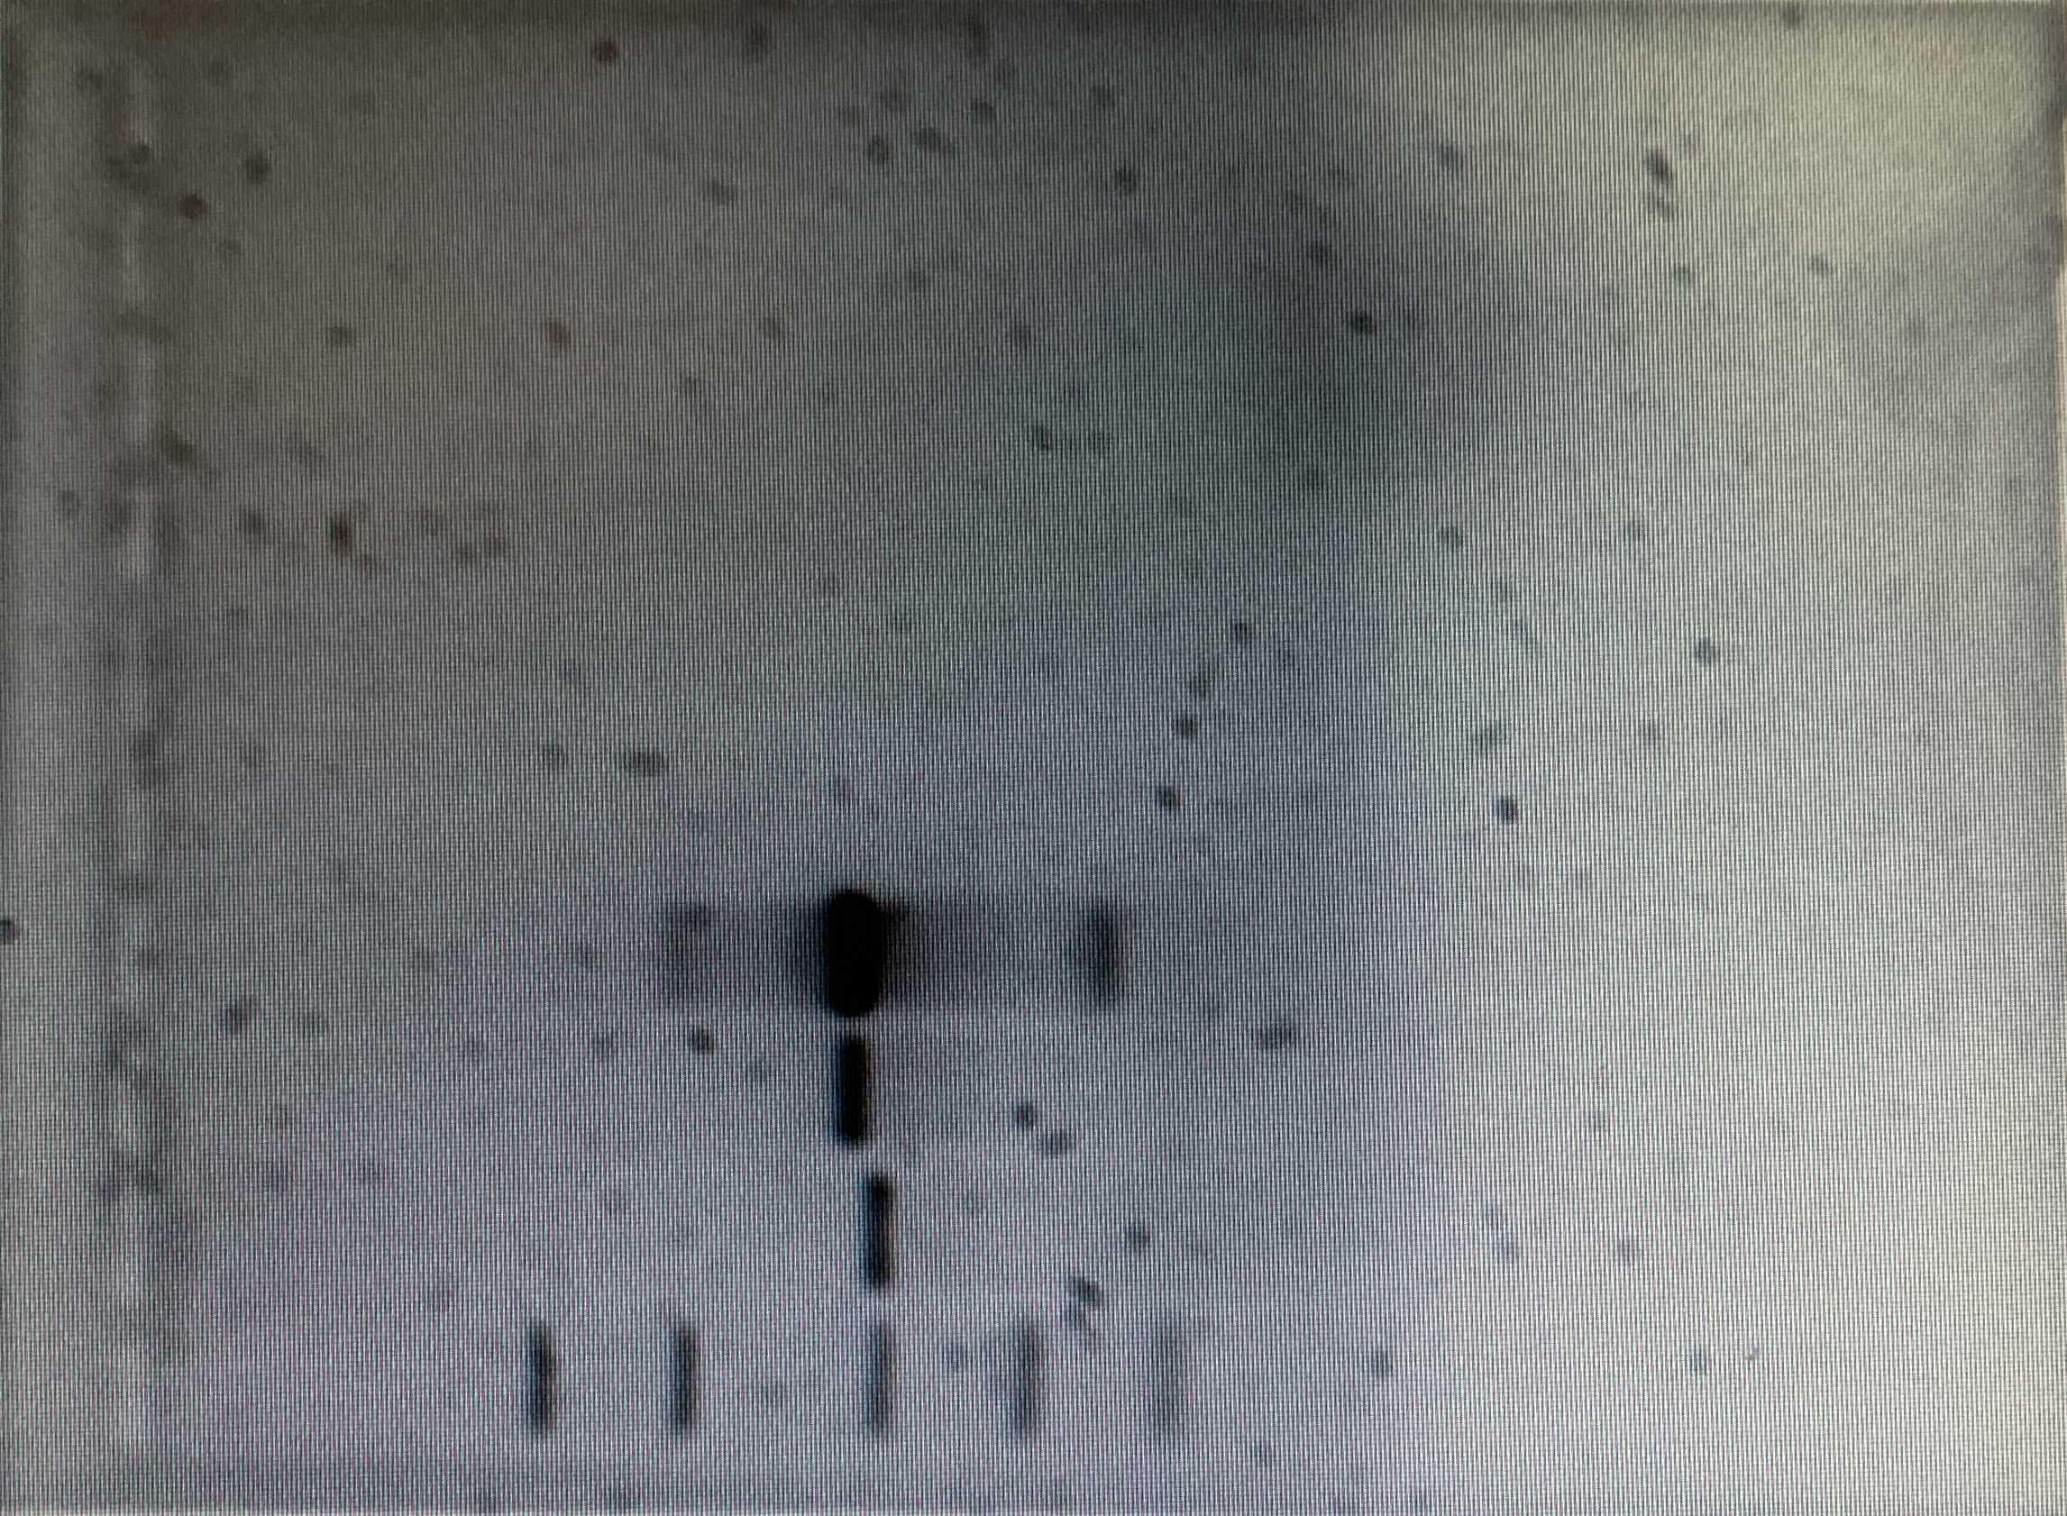
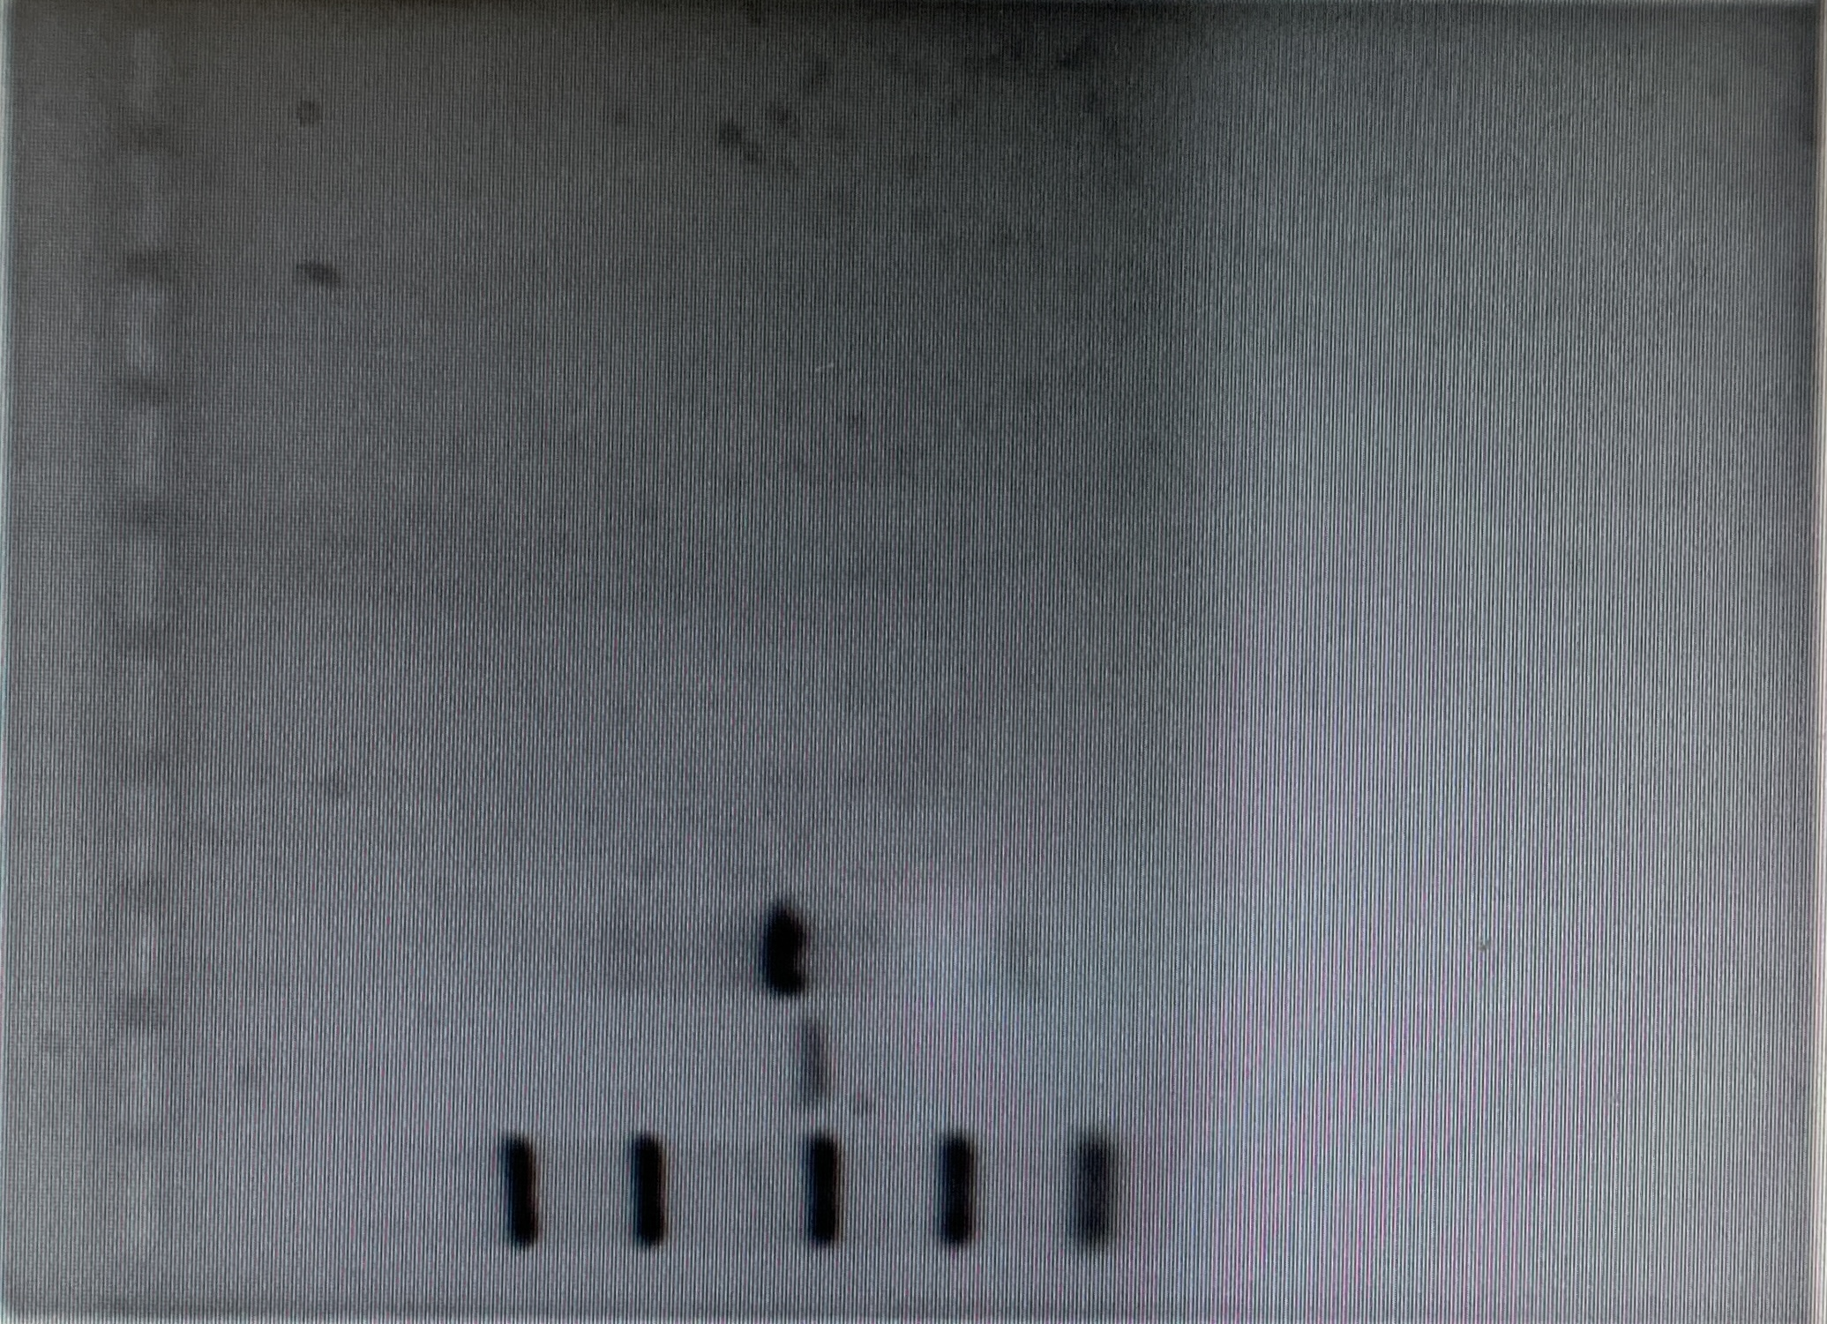
Synthesis of Double-Stranded RNA Targeting Bursicon Expression in the Blue Crab, Callinectes sapidus
Jacob P. Hagen, Enmin Zou
Abstract
In order for growth and development to occur, crustaceans must periodically shed their confining exoskeleton in a process called molting or ecdysis. The newly molted specimen is covered by a soft shell that must harden speedily. Shell-hardening in Crustacea consists of sclerotization and mineralization. While there is evidence that crustacean sclerotization is controlled by the neurohormone bursicon, it remains unknown as to which hormone regulates exoskeletal mineralization post-ecdysis. This project is examining the role of bursicon in post-ecdysial shell calcification using the blue crab, Callinectes sapidus, as the model crustacean. The blue crab bursicon or CasBurs is made up of α and β subunits (Chung et al., 2012). Templates for CasBurs α dsRNAs has been generated based on cDNA sequences encoding these two subunits (EU67719, GenBank), and CasBurs dsRNA successfully synthesized. The synthesized dsRNA for CasBurs will be injected to soft shell blue crabs to knock down the expression of bursicon gene through the RNAi mechanism. Ultimately, this project will result in a definitive answer to whether bursicon is the hormone that governs the process of post-ecdysial mineralization.
Background
Crustaceans shed their exoskeleton numerous times during their lives through the process of ecdysis, commonly known as molting. Ecdysis allows the crustacean to grow and develop, which is not possible unless the confining exoskeleton can be escaped. The molting cycle is comprised of 4 stages: postmolt, intermolt, premolt, and ecdysis. The process is regulated by molting hormones called ecdysteroids, which are secreted by the Y-organ. The Y-organ is regulated by the molt-inhibiting hormone (MIH), which is produced by the X-organ sinus gland complex in the eyestalk (Zou, 2020). The ecdysteroids are received by their receptor called the ecdysteroid receptor (EcR). Upon receptor dimerization with crustacean retinoid X receptor (RXR), this complex binds to its response element which mediates gene expression under the control of molting hormones (Durica and Hopkins, 1996; Chung et al., 1998). Once the old exoskeleton is shed, the crustacean is surrounded by a soft exoskeleton that makes the animal especially susceptible to predation and pathogens. The soft shell must rapidly harden to close this window of vulnerability.
Figure 1. Molting cycle of the model organism Callinectes sapidus, the Blue Crab
Results
Objective
Synthesis of dsRNA targeting the blue crab bursicon gene expression.
Total runs | Avg. Concentration CasBurs α dsRNA (µg/µL) | Total quantity CasBurs α dsRNAs (µg)
12 | .01325 | 10.789
Methodology
The blue crab bursicon, or CasBurs is made up of α and β subunits (Chung et al., 2012). Templates for CasBurs α dsRNAs has been generated based on cDNA sequences encoding these two subunits (EU67719, GenBank), and CasBurs dsRNA successfully synthesized. The synthesized dsRNA for CasBurs will be injected to soft shell blue crabs to knock down the expression of bursicon gene through the RNAi mechanism.
Figure 2. Data from dsRNA synthesis
Prospective experimental design
Late pre-molt blue crabs, or busters, will be individually placed in cages in aerated tanks filled with recirculating artificial seawater in a greenhouse at an ambient temperature and a natural photoperiod, approximately 14 hr light/10 hr dark. Artificial seawater will be made from the Instant Ocean sea salt and adjusted to a salinity of 10 - 12 ppt. Crabs in late post-molt or 24 hours after ecdysis will be used for dsRNA injection with a dosage of 0.02 µg/g. At day 4, survivors will be sacrificed for collection of carapaces and subjected to metal analysis.
References
Chung, A. C.-K., Durica, D. S., Clifton, S. W., Roe, B. A., & Hopkins, P. M. (1998). Cloning of crustacean ecdysteroid receptor and retinoid-X receptor gene homologs and elevation of retinoid-X receptor mRNA by retinoic acid. Molecular and Cellular Endocrinology, 139(1–2), 209–227.
Chung, J. S., Katayama, H., &amp; Dircksen, H. (2012). New Functions of Arthropod Bursicon: Inducing Deposition and Thickening of New Cuticle and Hemocyte Granulation in the Blue Crab, Callinectes sapidus. PLoS ONE, 7(9), e46299.
Durica, D. S., & Hopkins, P. M. (1996). Expression of the genes encoding the ecdysteroid and retinoid receptors in regenerating limb tissues from fiddler crab, Uca pugilator. Gene, 171(2), 237-241.
Zou, E. (2020). Invisible endocrine disruption and its mechanisms: A current review. General and Comparative Endocrinology, 293, 113470.
Figure 3. Casburs α cDNA electrophoresis showing 400bp sample near predicted size alongside cDNA samples in lanes 3 and 4. The samples in lanes 3 and 4 were used to synthesize Casburs α dsRNA.
Figure 4. Casburs α electrophoresis results showing Casburs α dsRNA sample alongside DNA sample near the predicted size of 400bp.
Acknowledgements
This project was supported by the Louisiana Sea Grant Undergraduate Research Opportunity Program.

