Slide 1

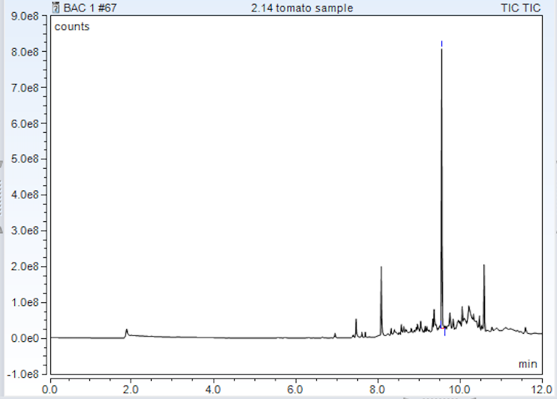
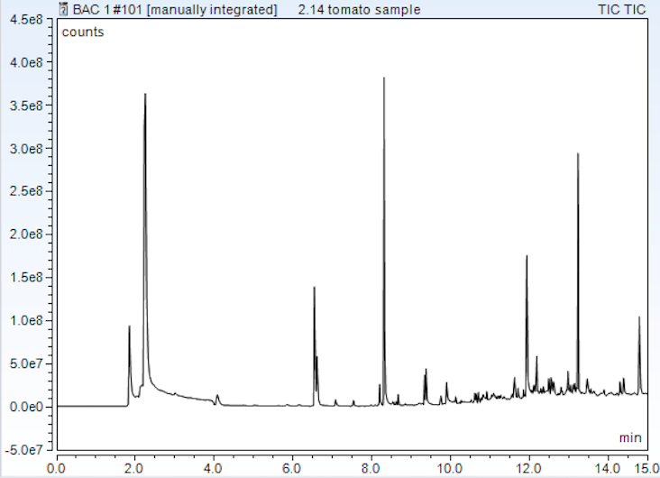
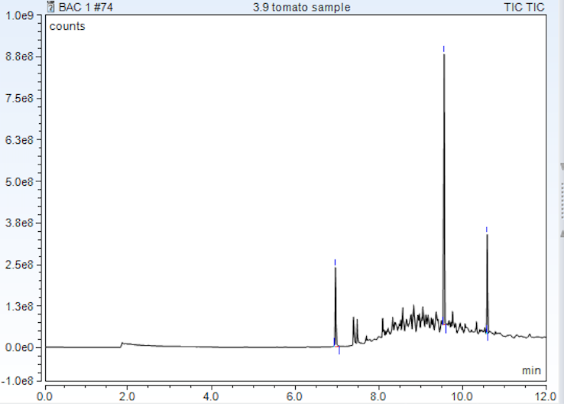
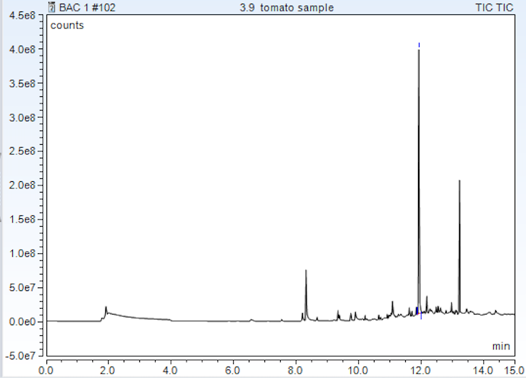
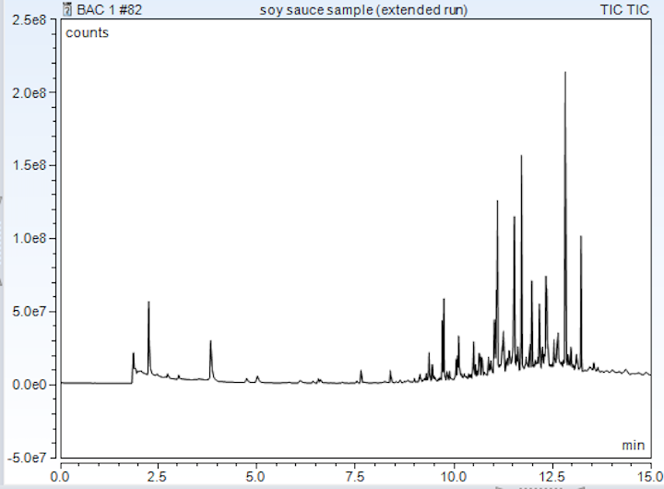
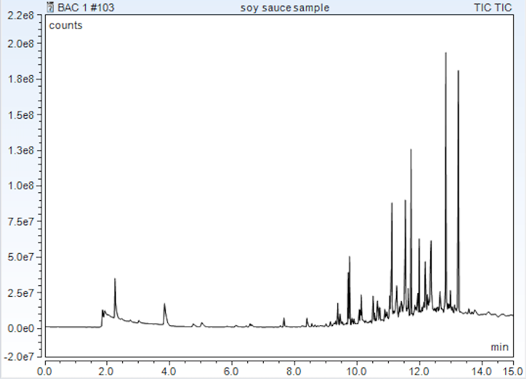
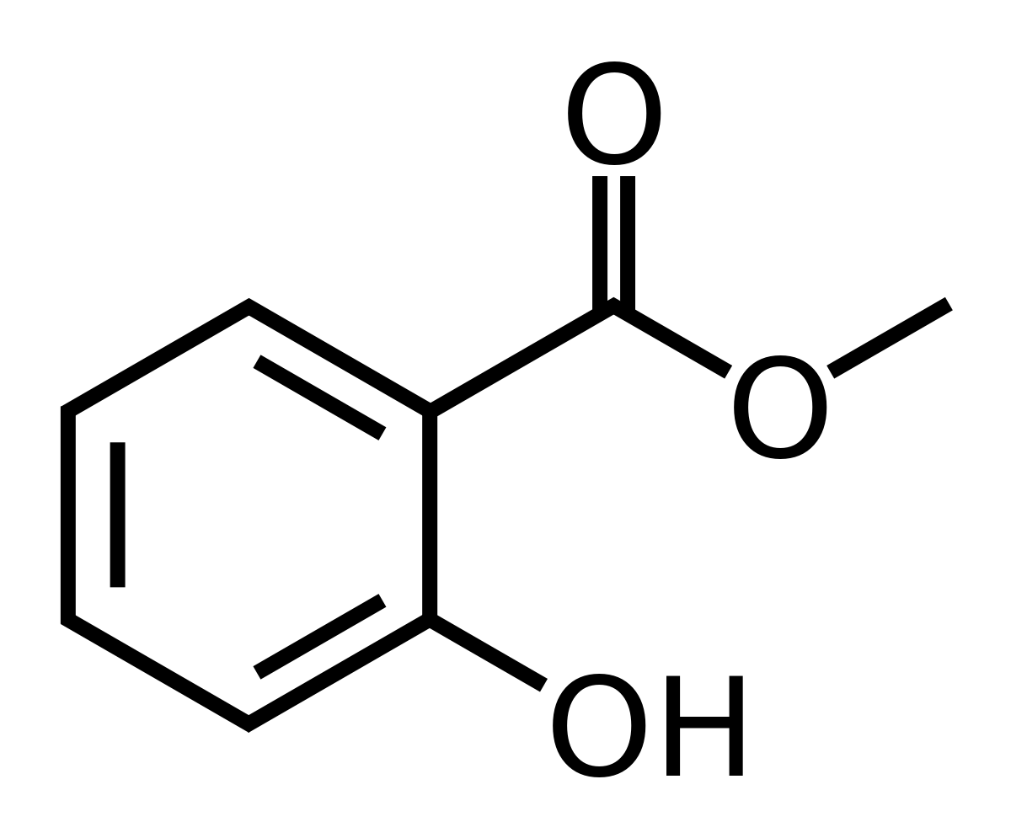
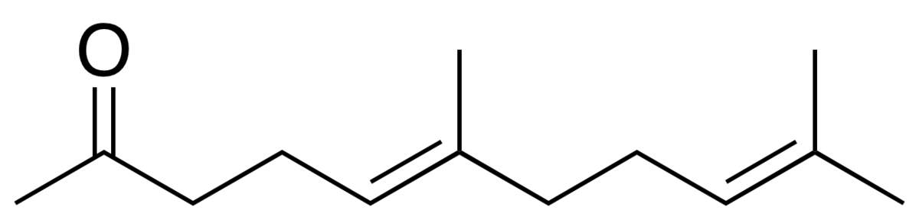



Using Chemical Analysis to Monitor The Shelf-Life of Food Products
Jannise, J. and Wayment, D.G.
Nicholls State University, Department of Physical Sciences, Post Office Box 2022, Thibodaux, LA 70310
Introduction:
Shelf-life expectancy is an important aspect when it comes to food products. It is what keeps consumers safe from ingesting old and expired foods. An accurate shelf-life is essential for these products in order to avoid people getting sick. When it comes to testing shelf-life, the four main categories to look at include physical, chemical, biochemical, and microbiological. Chemical analysis methods used in this project include UV-Vis spectroscopy, pH, and SPME-GC/MS. Changes in color, pH, and composition of a sample can indicate its degradation.
Objectives
To determine what compound is causing the degradation of the product.
To determine the approximant shelf-life of various food products
Results:
Ethanol
Trans-Geranyl Acetone
$$→$$
$$↓$$
Methyl Salicylate
$$→$$
Figure 1
Chemicals of interest labeled where they appear on the chromatogram
Figure 2
GC/MS chromatogram of 2/14 tomato sample from day 0 (left) and day 37(right).
The presence of Geranyl Acetone in any form results from the degradation of vegetable matter.
  Results in a sweet, floral, estery smell.
Methyl Salicylate concentration increases as the ripening process continues.
  Minty aroma, one of the only natural sources of methyl salicylate
Slight fluctuation in pH: ranges from 3.70 to 4.35
Absorbance peak at 259nm increased
Ethanol production shown in Figure 1 (right): large peak at ~2 minutes
Mold on 2/14 tomato sample appeared around day 21, but only in sample contained in glass
Figure 3
GC/MS chromatogram of 3/9 tomato sample from day 0 (left) to day 14 (right)
Chemical Structures:
Methyl Salicylate
Trans-Geranyl Acetone
Figure 4
GC/MS chromatogram of soy sauce alternative from day 0 (left) to day 12 (right)
Experimental:
Red Beefsteak tomatoes were cut and homogenized using mortar and pestle. Soy sauce alternative was acquired through the company, VegiWOW.
Two tomato samples were cut and homogenized on different days, February 14th and March 9th, so the differences could be monitored same day.
Samples pH was monitored every other day.
1g of tomato sample was placed in a 20mL headspace analysis vial, sealed, and preheated at 60ºC for 15mins.
The solid-phase microextraction needle (SPME) was ejected into the vial (not touching the sample) and exposed to the sample’s aromas for 7 ½ mins.
Samples were then run on the GC/MS.
A portion of the samples were diluted using a Pocket Refractometer to run on the UV-Vis spectrophotometer
Conclusions:
Presence of Geranyl Acetone and an increase of Methyl Salicylate can indicate the degradation of tomato products
With the presence of mold on the sample around day 21, it can be concluded that the levels of Geranyl Acetone and Methyl Salicylate in the sample that day should indicate the soy sauce expiration.
Soy sauce alternative has not been tested long enough to predict shelf-life expectancy
GC/MS:
Inlet temp: 220ºC with a spilt ratio of 5mL/min
Start at 40ºC and held for 5mins, then temperature was increased by 30ºC per minute until temp was 250ºC, then held for 3min
TRACE 1310 Gas Chromatograph with ISQ LT Single Quadrupole Mass Spectrometer
UV-Vis detection at 259nm
Standard curve analysis using Excel,
y = 5E6x + 3E7, R² = 0.992 (Methyl Salicylate)
Sources:
Zuniga, R.N. & Troncoso, E. (2013). Shelf-Life Calculation and Temperature-Time Indicators: Importance in Food Safety. Hauppauge, NY. Nova Science Publishers, Inc.
Kusumiyati, Hadiwijaya, Y & Putri, I. E. (2019). Non-destructive Classification of Fruits Based on UV-Vis-NIR Spectroscopy and Principal Component Analysis. Jurnal Biodjati, 4(1), 89-95.
Nawrocka, A. & Lamorska, J. (2013). Determination of Food Quality by Using Spectroscopic Methods. Nawrocka and Lamorska.

