Slide 1

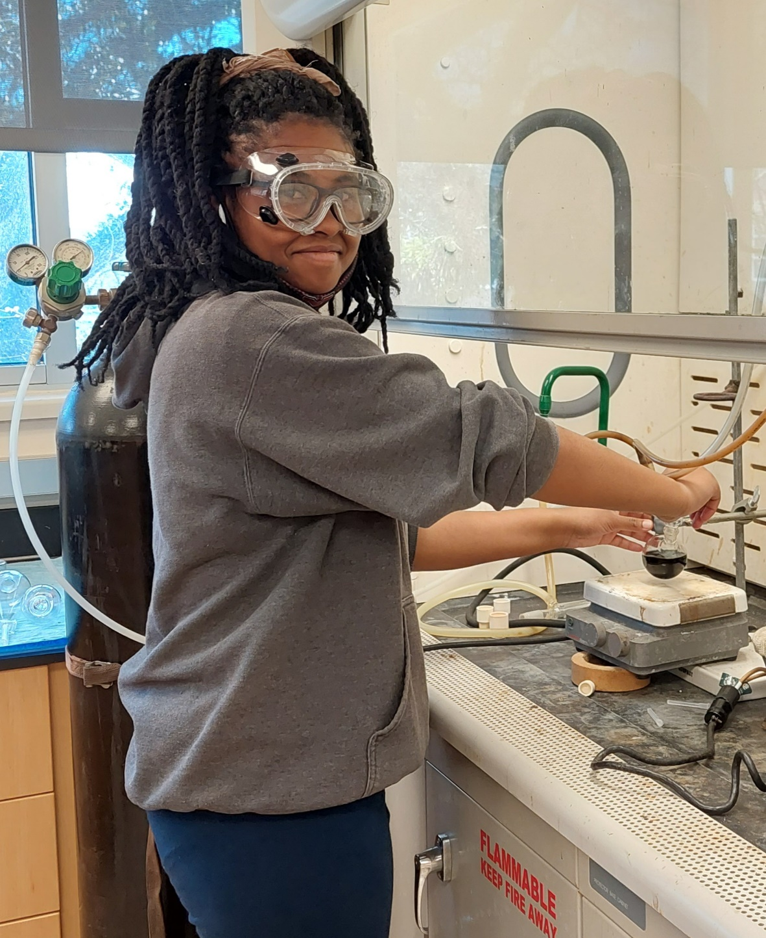
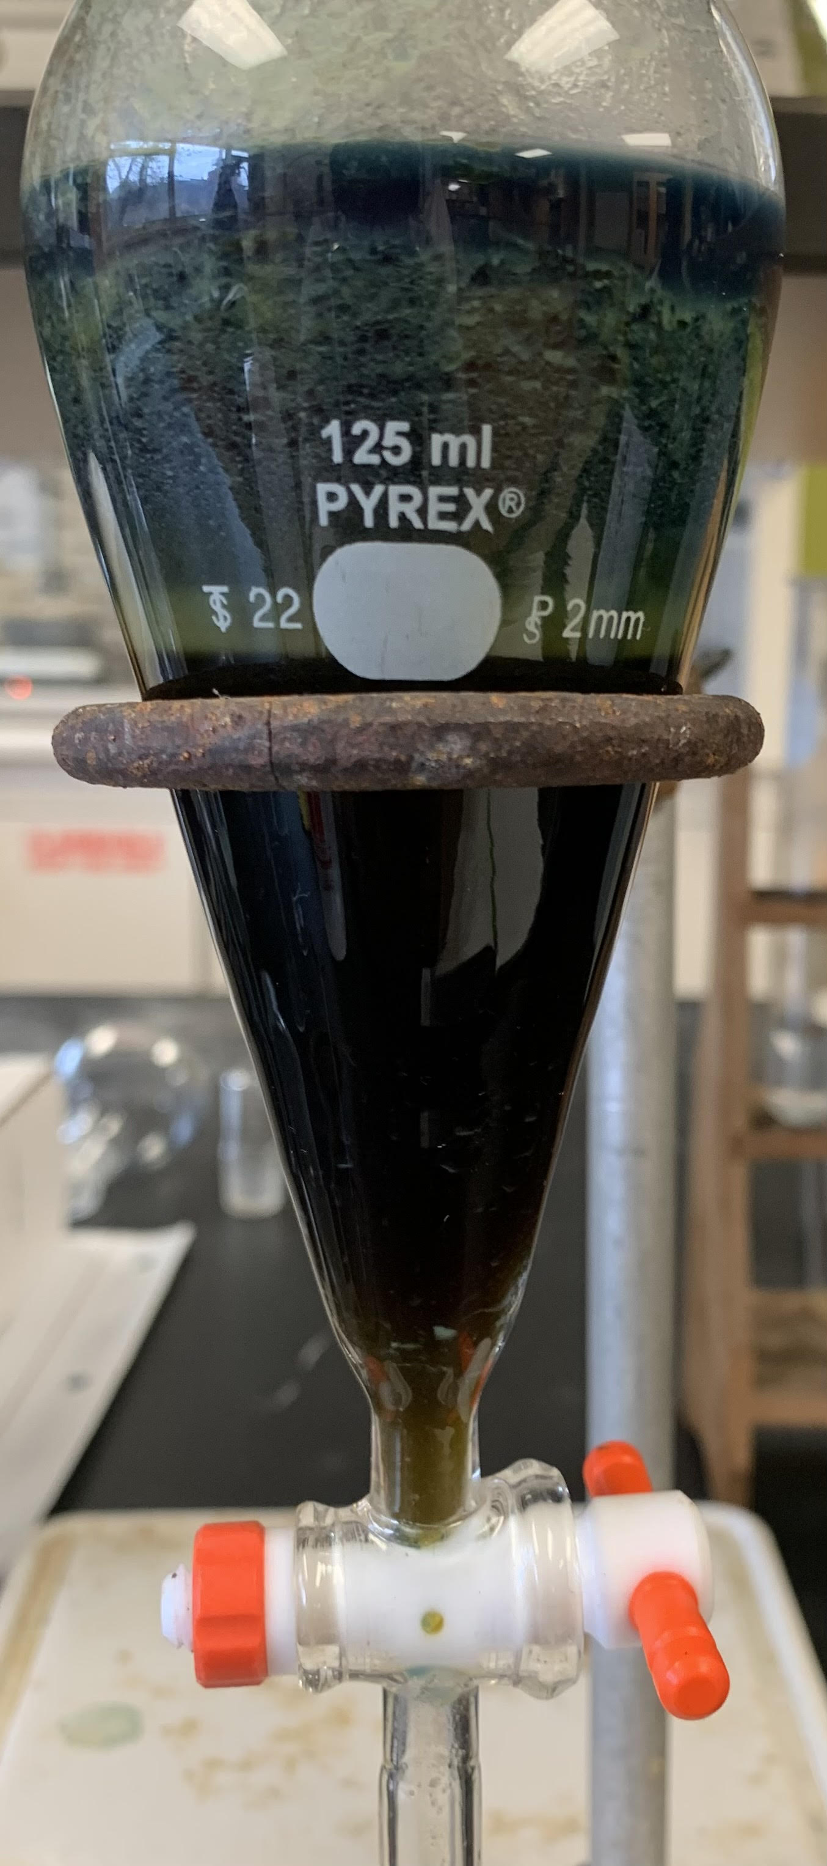
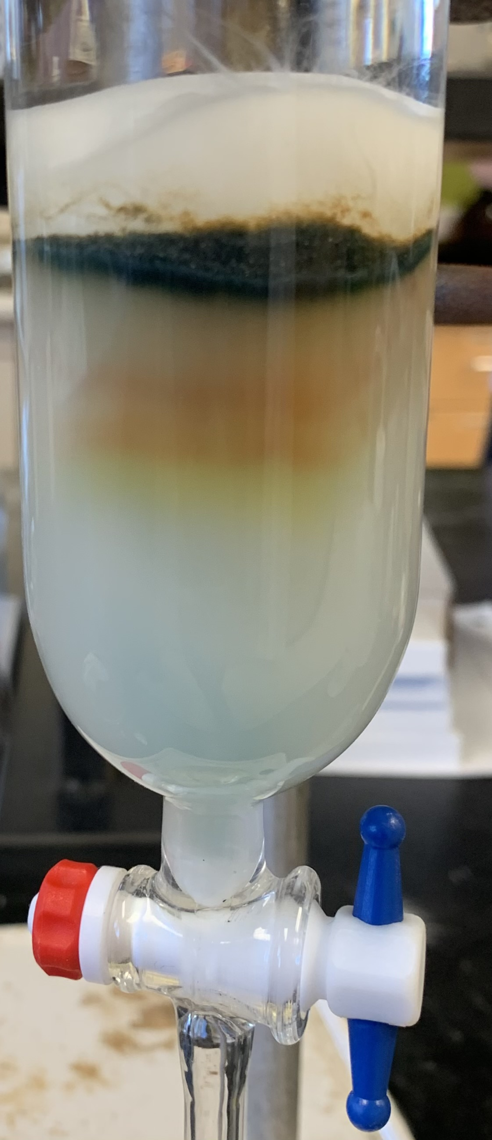
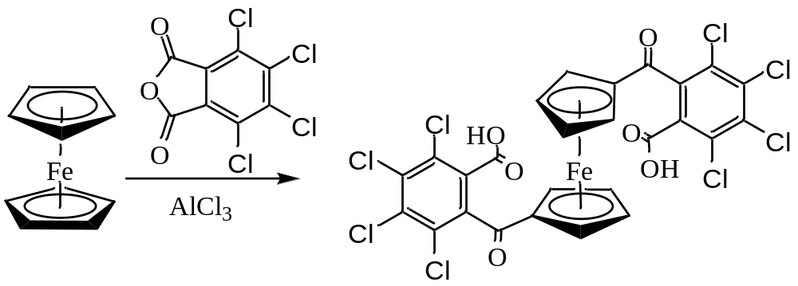
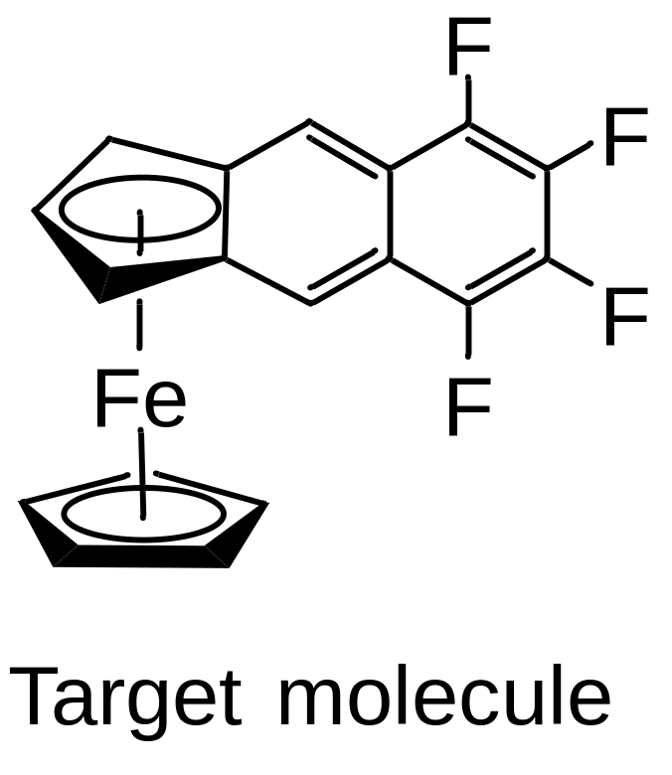
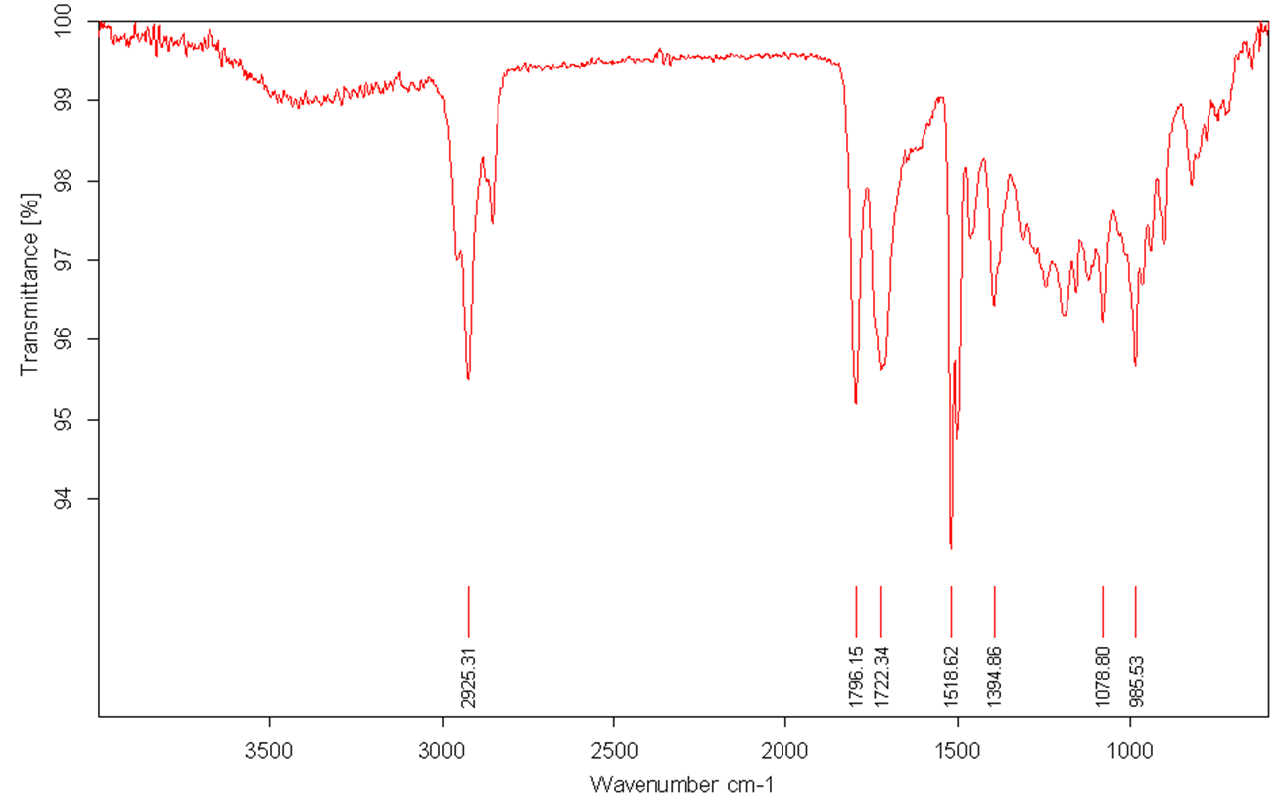
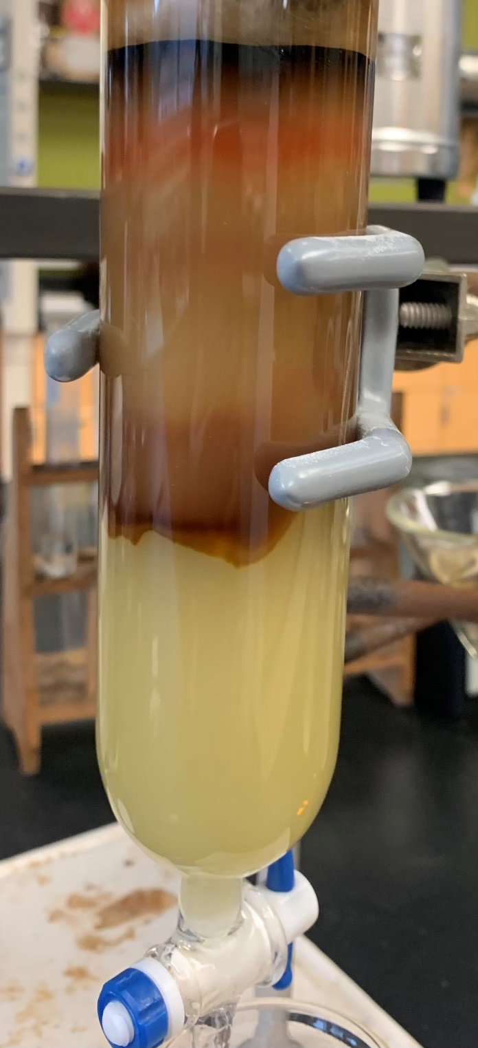
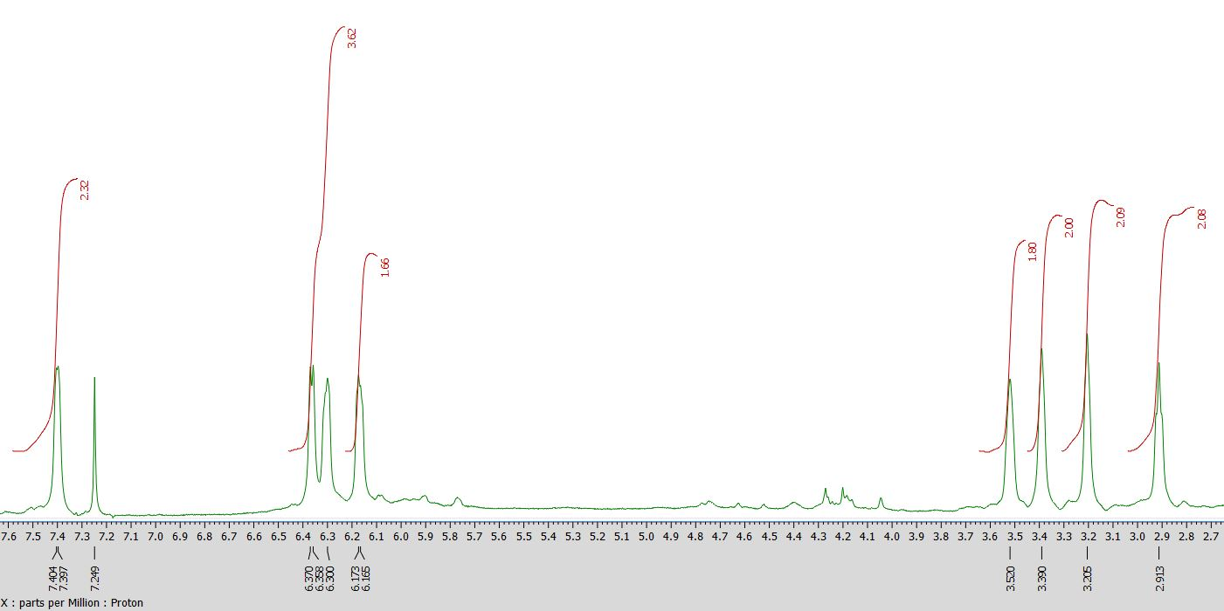
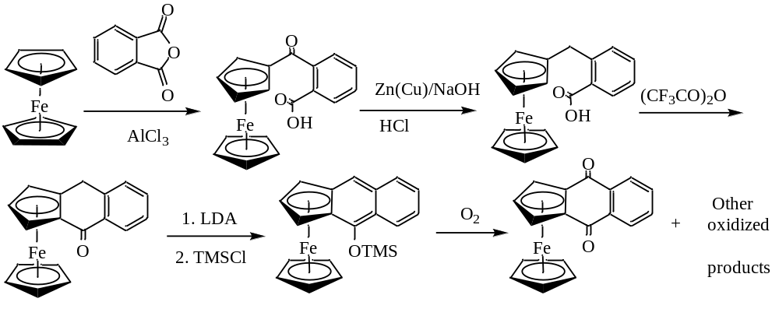
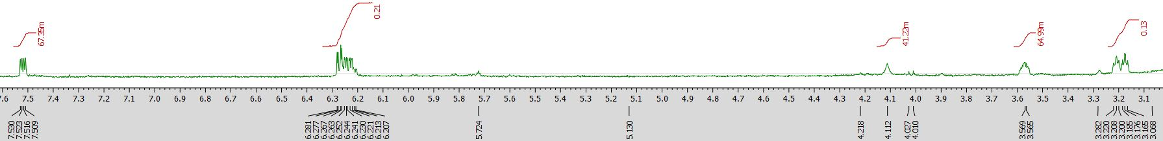
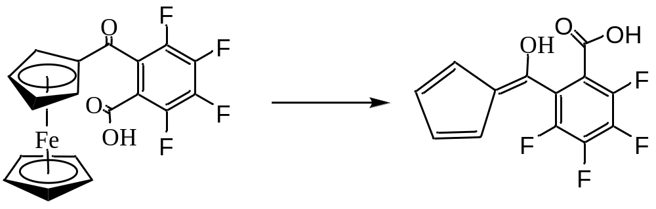
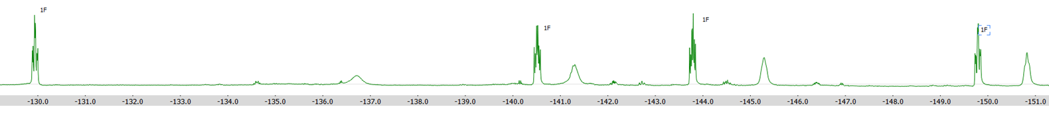

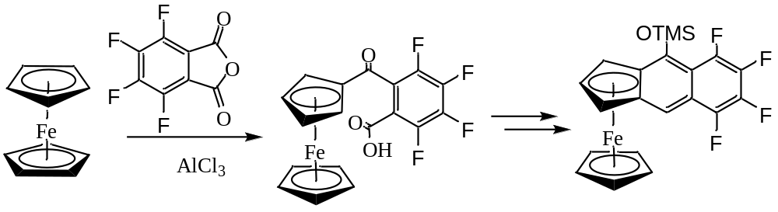
An approach to extending the π-conjugation of ferrocene using electron-deficient aromatic backbone
Melba Parnell and Uttam Pokharel
Department of Chemistry & Physical Sciences, Nicholls State University, Thibodaux, LA 70301
Introduction
Results
In this project, we are interested in investigating the reactivity of 2,3,4,5-tetrafluo- and tetrachloro-phthalic anhydride with ferrocene. The products of the reaction will be eventually be converted to the π-extended ferrocene derivative with a series of reactions. A long-term goal of the project is to incorporate electron-deficient groups to the aromatic core with extended π-conjugation of ferrocene (see below). We assume that the presence of electronegative groups reduce the electron density in the ligands that allows them to make a better interaction with electron rich Fe(II) center. We will explore the stability of such complexes and their suitability for the organic optoelectronic applications.
Friedel-Crafts acylation between ferrocene and tetrafluorophthalic anhydride
TLC results of the reaction between tetrafluorophthalic anhydride (1 eqvt) with ferrocene (2 eqvt) in the presence of AlCl₃ (5 eqvt) in dichloroethane under reflux for 12 h showed the consumption of tetrafluorophthalic anhydride.
Products of the reaction were separated by column chromatography
A dark red band was isolated when ethyl acetate was used as an eluent
IR showed the presence of two carbonyl (at 1796 cm⁻¹ and 1722 cm⁻¹)
Friedel-Crafts acylation between ferrocene and tetrachlorophthalic anhydride
Background
Earlier, we attempted to extend the π-conjugation of ferrocene using aromatic core without any substituents on it. When we attempted that methodology, the final product of the reaction was found to highly sensitive to air. We hypothesize that the air-sensitivity of the products can be lowered by lowering the energy of the HOMO. That can be done by incorporating electron-withdrawing fluoro- or chloro- groups in the molecule. By lowering the electron density in aromatic core of the ligands, we can also improve the bonding interaction between Fe(II) and π-extended aromatic ligands
The ¹H NMR showed the absence of unsubstituted cyclopentadienyl ring
The presence of unsubstituted Cp would give a singlet with five protons
Resonances at 7.5 and 6.2 ppm indicated the presence of vinyl protons indicates the formation fulvene derivative.
The ¹³C NMR analysis of the product is still underway
The electronegative fluorine reduces the electron-density at cyclopentadienyl ring which weakens its bonding with Fe(II)
The ¹H NMR showed the breakage of symmetry in the molecule, possibly due to high rotational barrier between two Cp rings.
IR of the product showed broad (3500 – 2500 cm⁻¹) O-H signal, two carbonyl (C=O) signals (1791 and 1708 cm⁻¹)
We are still working on the full characterization of the product
Conclusions
The Friedel-Crafts Acylation of ferrocene with tetrafluorophthalic anhydride lead to the formation of fulvene derivative by demetallation of the complex
From the Friedel-Crafts Acylation of ferrocene with tetrachlorophthalic anhydride gave a product with 1,1’-diketocarboxylic acid.
We are working on the characterization of other products of the reaction.
Proposed research
Acknowledgements
The ¹⁹F NMR of the product showed four resonances indicating the presence of fluorene in the molecule
The integration ratio of each signal is 1:1:1:1. The F atoms couple to their neighboring atom giving multiplet of the signals
There is the presence of some tetrafluorophthalic acid and tetrafluorophthalic anhydride as impurities in ¹⁹F NMR
Financial support
    SURE, Louisiana Board of Regents
Reference
Pokharel, U. R.; Bergeron, J. T.; Fronczek, F. R., Synthesis and crystal structures of 2-(ferrocenylcarbonyl)benzoic acid and 3-ferrocenylphthalide. Acta Crystallogr. Sect. E 2020, 76, 1163-1167.

