Slide 1
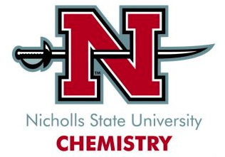
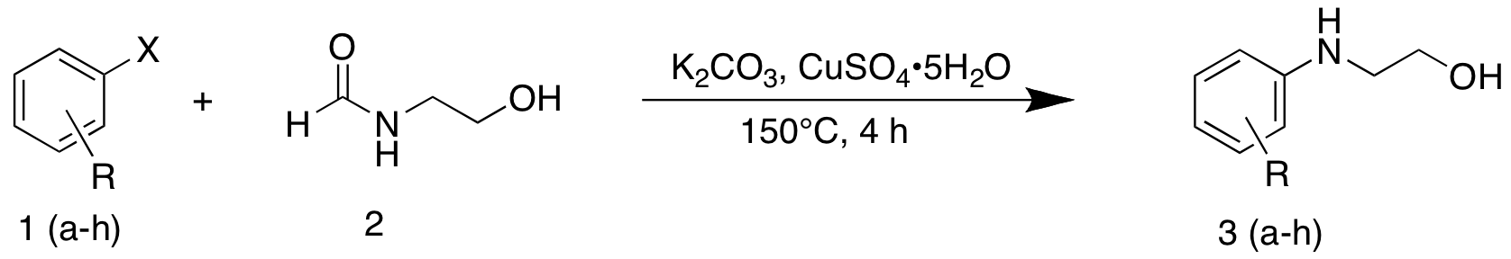

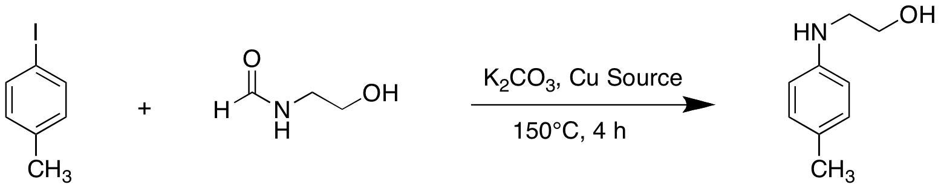
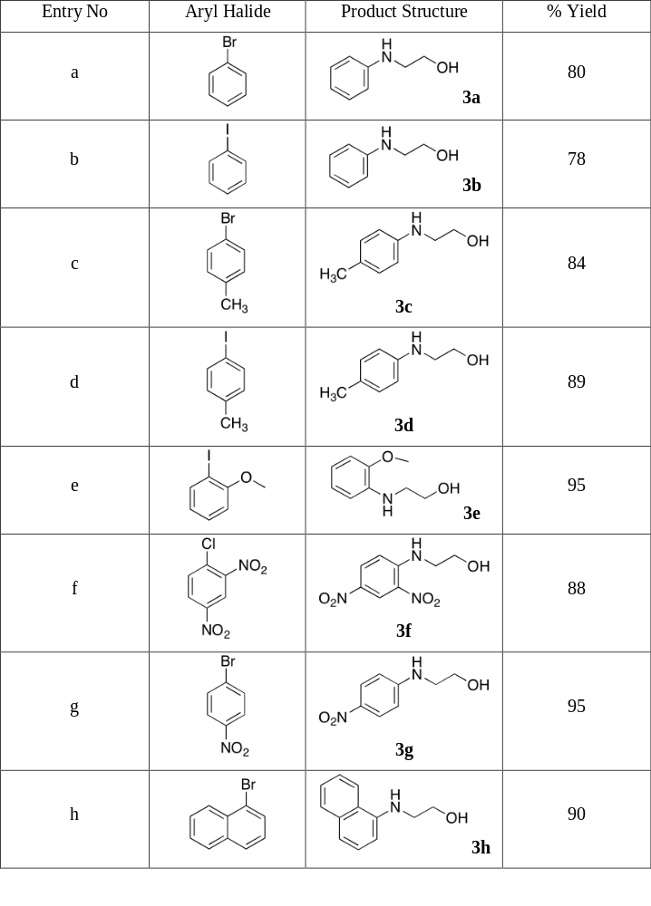
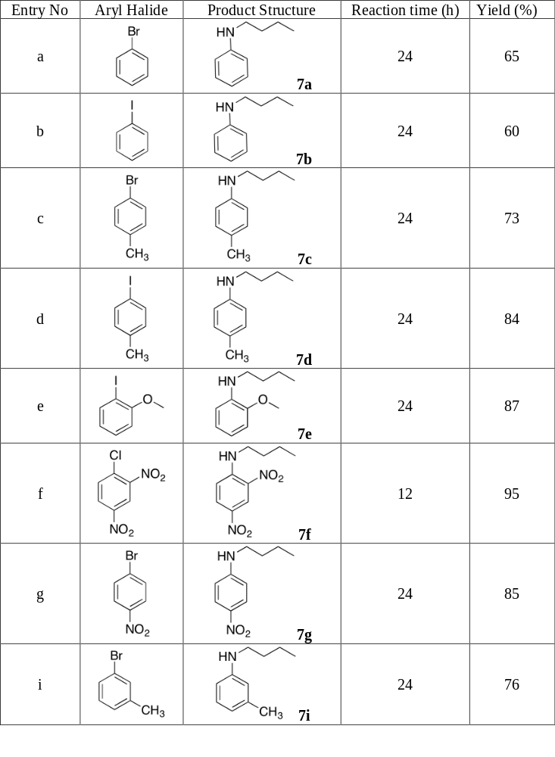



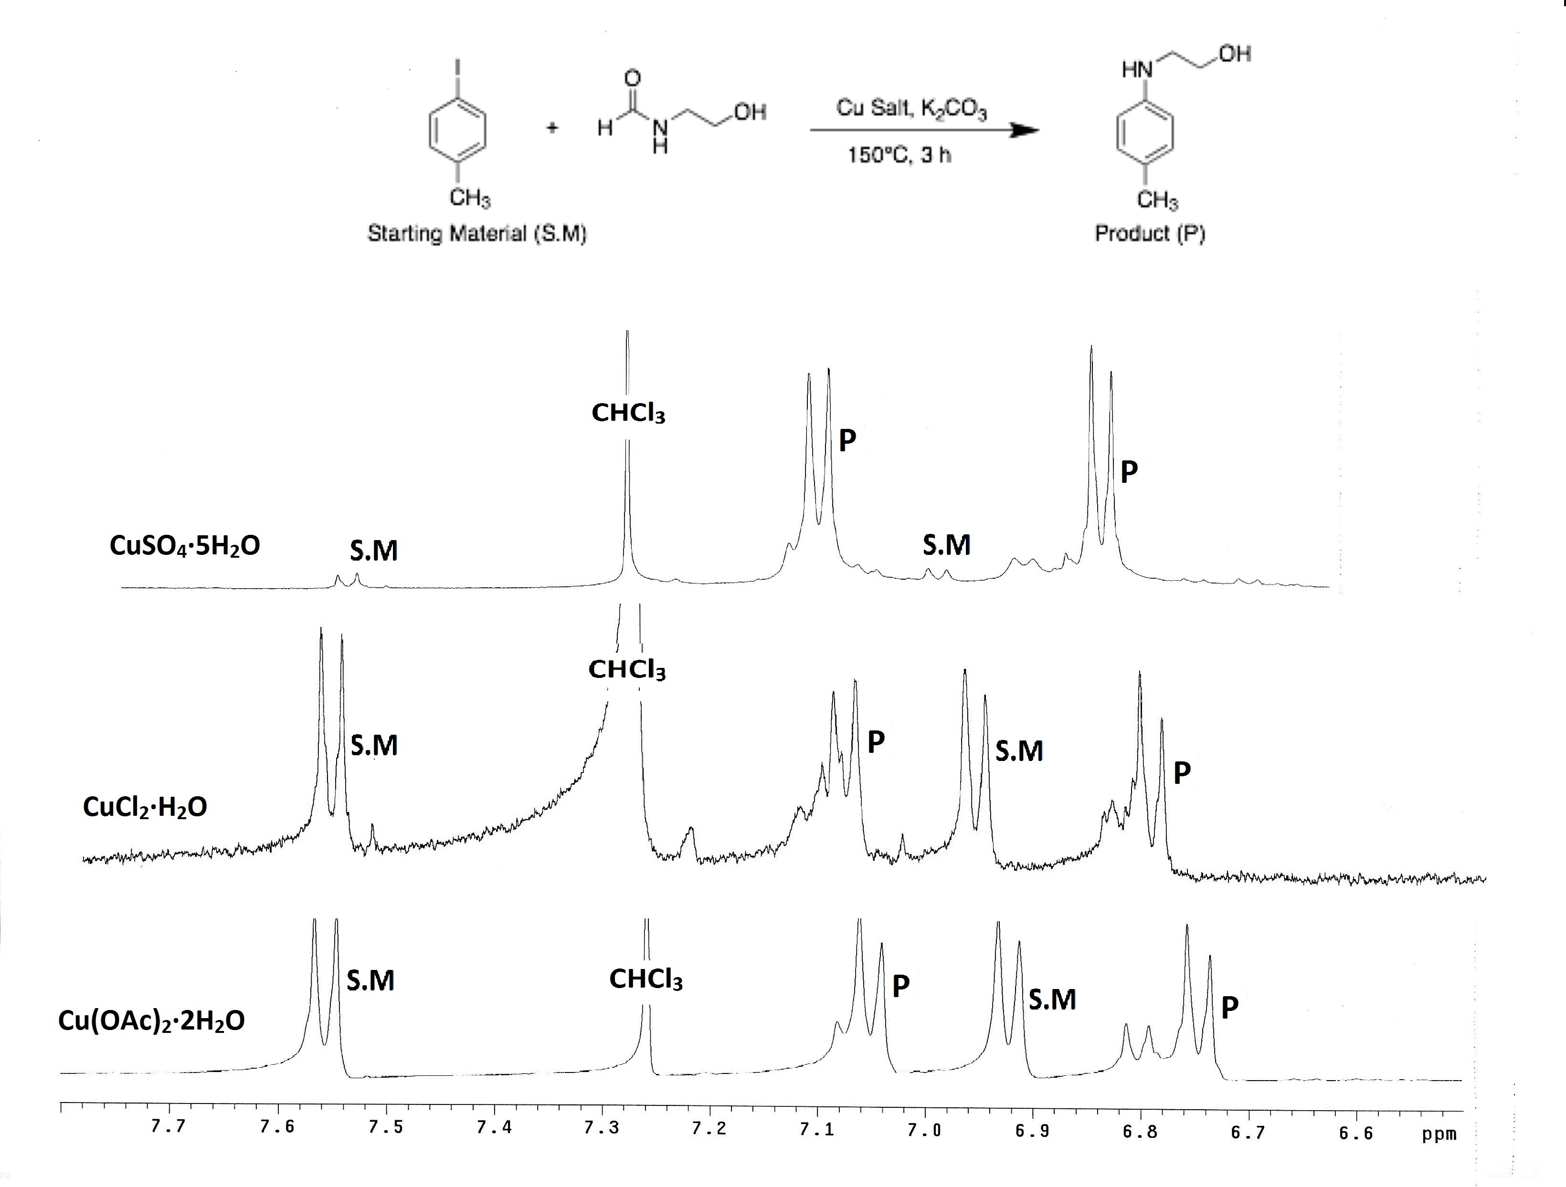
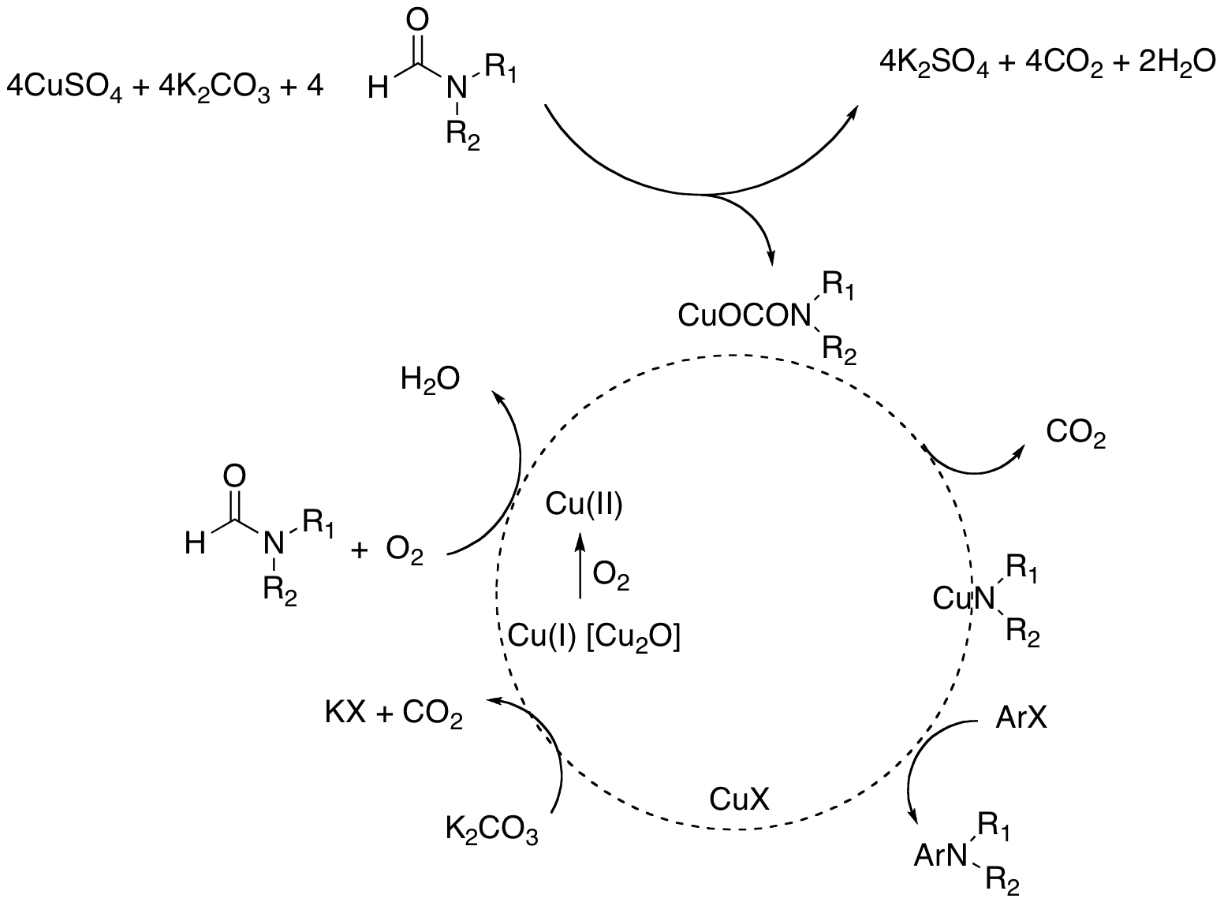
Development of Ligand-Free, Open-Air, Cu (II) Catalyzed N-Arylation of Amino Alcohols and Amines
Mohammad AbdelFattah, Rajesh Komati
Department of Chemistry& Physical Sciences, Nicholls State University, Thibodaux, LA-70301.
Abstract
The formation of carbon-nitrogen (C-N) bonds through metal-catalyzed cross-coupling reactions has been important in both organic synthesis and pharmaceutical industries. The C-N bond formation has been critical in the development of new drugs because 90% of pharmaceutical drugs possess at least one C-N bond. Arylation of amines plays an important role in organic synthesis due to its application in the fields of drug synthesis, materials, natural products, agrochemicals, and optical devices. Ullman and Goldberg were the first to report the use of copper as a transition metal catalyst for the formation of Carbon-Nitrogen bond. However, the use of high temperatures, long reaction times, lack of substrate tolerance, and low percentage yields has promoted the development of new methods for cross-coupling reactions. In this study, we report a simple, ligand-free, and inexpensive copper sulfate pentahydrate (CuSO₄·5H₂O) mediated synthesis of N-aryl amines by the coupling of N-formyl amines with a wide range of aryl halides. Major findings are supported by NMR analysis of the product.
Introduction
Ullmann and Goldberg were the first to report the use of copper as a transition metal catalyst for the formation of C-N bond.¹ However, the use of high temperatures, long reaction times, lack of substrate tolerance, and low percentage yields has promoted the development of new methods for cross-coupling reactions. As a result, palladium (Pd) metal rose to prominence, and many Pd catalyzed reactions for the formation of C-N bonds have been reported by coupling aromatic halides with amines, amides, and imides. However, due to the high cost and toxicity of palladium, alternative methods were developed. Indeed, palladium catalyzed reactions necessitate the use of external ligands and strict nitrogen environment, making the process very expensive. It is also worth noting that removing Pd residues from the reaction medium requires specialized treatments and techniques, which increases its cost.² Copper-mediated cross-coupling reactions have reemerged due to their low cost and ease of handling. Those reactions included the arylation of amines, amides, imides, and carbamates. Therefore, it is imperative to develop a more economical, safer approach that is less harsh to the environment and academic research.³
Methodology
We were able to cross-couple N-formyl amines with various aryl halides, such as aryl bromides, aryl chlorides, and aryl iodides. The coupling process takes place in the presence of copper (II) sulfate pentahydrate (CuSO₄·5H₂O) and potassium carbonate (K₂CO₃). The reaction was refluxed at temperatures ranging from 100℃ to 150℃ between 4 to 24 hours. The obtained products were extracted, purified by using flash column chromatography, and analyzed by NMR.
Results And Discussion
Scheme (2): Coupling of Aryl halides with
(N)-2-Hydroxyethyl Formamide
Scheme (3): Coupling of Aryl halides with
N-Butylformamide
Scheme(1): Screening of Cu Catalysts:
Entry | Cu Source (Mol %) | Yield (%)
1 | CuCl₂·2H₂O (10) | Trace
2 | Cu(OAc)₂·H₂O (10) | Trace
3 | CuSO₄·5H₂O (10) | 9
4 | CuCl₂·2H₂O (100) | 42
5 | Cu(OAc)₂·H₂O (100) | 48
6 | CuSO₄·5H₂O (100) | 89
Several copper salts, such as copper (II) chloride, copper (II) acetate, and copper (II) sulfate pentahydrate were screened to determine the most efficient catalyst for the cross coupling of N-formyl amines with aryl halides. Copper (II) sulfate pentahydrate was the dominating catalyst in the screening process.
Conclusion
We have optimized reaction conditions and developed a novel catalytic system for the formation of C-N bonds.
We have major advantages over other reported reactions, such as using inexpensive copper, short to moderate reaction time, mild temperatures, and open-air synthesis.
Figure(1): NMR Analysis on the Progress of the Reaction
Figure (2): Reaction Progress
References
1. Maria Thomas, A., Sujatha, A. and Anilkumar, G., 2015. Goldberg reaction: Development, mechanistic insights and applications. Mini-Reviews in Organic Chemistry, 12(1), pp.3-23.
2. Maiti, D., Fors, B.P., Henderson, J.L., Nakamura, Y. and Buchwald, S.L., 2011. Palladium-catalyzed coupling of functionalized primary and secondary amines with aryl and heteroaryl halides: two ligands suffice in most cases. Chemical science, 2(1), pp.57-68.
3. Komati, R. and Jursic, B.S., 2014. Ligand free open-air copper (II) mediated aryl formamidation and amination of aryl halides. Tetrahedron Letters, 55(9), pp.1523-1527.
0-1 hours
2-3 hours
4 hours
Figure (3): Proposed Mechanism
Acknowledgements
Nicholls State University
Financial Support
Louisiana Board of Regents , Grant# LEQSF (2021-22)-RD-A-31

