Slide 1

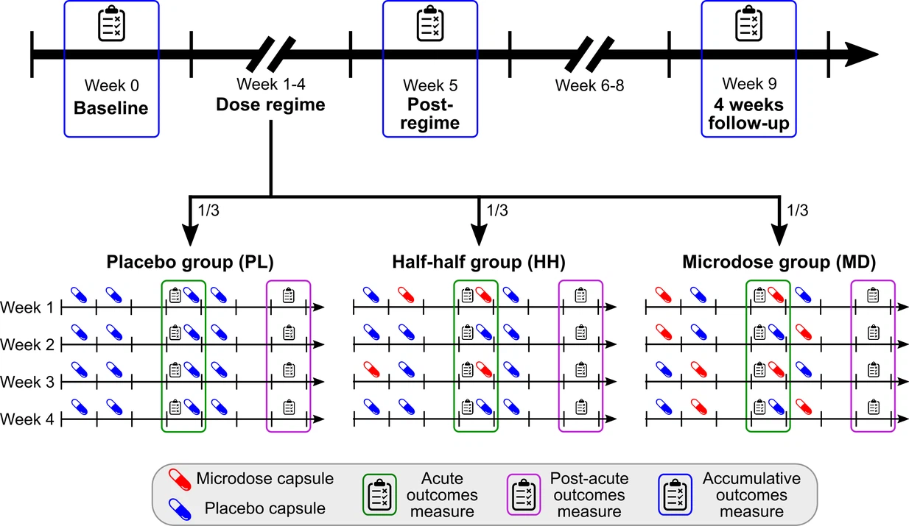
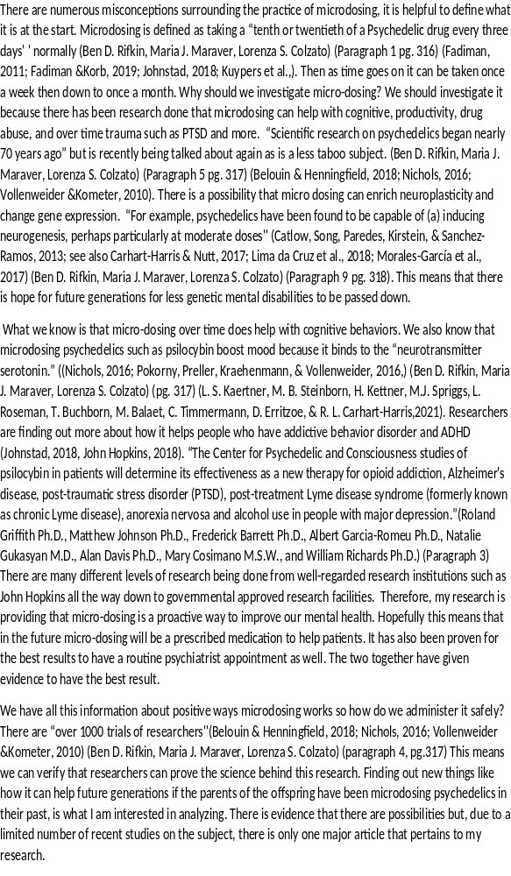
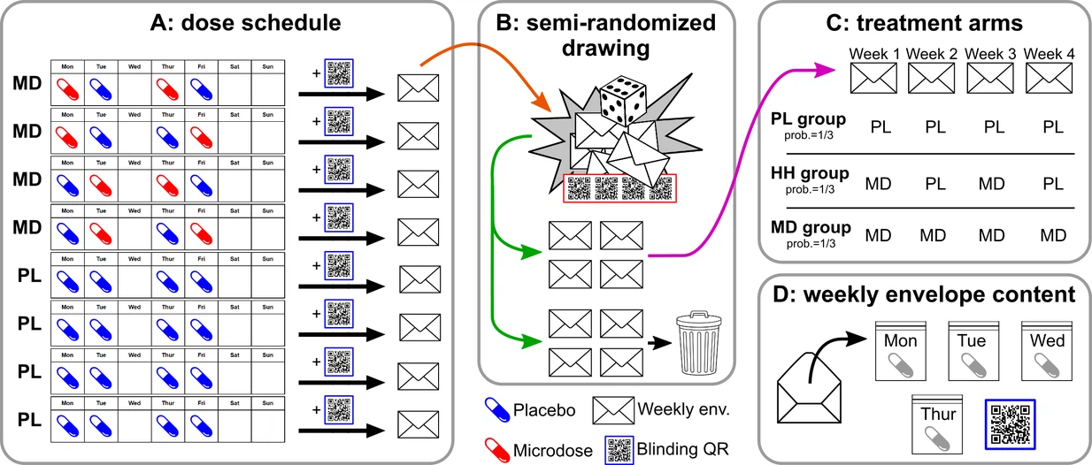
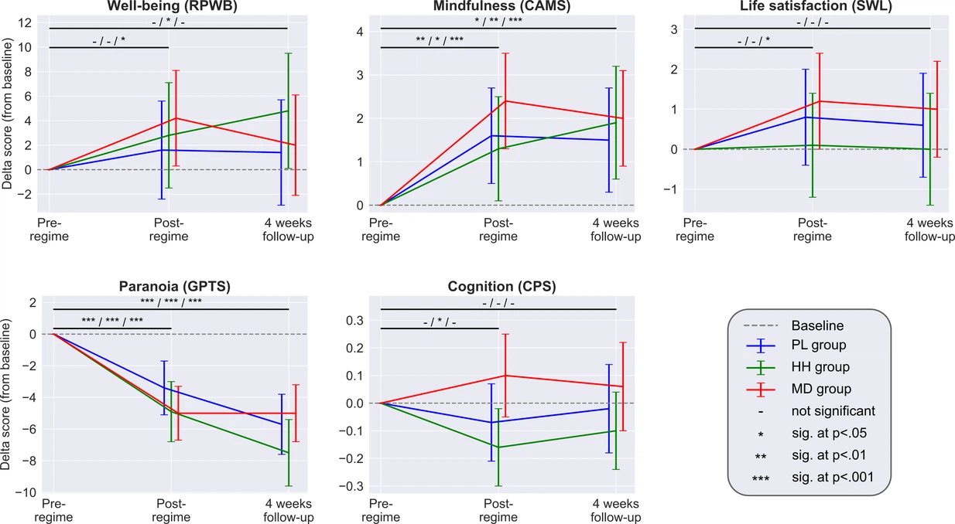
Changing the way Psychedelics are Stigmatize:
The Benefits Of Psychedelics for Mental Disorders
Nicole Hue
Many people deal with depression, anxiety, ADHD, and addiction. People are prescribed antidepressants and go through counseling to help them with their mental health. For the percentage of the people who have these mental disabilities taking medication and going to counseling just keeps their head over the water, but once they started to microdosing it life became clear. Their cognitive ability to be creative increased along with productivity in everyday life. It is like fog started to disappear and they could see clearly again.
Specifically, my work is looking at how many positive outcomes have been coming about through research. The evidence from clinical studies has been finding new benefits from microdosing including how it is changing neuroplasticity in users. Studies also show that there is a possibility that we can be changing users' neurogenesis. This means that we can help patients that would need help growing and or develop new nervous tissue. This can potentially help more patients who have neuro diseases and disorders like Dementia and Parkinson’s disease. As I examine more research studies the outcome is all saying how microdosing is beneficial to those who suffer with mental disorders. My hypothesis on microdosing is that it is effective in those that suffer with mental health. Even though mental health is being taken more seriously now, I want to raise the awareness of how much faster microdosing is helping users without all the side effects of antidepressant medications.
Abstract
Literature Review
Future Possibilities
Introduction
Results
How researchers know microdosing helps cognitive ability is through clinical trials. These trials have proven to be satisfactory in treating mental health disorders and increasing cognitive abilities. This can be proven because of it being legalized in Oregon to microdosing to help those who suffer from PTSD and other mental health disorders. The amount of people that it is beneficial is the reason that it is being administered to help those who suffer from these mental health disorders. Another is prestigious schools like John Hopkins are doing research now to see how microdosing can help those with mental health disorders. For one experiment they helped someone with addiction.
There is an abundance of clinical trials being done when it comes to microdosing psychedelics, and the benefits outweigh the disadvantages. In conclusion, microdosing is so important to understand because of the definitive positive outcomes that are breaking the generational stigmatization of mental health disorders. This can potentially help change the way people look at the advantages of psychedelics and how it positively can alter our neuroplasticity for a more positive outcome.
Add your information, graphs and images to this section.
PL, HH, MD schedule to measure microdosing. This trial was used to measure the mood ,cognition, ect. to see if it benefited the patients. Threw a control group, mixed group and a placebo group.
Work Cited
Microdo sing Psychedelics as Cognitive and Emotional Enhancers
Self-blin ding citizen science to explore psychedelic microdosing
derson, T., Petranker, R., Rosenbaum, D., Weiss-man, C. R., Dinh-Williams, L. A., Hui, K., Farb, N. A. S. (2019). Microdosing psychedelics: Personality, mental health, and creativity differences in microdosers. Psychopharmacology, 236,731–740. http://dx.doi.org/10.1007/s00213-018-5106-2
Center to Study Psychedelics for Treatment of Depression, Anxiety, Ptsd Launches at Ut Austin’s Dell Med. (2021, December 16). States News Service
Johns Hopkins Launches Center for Psychedelic Research. Johns Hopkins Medicine Newsroom. (2019, September 4). Retrieved February 9, 2022, from https://www.hopkinsmedicine.org/news/newsroom/news-releases/johns-hopkins-launches-center-for-psychedelic-research
Johnstad, P. G. (2018). Powerful substances in tiny amounts: An interview study of psychedelic microdosing. NAD Nordic Studies on Alcohol and Drugs, 35, 39–51. http://dx.doi.org/10.1177/1455072517753339
L. S. Kaertner, M. B. Steinborn, H. Kettner, M. J. Spriggs, L. Roseman, T. Buchborn, M. Balaet, C. Timmermann, D. Erritzoe, & R. L. Carhart-Harris. (2021). Positive expectations predict improved mental-health outcomes linked to psychedelic microdosing. Scientific Reports, 11(1), 1–11. https://doi-org.ezproxy.nicholls.edu/10.1038/s41598-021-81446-7
Ly, C., Greb, A. C., Cameron, L. P., Wong, J. M., Barragan, E. V., Wilson, P. C., Olson, D. E. (2018). Psychedelics promote structural and functional neural plasticity. Cell Reports, 23, 3170–3182. http://dx.doi.org/10.1016/j.celrep.2018.05.022
Marona-Lewicka, D., & Nichols, D. E. (2007). Further evidence that the delayed temporal dopaminergic effects of LSD are mediated by a mechanism different than the first temporal phase of action. Pharmacology, Biochemistry, and Behavior, 87, 453–461. http://dx.doi.org/10.1016/j.pbb.2007.06.001
Rifkin, B. D., Maraver, M. J., & Colzato, L. S. (2020). Microdosing psychedelics as cognitive
and emotional enhancers. Psychology of Consciousness: Theory, Research, and Practice, 7(3), 316–329. https://doi-org.ezproxy.nicholls.edu/10.1037/cns0000213

