Slide 1

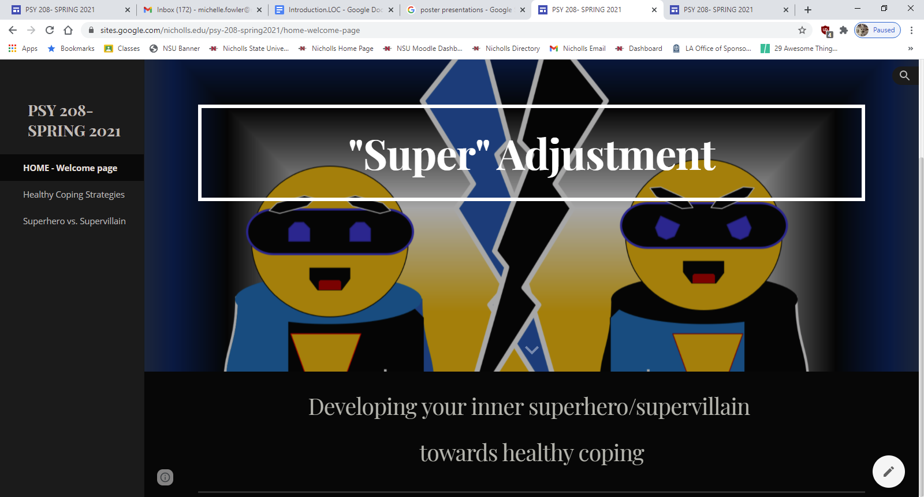
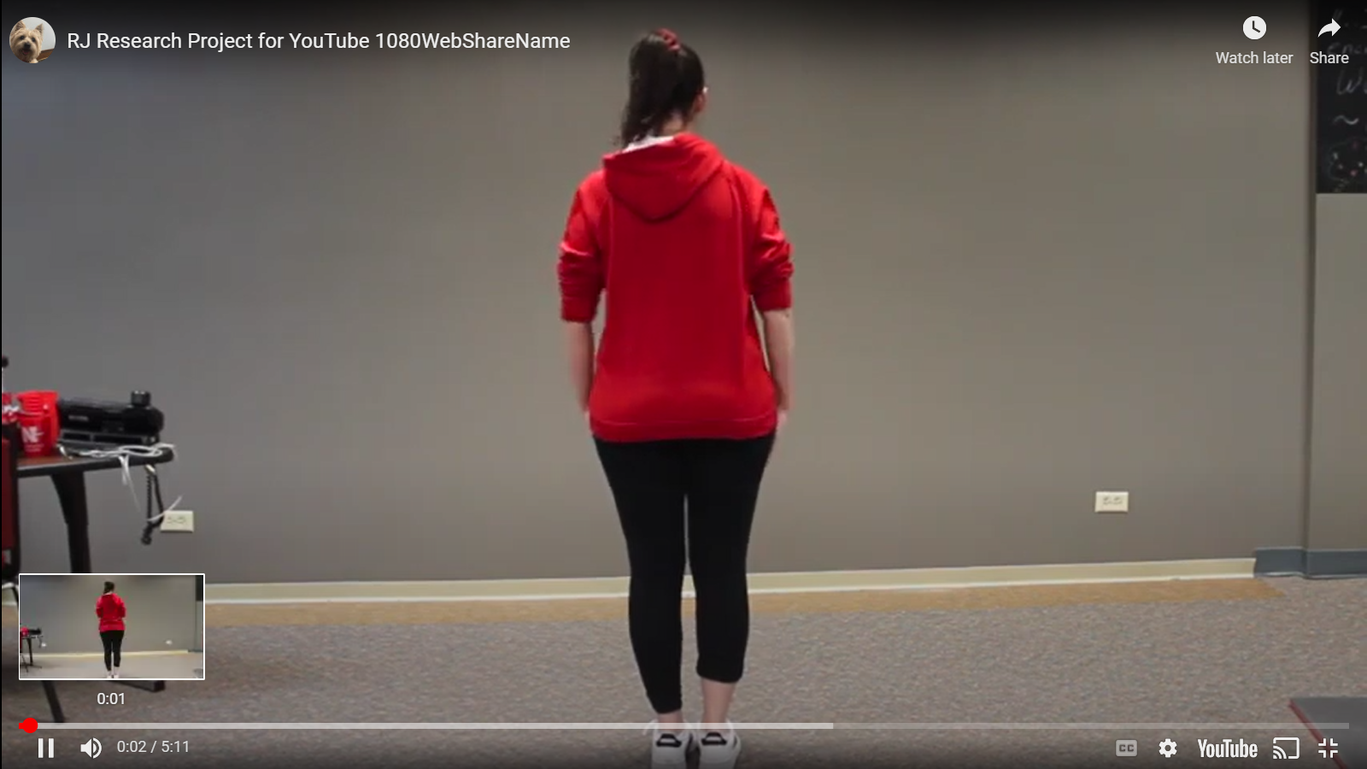
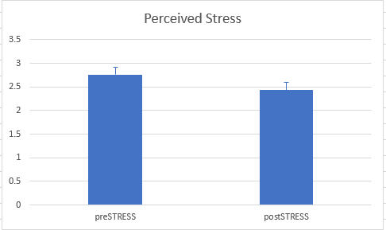
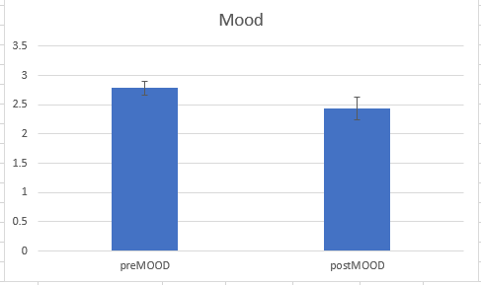
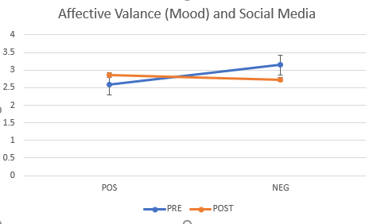
The Impact of Dance on Stress Reduction and Mood
Racheal M. Johnson and Michelle L. Fowler, PhD
Department of Psychology, Counseling, & Family Studies, Nicholls State University
INTRODUCTION
Social Media is a fairly recent space that individuals use alongside the growth of the technological world. A recent study has shown that social media sites can assist in reducing stress, as such sites may serve as a coping mechanism to users (Coats, Sykora, & Jackson, 2019) through sites designed with entertaining content, including humor, identity exploration, and creative expression (Nesi, 2020). Within the app TikTok, recent emerging trends in social media involve common dance routines. Many users are drawn to the platform by these dance challenges—short dance routines of varying complexity set to popular songs that are recreated by other users in hopes of eventually going “viral” (i.e., recreated on a massive scale by other users) on the app (Johnson, 2021). Dancing as a therapeutic method is something recent within studies about mental health, but not new (Laland et al., 2016). For example, Martin et al. (2018) showed a significant reduction in stress and increase in coping in participants. Additionally, dance has been shown to contribute to the healing process by allowing for the development of a sense of control (Hanna, 1995). In considering these findings coupled with increases in stress on college campuses at epidemic levels (Scheffler, 2019), research is needed on how the impact of social media content targeting college students may be employed to regulate stress and mood. The purpose of this study is to investigate how different levels of engagement – by viewing, mimicking, or freestyling to presented videos - might reduce stress and elevate mood.
4. MATERIALS
Stimuli for the video content was recorded using a Canon Rebel T6. The dance challenge was presented as an instructional video on a 32-inch Westinghouse television monitor administered via a connected HP laptop. The dance sequence was arranged to the song Rent by the artist Big Freedia (Asylum Records, 2018; limited permission for use granted by MidCitizen Entertainment). The sequence contains with 9 eight-count sections repeated in a loop 10x. Video content was edited using Apple iMovie and converted to jpeg (see Figure 01). Questions for the pre-post questionnaire were partially derived from the Perceived Stress Questionnaire (PSQ) (Levenstien et al., 1993) to measure their stress and the Brief Mood Introspection Scale (BMIS) (Mayer & Gaschke, 1988) to measure affect.
6. DISCUSSION & FUTURE DIRECTIONS
Interaction with social media was shown to significantly decrease perceived stress and significantly increase mood irrespective of interaction type. Given previous research into the health benefits of physical activity and dance, this finding is not consistent with our hypothesis that active participation by either following along with the video or freestyle dancing would produce greater outcomes than viewing the video alone. Although we considered that passive viewing as an escape mechanism would certainly decrease perceived stress, we theorized that this would produce linear differences across the levels of participation. One potential source to consider is in the sensitivity of the scale, as we used a 5-point Likert scale. Another potential source lies within the temporal use of psychometric questionnaires within a short timeframe.
Secondly, this study suffered greatly from lack of power in the engagement condition. Subsequent power analysis revealed that sample sizes would need to surpass 35 participants per sample. While most of this study achieved power from repeated-measures methodology, this element showed interesting promise and trends towards differences between the engagement condition. In considering the Freestyle condition, participants may have found an experimental setting not particularly inspiring to truly embrace the "dance like nobody is watching" mentality. In considering the Following condition, the repetitive nature of the song lyrics does not allow for the organic individuality typically expressed in dance challenges. Finally, the duration of the dance challenge is of particular interest for further study, as the current interval of the video might have not allowed enough time for neuromechanisms underlying the stress response to respond. A future study could seek to investigate whether power could be increased by varying the video lengths, in which the loop could be modified at 1/3 as well as 1.5x the current duration for only the Following and Passive Viewing Conditions. Nonetheless, the promise shown from this data suggests that future research should continue this avenue of inquiry into developing social media platforms that seek engagement beyond simple passive viewing.
FIGURE 01:
Video still of instructional dance video.
5. RESULTS
N=18 (n=6 per sample), α=0.05: Error bars represent SEM.
5.1 Biometric Data
To ensure movement, results from the fitness tracker showed overall significant results between pre-post heart rate (resting HR: M=90.6, s=17.6; active HR: 106.0, s=16.7), (F(1,15)=14.741, p=0.002) and number of steps (F(2,15)=772.574, p<0.000), in which both the mimicking (M552.7, s=33.3) and the freestyle (M=520.2, s=33.7) groups showed significantly higher steps than the viewing only group (M=0.0,s=0.0). However, no other significant differences were observed.
2. SPECIFIC QUESTIONS
The current series of questionnaires seeks to examine:
  Is there a relationship between watching social media styled dance videos and stress reduction?
  Is there a relationship between watching social media styled dance videos and mood?
  Would differing levels of interaction with watching social media styled dance videos have different effects on stress and mood?
5.2 Perceived Stress as a function of Social Media Dance Challenge
The stress questionnaire consisted of 9 Likert-scaled questions regarding perceived stress, including finances, current goals, future goals, academic load, work load, family dynamics, interpersonal relationships, and community factors. Results of a mixed 2x3 ANOVA show that perceived stress decreases as a function of social media interaction (F(1,15)=8.201, p=0.012, ω=0.763). However, no significant main effects were observed by engagement type, p=0.284, ω=0.249.
5.3 Mood as a function of Social Media Dance Challenge
The mood questionnaire comprised of 20 Likert-scaled questions on mood states. Results of a mixed 2x3 ANOVA show that mood significantly increases as a function of social media interaction (F(1,15)=6.645, p=0.021, ω=0.674). However, no significant main effects were observed by engagement type, p=0.128, ω=0.403.
5.4 Affective Valance as a function of Social Media Dance Challenge
Results of 2x3 mixed ANOVA show a significant interaction between pre-post testing of positive versus negative valance. However, no significant main effects were observed by engagement type, p=0.293, ω=0.243.
FIGURE 02: Mean stress collapsed across engagement conditions. Higher values indicative of higher perceives stress.
REFERENCES
Big Freedia (2018). Rent. Asylum Records.
Christie, M. J. (1981). Electrodermal activity in the 1980s: a review. Journal of the Royal Society of Medicine, 74(8), 616-622.
Coates, R., Sykora, M., & Jackson, T. (2019, January). Browsing to breathe: social Media for Stress Reduction. In Proceedings of the 52nd Hawaii International Conference on System Sciences.
Johnson, A. (2021). Copyrighting TikTok Dances: Choreography in the Internet Age. Washington Law Review, 96(3), 1225.
Hanna, J. L. (1995). The power of dance: Health and healing. The Journal of Alternative and Complementary Medicine, 1(4), 323–331. https://doi.org/10.1089/acm.1995.1.323
Laland, K., Wilkins, C., & Clayton, N. (2016). The evolution of dance. Current Biology, 26(1).
Levenstein, S., Prantera, C., Varvo, V., Scribano, M. L., Berto, E., Luzi, C., & Andreoli, A. (1993). Development of the perceived stress questionnaire: a new tool for psychosomatic research. Journal of Psychosomatic Research, 37(1), 19–32.
Martin, L., Oepen, R., Bauer, K., Nottensteiner, A., Mergheim, K., Gruber, H., & Koch, S. C. (2018). Creative arts interventions for stress management and prevention—a systematic review. Behavioral Sciences, 8(2), 28.
Mayer, J. D., & Gaschke, Y. N. (1988). The experience and meta-experience of mood. Journal of Personality and Social Psychology, 55, 102-111.
Nesi, J. (2020). The impact of social media on youth mental health: challenges and opportunities. North Carolina medical journal, 81(2), 116-121.
Scheffler, R. M. (2019). Anxiety Disorder on College Campuses: A New Epidemic (Preliminary Findings). Under review.
Wang, J., Wang, Y., Weng, N., Chai, T., Li, A., Zhang, F., & Yu, S. (2022). Will You Ever Become Popular? Learning to Predict Virality of Dance Clips. ACM Transactions on Multimedia Computing, Communications, and Applications (TOMM), 18(2), 1-24.
3. PROCEDURE
University students enrolled in courses for the behavioral sciences were recruited to view a social media styled dance video simulating a dance challenge. Following consent procedures, a Fitbit Charge 5 Fitness Tracker was fitted to the participant to measure steps and heartrate. Participants were then given a questionnaire with questions measuring perceived stress and mood followed by a 5 minute and 12 second video demonstrating the dance challenge. Participants were randomly assigned to either watch the video, to follow along with the video by copying the steps, or to dance freestyle while the video played in the background. At the conclusion of the video, measurements for steps accrued and heartrate were recorded. Participants were then provided the questionnaire to measure perceived stress and mood prior to debriefing.
FIGURE 03: Mean mood states across engagement conditions. Higher values indicative of higher negative valance.
ACKNOWLEDGMENTS
We thank all our participants who contributed to this experiment by volunteering their time to this endeavor.
Additionally, we want to thank Big Freedia, Asylum Records, and MidCitizen Entertainment for the use of the music track, which served as inspiration in combining our love of science and dance.
FIGURE 04: Overall interaction of affective valance across engagement conditions.
CONTACT
Michelle L. Fowler, PhD, Assistant Professor, Department of Psychology, Counseling, & Family Studies, Nicholls State University. michelle.fowler@nicholls.edu

