Slide 1

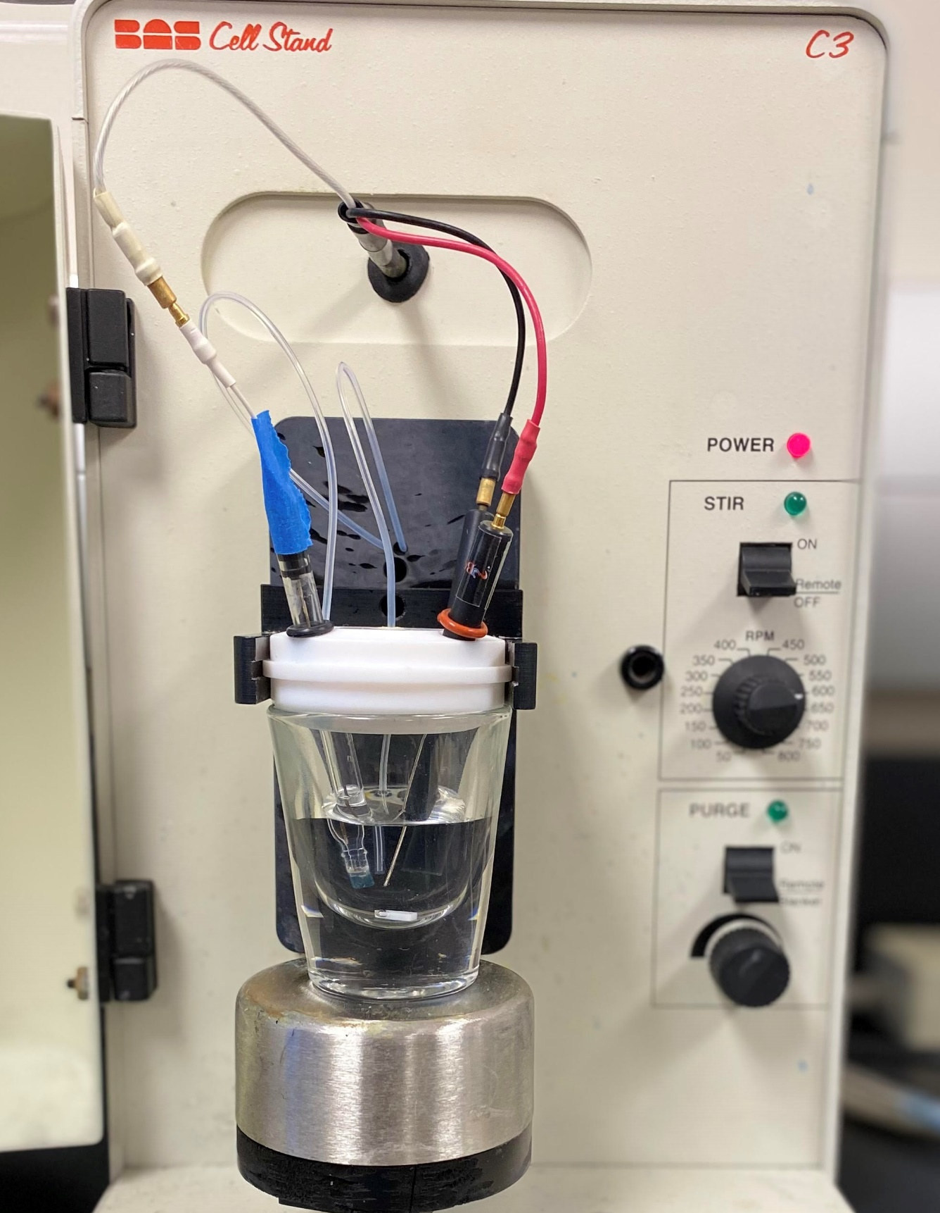
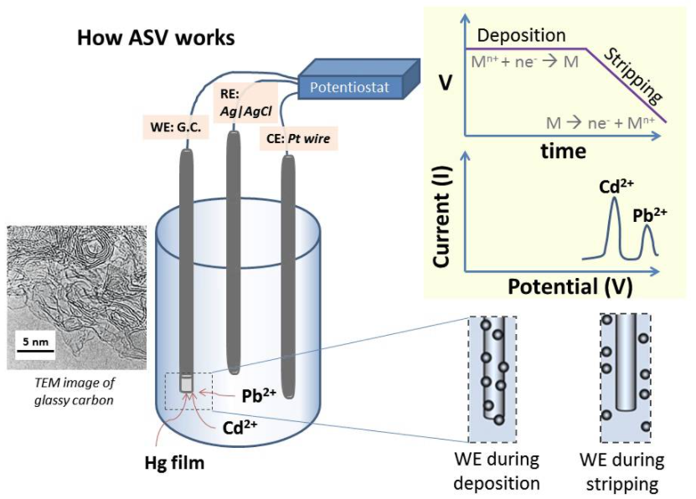
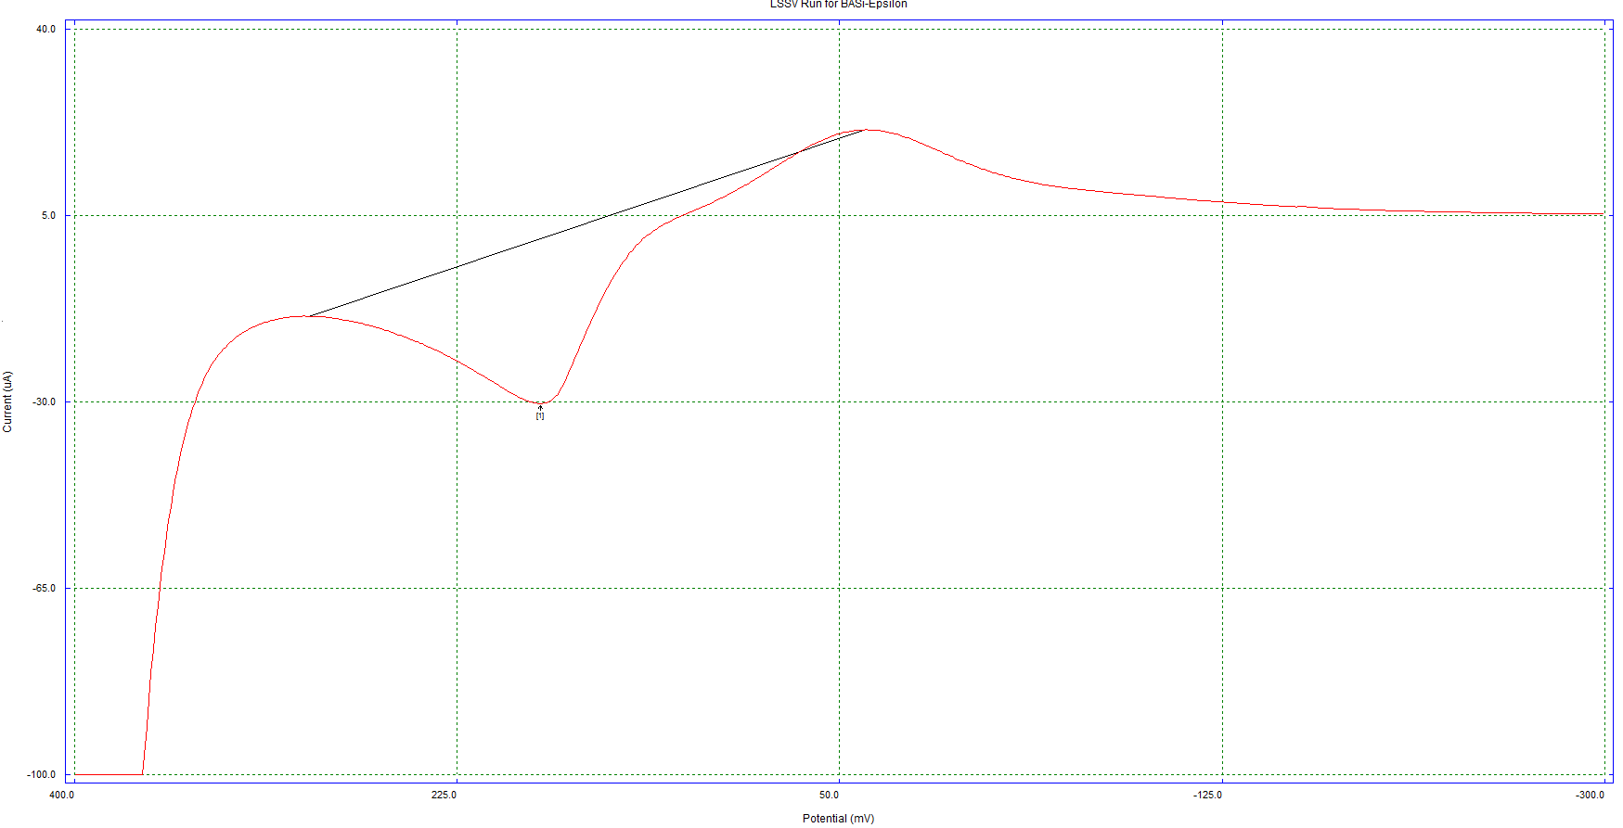
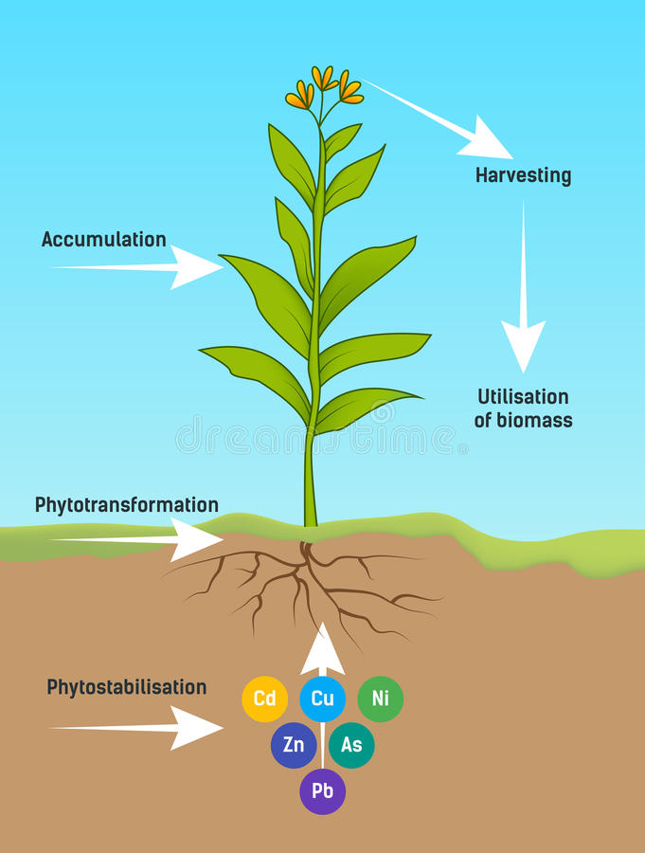
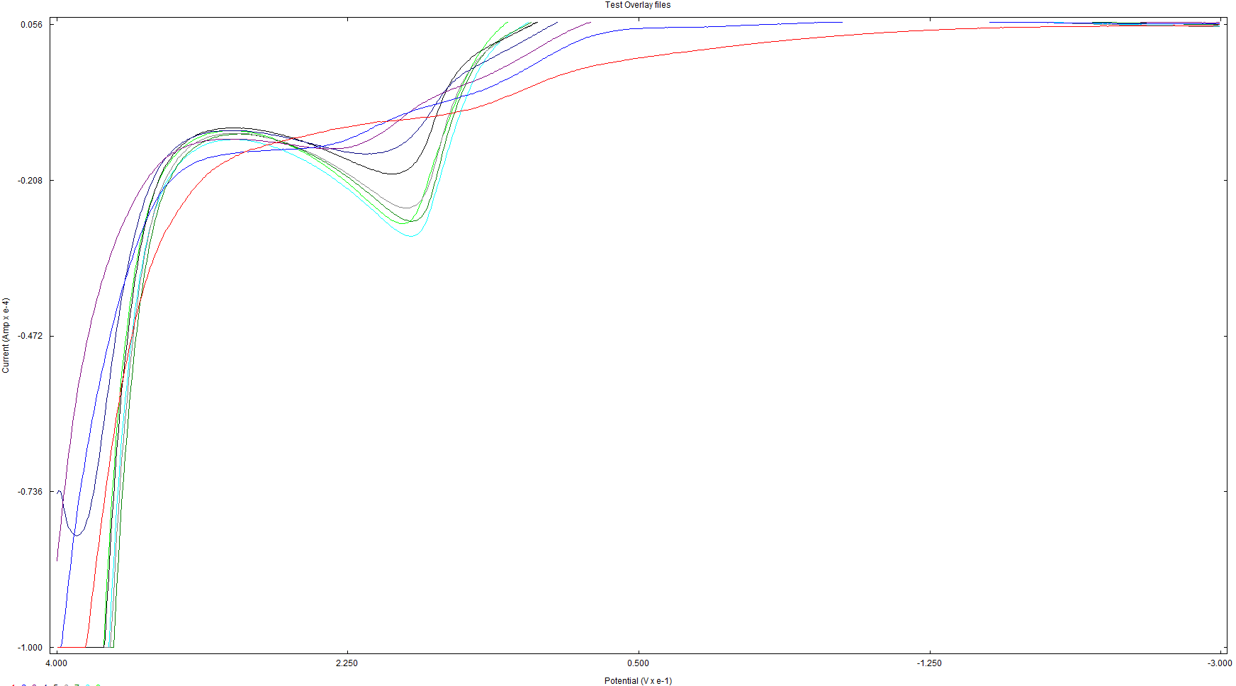
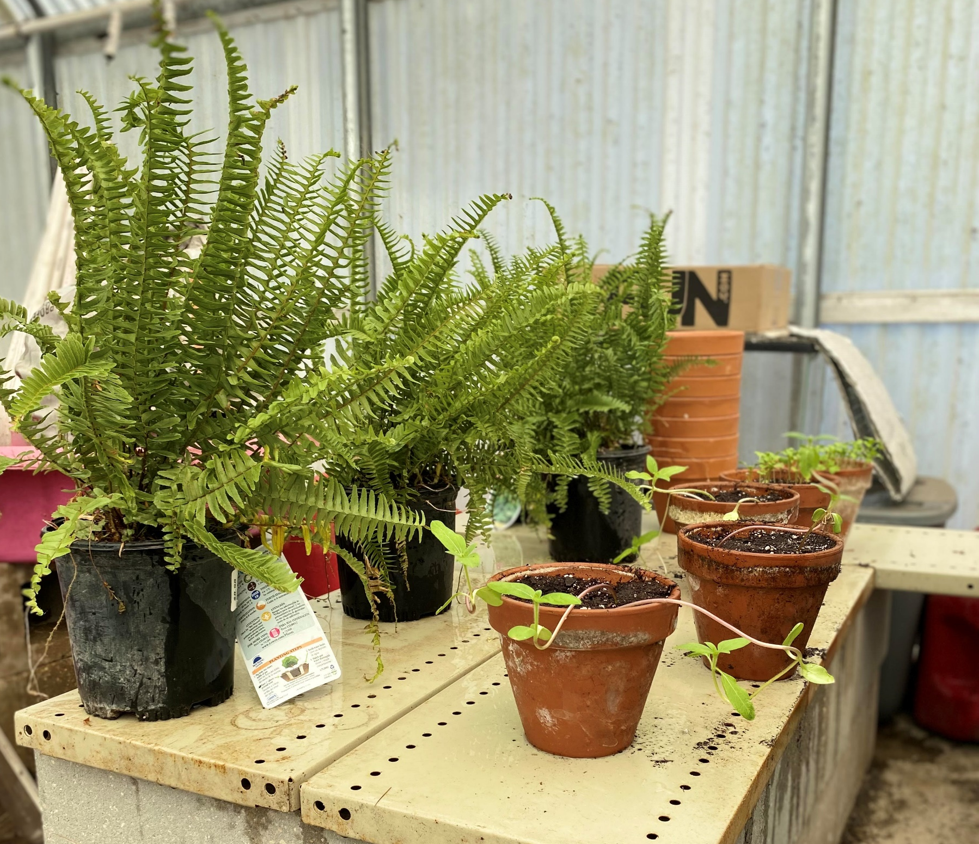
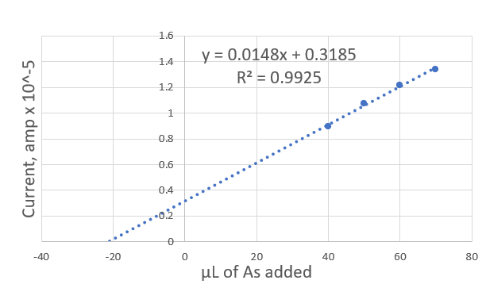
Investigating the potential of sunflower plants (Helianthus annuus) in the removal of toxic metals from soil versus ferns (Nephrolepis obliterata) and mustard green seeds (Brassica juncea).
Seth Bergeron, D.G. Wayment
Nicholls State University, Department of Chemistry and Physical Sciences, Thibodaux, LA 70301
Introduction
Methodology
Results
 | Pb | Cu | As
Detection voltage | -510mV | -105mV | 180mV
Amount detected (ASV) | 0.041 ppm | 0.209 ppm | 0.037 ppm
Atomic Absorption | 0.033 ppm | 0.201 ppm | * Cannot detect
Table 1. Amount of each metal in potting soil pre-experiment and where they are detected
Phytoremediation is the process of removing metals from soil using plants as the cleaning agent. This process is one of the best methods available in order to rid soil of heavy metals pollution. The pros of the method are what make it really stand above the rest.
Cheap ($60,000 - $100,000 a year)
Plants improve soil health outside of getting metals out
Decrease erosion
Recover and reuse metals taken out of the soil
However, there are still issues with the method
Removal only happens as far as the roots can reach
Important nutrients can be removed along with toxic metals
There is a large amount of toxic byproducts that need to be disposed of (The plants)
Only a certain number of plants can participate in phytoremediation
The efficiency of the phytoextraction can be measured by monitoring the movement of metals from the soil to the plant. Detection of the movement of metals can be accomplished using Anodic Stripping Voltammetry and checked with Atomic Absorption.
Detection Methods:
Anodic Stripping Voltammetry:
  Supporting electrolyte solution is made to be 0.001 M HgNO₃, 0.5 M KNO₃, and 0.5 M HNO₃. This supporting electrolyte solution will be used on all three metals being detected (As, Cu, and Pb).
  Standard curves are made using varying amounts of 10ppm standards for each metal
  For lead and copper, a glassy carbon electrode is used; for arsenic, a gold electrode is used
Figure 2. Explanation of Anodic Stripping Voltammetry
Experimental Design:
For each plant (sunflowers, ferns, and mustard green seeds)
  Four plants each
    Three experimental and one control
  One pot will contain all the metals and no plants as a control as well
Experiment will last for 100 days
  Samples will be taken every 10 days from the
    Soil
    Stem and leaves
Samples will be analyzed as follows
  Sample will be digested in 2mL of conc. HNO3 and 6-8mL of di H2O. After being heated, 1-2mL of 30% H2O2 will be added.
Figure 3.
Set up for cyclic voltammetry machine
white lead is the Ag/AgCl reference electrode
red lead is the plantinum auxiliary electrode
black lead is the working electrode. Can be either glassy carbon or gold
Conclusion
Anodic Stripping Voltammetry is an effective way to detect heavy metals at a low level.
The use of a gold electrode to detect Arsenic is a new method developed for this experiment.
Atomic Absorption confirmed the results from anodic stripping voltammetry.
Methods have been fully established for the ongoing phytoremediation experiment.
  All plants are in a controlled environment, and the metals will be added to the soil shortly.
Figure 4. Example of an Anodic Stripping Voltammetry graph for Arsenic
Element | Permissible value for plant, mg per kg of soil
Arsenic | 0.0002
Lead | 2.0
Copper | 10.0
Table 2. Amount of metals that can be added to the soil as to not harm the plants
Figure 7. Current set up of phytoremediation experiment.
On the left are the Kimberly ferns (Nephrolepis obliterate)
On the front right are the sunflowers (Helianthus annuus)
On the back right are the mustard green seeds (Brassica juncea)
Figure 5. File overlay for Arsenic showing the increase in current as concentration increases
Acknowledgements
Special thanks to the Nicholls State Biology Department for allowing access to the greenhouse on our campus.
Figure 1. Graphic showing how phytoremediation works
Figure 6. Calibration curve for Arsenic; made from standard addition and the file overlay for arsenic

